Slide 1
Russian Journalism as a Social Lift
Svetlana Pasti, University of Tampere
10-12 November 2011 MSU
The 3d International Media Readings

Slide 2
Two ideal types of professionalization
Anglo-American – Market as a driving force: Occupation became a high-status profession by forming itself independently from the State in the market competition for specialized services
Continental – State as a driving force: Professional posts organized, legitimized and controlled by the State
2
2
2

Slide 3
Communist ideal type
Communist Party as a driving force:
Managed professional education and training, formed professional practices
State planned economy
State formed labour market
Absence of private practice
Party total control in society
Journalism as state service

Slide 4
Prestige of journalistic profession: Soviet time
Closed to outsiders,not accessible to everyone
Journalists ─ part of political elite (messengers and propagandists of the party)
Editors-in-chief – part of Party nomenclature
Journalists ─ part of labour intelligentsia recruited from working class and competent in ordinary people’s needs
4
4
4
4
4
4
4
4
4
4
4
4
4

Slide 5
Post-Soviet transit
5
5
5
5
5
5
5
5
5
5
5
5
5
Attempt to transform the State political journalism into the Market plural journalism
with its further professionalisation on the basis of emerging political, economic and professional freedoms and open communication with the world

Slide 6
Towards liberalisation since 1992
6
6
6
6
6
6
6
6
6
6
6
6
6
6
Media became free from Communist Party and State
Censorship was forbidden by new media laws
Party/Komsomol organisations ceased to exist in the editorial offices
Journalism opened for anybody
Journalists moved up from staff work to freelancing

Slide 7
Return of State to the media market
7
7
7
7
7
7
7
Russia – effort to preserve state-owned media: state broadcasters have 75% of the audience, in the regions nearly 80% of all press
Other post-Soviet countries CIS: Armenia, Georgia, Latvia, Lithuania, Moldova, Estonia legislated to prohibit and restrict the State’s opportunities to operate mass media

Slide 8
Paradox of media market
8
8
8
8
Media market is ranked 10th in the world by economic indicators
But media market has non-market character:
Overwhelming majority of the regional and local newspapers exist owing to administrative resources – Neo-sovetisation
The main trend is decrease of the commercial capital and increase of the state capital and mixed (state and commercial) capital

Slide 9
World Audit Democracy: Russia - place 134
9
9
9
Russia occupied place between Yemen and Chad in the list of 150 countries having:
democracy rank - 136
press freedom rank - 131
corruption rank - 127
http://www.worldaudit.org/democracy.html

Slide 10
Change for the worse for last 13 years
10
10
Democracy rank: From place 106 to place 136
Not Free Media – 131 place (0-150)
Corruption rank: From place 76 to place 127

Slide 11
Questions
11
11
How do Russian journalists estimate conditions in their profession?
How are they satisfied in their profession?

Slide 12
Method
12
12
12
12
12
12
12
Two surveys: 1992 and 2008
1992 – survey in the regions
2008 – two stages: (1) All-Russian Congress of Journalists, (2) survey in the regions
Questionnaires based on Weaver’s research with additional questions relevant to Russia

Slide 13
Regions
13
13
13
13
13
13
13
1992 – ten regions representing basic national geographic and socio-economic features
2008 – thirty six cities from all six economic zones of the RF: big cities (1 million and over), mid-sized cities (200-999 thousand) and smaller cities (under 200 thousand) with two capitals Moscow and St Petersburg

Slide 14
Respondents
14
14
14
14
14
14
14
1992 – 1000 respondents
2008 – 800 respondents
Full-time working journalists in press, radio and television, the internet media (2008) providing local news, political and economic issues, culture, leisure, youth topics

Slide 15
Job conditions
15
15
15
15
Editorial autonomy
Satisfaction in job

Slide 16
Editorial autonomy
16
16
16
16
16
16
I. If you get a good idea for a publication and you consider it is important, how often are you successful in realizing it, and to make a material?
II. How independent are you in the selection of news, topics, problems of coverage?
III. How independent are you in emphasizing ideas or aspects which in your opinion are important to your material?

Slide 17
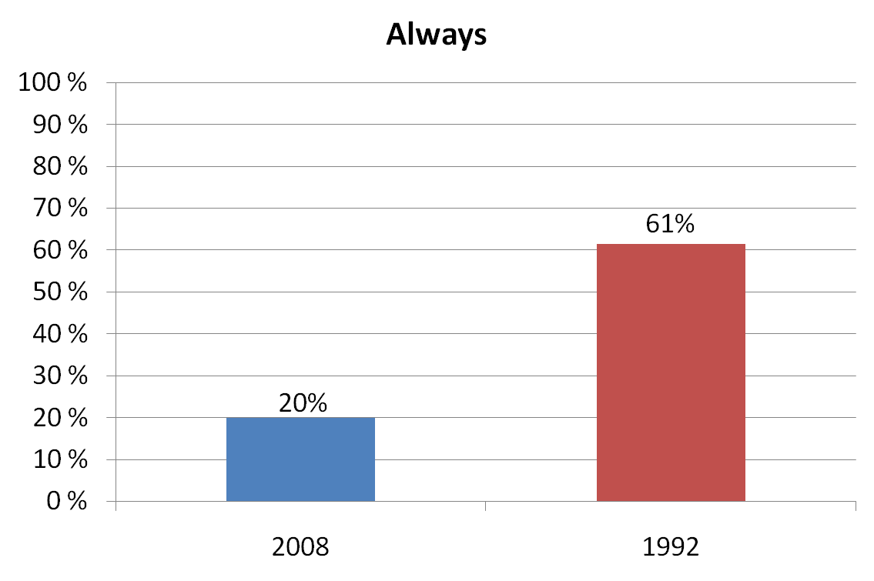
I. If you get a good idea for a publication and you consider it is important, how often are you successful in realizing it, and to make a material?
17
17
17
17
17
17
17
17

Slide 18
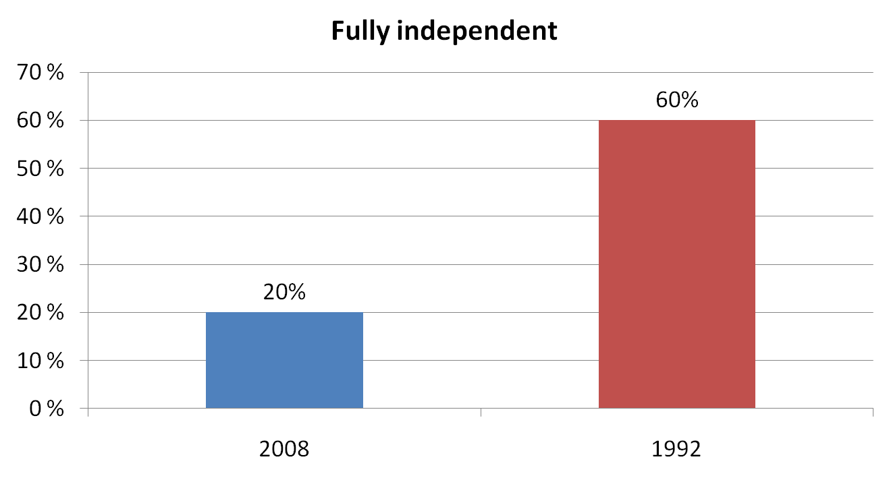
II. How independent are you in the selection of news, topics, problems of coverage?
18
18
18
18
18
18
18
18

Slide 19
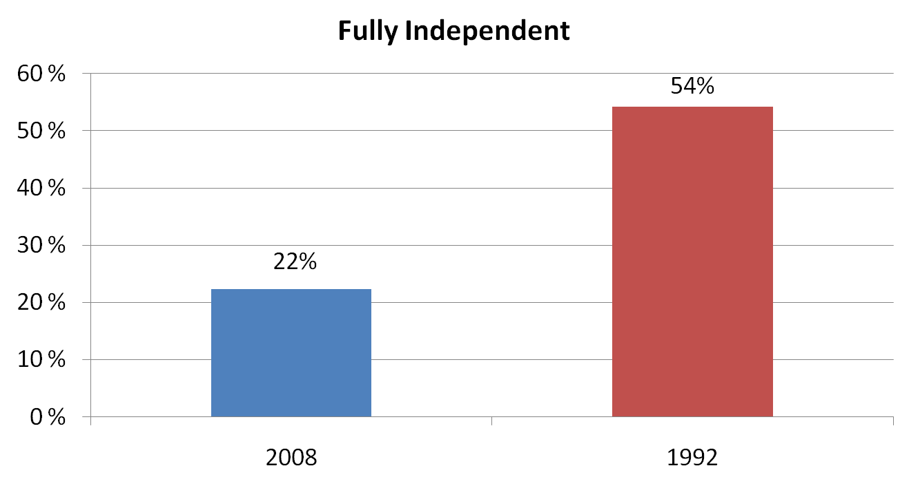
III. How independent are you in emphasizing ideas or aspects which in your opinion are important to your material?
19
19
19
19
19
19
19
19

Slide 20
Job Satisfaction
20
20
20
20
20
20
20
72% satisfied (very and chiefly) in 2008
62% satisfied (very and chiefly) in 1992

Slide 21
Facing dilemma
21
21
21
21
21
21
21
21
Democracy less
Press Freedom less
Corruption more
Happy journalists more

Slide 22
Job satisfaction in 2008
Sources of satisfaction | Fully and chiefly satisfied %
1. To independently decide how and what to write, to tell | 65
2. To help people | 64
3. Editorial policy | 60
4. Job security, social security | 52
5. Opportunities for better qualification | 51
6. To influence society | 49
7. Opportunities for second job | 48
8. Opportunities to grow in the post | 42
9. Salary | 39
10. For a career via journalism in politics, state service, business | 38
11. Political independence of the profession | 37
12. Extra privileges | 37
22
22
22
22
22
22
22
22

Slide 23
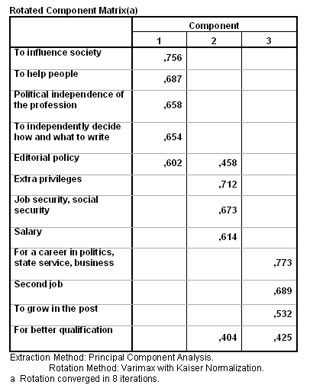

Slide 24
Factor analysis: Power
24
24
24
24
24
First factor
To influence society 0,756
To help people 0,687
Politic. independence of the profession 0,658
To independently decide how and what to write 0,654

Slide 25
Factor analysis: Wealth
25
25
25
25
25
Second factor
Extra privileges 0,712
Security that job provides 0,673
(staff employment)
Income 0,614

Slide 26
Factor analysis: Social mobility
26
26
26
26
26
Third factor
A career via journalism in politics, state service, business 0,773
Second job 0,689
Growing in the post 0,532
Bettering qualification 0,425

Slide 27
Privileged profession Journalism
27
27
27
27
Resource of Power – Political capital
(it is consolidated with information capital, which journalists possess under authority of their profession )
Resource of Wealth – Economic capital
(elitist earnings on the markets of media, advertising, and PR services including political campaigns - elections
Resource of Social mobility – Cultural capital
(in)formal or social networks, family privileges were and are the most significant resources for social mobility; the tradition of political culture where rational-legal authority is weak

Slide 28
Journalism as privileged profession
28
28
28
It accumulates three kinds of capital:
Political, Economic and Cultural
It opens access to Social mobility
Journalism operates as a Social lift

Slide 29
Social lift definition
Concept ‘Social lift’ from Pitirim Sorokin, Russian-American sociologist, his publication Social mobility (1927) ─ a complex of movements across many different social dimensions
Glass (1954) Social mobility in Britain refocused on mobility through education and occupation
New studies abroad debated the openness of American and other societies and mobility patterns associated with social democracy and liberal capitalism (Heath 1981, Payne 1987)

Slide 30
Social lifts are broken
1986-1993 – Closeness of basic social groups
Modernization boils down to re-distribution of material and social resources
Contradiction between conservation of social-professional structure and increasing property differentiation (Chernysh 1994)
Social lift in Russia works worse than in the USA and Europe (Guriev 2007)
Social lift stalled (Belyaeva 2009)

Slide 31
Russian journalism as Social lift
Openness for anybody
Temporality to be a journalist
De-unionization
Lifting to higher social class (vertical mobility)
Moving within social class (horizontal mobility)
Geographical mobility
Occupational mobility
31
31

Slide 32
Openness
Since the beginning of the 1990s journalism is open to all
Not barriers as other professions (specialized education, diploma, training, experience)
Newcomers with other education in journalism: 2008 – 48%, 1992 – 44%
32
32

Slide 33
Temporality to be a journalist: Young generation says
“Among young journalists I seldom meet individuals who in the first place want to stay in journalism and, secondly, want to be of some use and really will be interesting for readers, listeners and viewers.
Contemporary youth, such advanced young people, the Pepsi generation burst into journalism. I hope, that in ten years this profession will not be fashionable. And then in journalism there will be people who actually want to do this work, but not because that want to say ‘I am a journalist, I am such a hardboiled journalist’”
(Young journalist, St Petersburg 2005, quality weekly)
33
33

Slide 34
Leaving journalistic position
34
34
34
34
34
34

Slide 35
De-unionization
1992 – member of journalist union: 60%
2008 – member of journalist union: 42%
old (Soviet) generation: 76%
post-2000 generation: 17%
It is fraught with deepening atomization of profession, decreasing solidarity and inequality in terms of income, privileges and perspectives
35
35

Slide 36
Social background by locality
Social background | Place of resident
 | Big city | Mid-sized city | Small city
 | % | % | %
Top manager | 8 | 7 | 4
Mid manager | 25 | 18 | 17
Supervisor | 3 | 6 | 4
Journalist or editor | 4 | 4 | 1
Other professional | 27 | 29 | 11
Clerk | 9 | 9 | 10
Urban worker | 12 | 18 | 28
Rural worker | 4 | 5 | 21
Other | 6 | 4 | 4
 | 100,0 | 100,0 | 100,0
36
36
36
36
36
36

Slide 37
Social background by generation
 | Generation
 | In 1991 or earlier | 1992-1999 | 2000 or later
 | % | % | %
Top manager | 7 | 6 | 8
Mid manager | 22 | 20 | 20
Supervisor | 6 | 6 | 3
Journalist or editor | 3 | 4 | 4
Other professional | 18 | 25 | 33
Clerk | 1 | 9 | 8
Urban worker | 20 | 20 | 12
Rural worker | 10 | 5 | 5
Other | 4 | 5 | 7
 | 100,0 | 100,0 | 100,0
37
37
37
37

Slide 38
Elitization of journalism by locality and generation
38
38
38
38
38
38
38
38
38
Large city and mid-sized city – journalism becomes bourgeois – majority comes from middle class and elite families
Smaller city – journalism more democratic – a half comes from working class and clerks families
Post-2000 generation –decreasing working class offspring: 17%: 30% (Y:Sov.) and increasing from middle class: 33%: 18% (Y:S)

Slide 39
Lifting to higher social class
From working class in the middle class ─ mostly in small cities
From middle class occupations to elite positions in journalism ─
appointment of ‘own people”, (non) journalists to the posts of chief editors by a new government became a regular matter after the elections – Political appointments – Neo-sovetisation
From the media to parliaments (politicians)
From journalistic status to establishing his/her own media or holding (entrepreneurs)
39
39

Slide 40
Mobility: geographic, media organization, occupational
From small cities to big cities
From small media organizations to the leading mainstream media
From journalism to other occupations, the state service, business, politics
40

Slide 41
Conclusion
41
41
41
41
41
41
41
41
41
41
41
Since 2000 presence of the State increased in the media market
Number of satisfied journalists in 2008 is more (72%) than it was in 1992 (62%)
Yet Russian media are rated as not free (World Audit Democracy 2010)
Freedom of speech is not a great value in society
But order is a great value: 72% of Russians agree for some infringements of democratic principles and restrictions of personal freedoms for support of order (Levada Centre 2010)

Slide 42
Conclusion
Journalism provides access to three important resources: power, wealth and social networks
This combination of resources makes journalism an attractive profession and privileged in comparison with other professions
Journalism operates as a Social lift – vertical mobility, horizontal mobility; open for all

Slide 43
Thank for your attention!
Svetlana.pasti@uta.fi

