Slide 1
Quality Press in Russia:
Between Image resource and Professional passion
Gorod Peterburgskyi zhurnal
Svetlana Pasti, University of Tampere
September 30, 2010 MSU, Moscow

Slide 2
Why to address to Quality press?
Disproportion in the development:
Rise of commercial, popular press and decrease of quality press
Symptoms of its stagnation:
unprofitability of publications
bankruptcy
absence of new successful projects on the national level
2

Slide 3

Russkaya Zhizn, 2007-2009

Slide 4
Bitter experience from Russkaya Zhizn (Russian Life), 2007-2009
Dmitry Oljshansky, the editor-in-chief:
Neither standards of quality of production, nor skilful marketing could ensure good sales and cover the outlay of the production
It remained invisible in the press market in spite of the well thought-out and arranged system of sales
Not to survive if: no a part of a large publishing house, no the famous brand and no “format” of a popular media.
4

Slide 5
Crisis’s impact, 2009
Come-down of bulk of advertising up to 40-42 percent in the print media, first half 2009 (Polit.ru 23.07.2009)
200 magazines closed (Alexander Osjkin, the Chief of the PDA, 2009)
The most suffered: glossy, business and socio-political publications
Entertaining press suffered the least of all, its circulations practically remained on the same level that was before the crisis (Purgin 2010)
5

Slide 6
Non-market conditions
The very big segment of regional press consist of non-market publications
which either are very closely affiliated with definite financial-industrial groups and partially serve as a cloak of its business,
or they belong the state being financed directly from regional and local budgets
(Jury Purgin, interview 8.9. 2010)
6

Slide 7
St Petersburg:
Non-market conditions
6 000 print media registered but one sixth or 900 publications really issued
But only 150 covered its expenses working as business units
750 existed owing to subsidies from state, corporations and solvent clients
(Massmedia 2009, 269-272)
7

Slide 8
Current characteristics:
St Petersburg’s press market
High quantitative parameters in the press market
But the growth of number of publications is not accompanied with the growth of circulations and sales.
The biggest media market has no any publication reaching high circulation that “all inhabitants read”. The majority of publications have very insignificant audiences by principle of “a crazy quilt”
(Massmedia 2009, 271)
8

Slide 9
Press Market structure: St Petersburg
900 print media really issue:
Among them: 550 magazines and 332 newspapers
51.3 % - specializing press: trade, corporate, by interests, scientific, business-oriented, gendered, educational and others
32 % - advertising-informational publications
1.2 % - socio-political analytical press
(Massmedia 2009, 281)
9

Slide 10
Quality Press
McQuail’s Mass Communication Theory (McQuail 2010, 30):
Quality press had its origins in “the prestige press” - of the late-nineteenth-century bourgeois newspaper “that contributed much to our modern understanding of what a newspaper is or should be”.
Its fundamental principles were followings:

Slide 11
Quality Press
…was independent from the state and from vested interests
was recognized as a major institution of political and social life (especially as a self-appointed former of opinion and voice of the ‘national interest’)
it tended to show a highly developed sense of social and ethical responsibility (in practice fundamentally conformist)
it fostered the rise of a journalistic profession dedicated to the objective reporting of events. …
…what is ‘quality’ newspaper still reflect the professional ideals of the prestige press and provide the basis for criticism of newspapers which deviate from the ideal by being either too partisan or too ‘sensational’, or just too ‘commercial’ (McQuail 2010,30)
11

Slide 12
Quality Press:
Post-communist countries
“democratic spirit and political rationality, in-depth debate, analyticity and high journalistic culture” (Spassov 2004, 9)
a key factor in qualitative change of the public sphere in the context of the new political reality after the collapse of communism and their integration in the European Union
12

Slide 13
Quality Press:
Russia
Researchers: old normative approach
“Solid newspapers and magazines destined for educated readers and be related to the most serious and influential print media as distinct from tabloids aimed at mass audience” (Zemlyanova 1999, 78)
13

Slide 14
Quality Press:
Russia
Professionals: Emphasis on the national traditions:
‘The quality of writing’ - ability to use the thinnest nuances of Russian language, to play by intonations and to perfect the brilliant skill of a hint
(Gutiontov et. al 2008)
Aesopian language – legacy and cultural capital from the national history of Russian journalism, its persisting intellectual resistance against total state censure during the Tsar’s rule and later the Soviet rule
14

Slide 15
Quality Press:
Russia: two keys
I Resisting spirit and opposing stand to the government. It rather as critical press and less than the press reflecting the authorities’ views (mainstream media as elite oriented media)
II Best articles remind the standards of ‘big’ literature. Journalism as “srochnaya slovesnostj” (urgent literature) (Vladimir Dalj)
15

Slide 16
No universal definition of quality press
Pluralistic perceptions what is the quality press reflect the particular time and place with inherent there political, societal, cultural and historical contexts.
It leads to no single and universal definition of the conception of the quality press
16

Slide 17
Postmodernist trend
Old normative distinction between quality press as serious, prestige, elite and popular press as no serious and mass does not work more.
Journalism tolerates to the erosion of borders between the serious and the popular.
Quality press seeks popularity to get more the audience, the popular press strives to establish some reliability among its readers.
Both the Serious and the Popular benefit from each other
17

Slide 18
Two basic approaches in research
First - from the USA - empirical mass communication research:
Pragmatic oriented to the press industry
Explores link between quality and circulation, quality and profit, quality and audience size
Quantifiable data and content analysis
(Bogart 1989)
18

Slide 19
Two basic approaches in research
Second - from the Europe - debating press standards
It has the interest in relationship between ‘high’ and ‘low’, or elitist and popular culture,
problematizes questions of taste, cultural value and judgement, cultural stratification and cultural diversity.
Critical Theory and Cultural Studies
19

Slide 20
Magazine research
20
20
Is not enough, neglected (McQuail 2010, 31; Holmes 2007, 510; Korinek 2000, 12):
Perhaps, magazines are less easy to study than newspapers because of their great number and diversity
Perhaps, because of underestimated importance of magazines in comparison with other media
Wide range of perspectives: History, feminism, fan culture, visual culture, practitioner culture, political economy … (Holmes 2007, 512)

Slide 21
Why Gorod is to study?
A single Regional weekly setting social-political agenda in five million’s city (experts)
The single in St Petersburg analytical serious magazine reporting about all sides of life of society with humor and some sarcasm. (http://www.karta-smi.ru/6812)
21

Slide 22
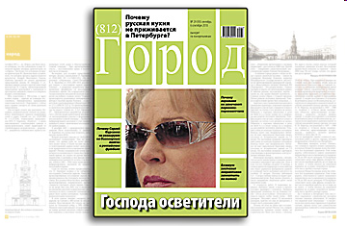
Gorod

Slide 23
A Case of Gorod (City):
Questions
How does the magazine Gorod succeed in surviving, when other quality publications failed to keep in the market?
Who today is interested in development of the quality publications in Russia?
What should be taken from the successful life-story of Gorod for the benefit of Russian quality press?
23

Slide 24
Method: Case study
Research task is to scrutinize and describe life story of Gorod and its strategy of survival in the commercializing environment, when other quality publications disappear
Analysis focuses on the crisis’s events – closures and indirectly compares resisting reaction of Gorod with the other quality publication which found itself in the same situation of closure
Focused in-depth interviews with the editor-in–chief of Gorod and local experts (4)
Open sources as the city press, online publications and the magazine’s materials
24

Slide 25
The birth: 2002
2002 - appeared as an image project for one potential candidate in the governor’s election
2002 – got a new publisher with the strong professional ambition to make a good magazine
25

Slide 26
Conception
“… all the main news of Petersburg for a week and analysis of the basic trends in politics, culture, economy, sport, high life and children’s life….
There will be what you (reader) wants… let’s write, call, propose.
It seems to us that Petersburg has not enough of such a quite conceptually traditional weekly magazine” (Gorod, 22.04. 2002)

Slide 27
Basic characteristics: Quality
Weekly format with 45 pages, every Monday
The main news for a week with comments
Analytical articles, monitoring data, interviews in sections: politics, economy, society, culture, sport, fashion, program for a weekend, city’s rating of television channels and programs, weather
Deep investigation of problems of the city
Independence, plurality, irony, underlying message, allegories, game with hints
Authors – magazine journalists, writers, experts
Good literary language
Art paper, Colorful photos and illustrations on each page
Printed in Finland

Slide 28
Audience
At the start in retail, then subscription and free delivery: numerous city’s cafes and restaurants, business centres, hotels, car showrooms, airports, in the business class coaches on Petersburg-Moscow trains and the cultural centres: the city philharmonic and the gallery of the interior
Audience: active citizens representing middle class
28

Slide 29
Recognition
2002 – 7.000 copies
2004 – 12.000
2007 – 31.000 (Gortis 2008)
2008 – 15.000
2009 – 10.000
2004 – recognition as the best media in 2003 by reader’s opinion and city journalists’ opinion (Gorod 22.03.2004)

Slide 30
The Arrest: 2004
2004 - arrested print run of issue for 22 March
At the sales-points people were told that the issue did not appear because of editorial problems. People call to the editorial office
Magazine Journalists investigate the situation and reveal:
Arrest owing to the photo of the director general of the main television company St. Petersburg, the Fifth Channel.
The photo is on the break of the pages – scandal
She initiated the withdrawal of print run via her friend, the head of the department of the mass media of the city’s government.
Using ‘the telephone right’ the official recommended the distributer to withdraw the whole print run in the city

Slide 31
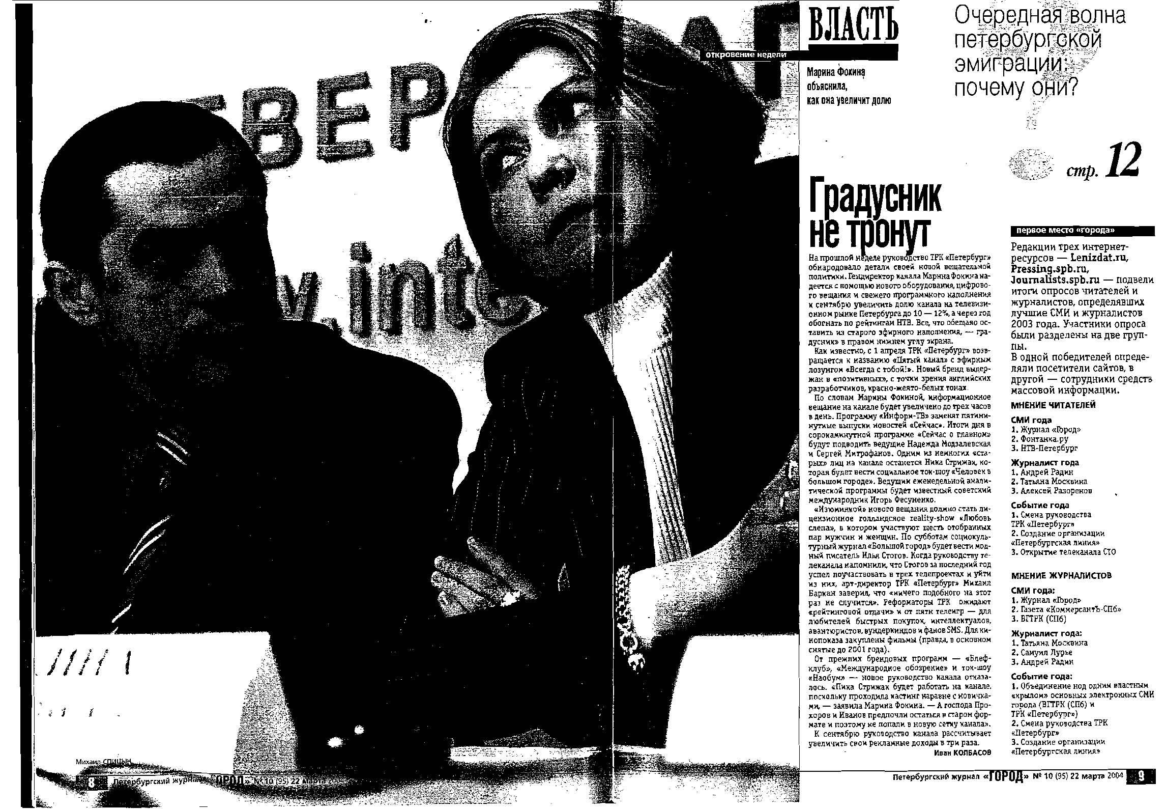
Personal Factor
31

Slide 32
Who did help to Gorod?
I. Readers calling to the magazine and other media: newspapers with a question about the fate of the magazine
II City’s journalists launching loud campaign in defense of Gorod in their newspapers
III Editorial staff of the magazine Gorod

Slide 33
Closure: 2008
2008, May: Publisher now living in Moscow had announced the closure for economic reasons:
2002-2008: investments about 5 million dollars,
annual budget from 1/2 to 1 million dollars
Gorod covered only 50% of its outlay
But…

Slide 34
Political-Economy Factor
Closure could be owing to
redistribution of financial flows in Moscow.
They were re-directed to the media projects of the federal centre
since a shift of the national leaders had occurred
Kommersant 22.5.2008

Slide 35
Who did help to Gorod?
Public resonance in media: press and televison started by city’ s journalists
With wide support from readers, authors of the magazine and public figures:
Live television program on the Fifth channel:
Gorod bez Goroda (The city without Gorod (City): What press does the city need?
Editor-in chief motivated to find new sponsors

Slide 36
Born again to be Gorod 812
August 2008 – renamed from Gorod Peterburgsky zhurnal into Gorod 812
New publisher – the city’s media holding AZHUR – Agency of Journalistic Investigations
Magazine is published in print and has its online version not repeating print version
http://www.online812.ru
Continuity of editorial policy with the old Gorod maintained

Slide 37
Economic support
2002-2008 – private sponsor from Moscow
2008-2010 – within media holding Azhur, profitable Fontanka.ru covers expenses of Gorod

Slide 38
Discussion: Trends in development of quality press
First: for prestige
Quality press is Image project
for the reputation of its sponsors - political class and big business
A wish to have a good image is precondition for increasing of institute of reputation
It also publishes big image advertising, big brands of car concerns, construction concerns, multinational cartels
38

Slide 39
Trends in development of quality press
Second: for moral satisfaction
Quality publication as an Outlet for sponsor’s impulse to do good for people,
to support independent critical opinion as distinct from his personal compromises in basic (political) business
39

Slide 40
Trends in development of quality press
Third: Exclusive
It lives by no market laws but owing to sponsors (private, corporate, state)
It is non-commercial product, rather exclusive not having a mass audience and mass sales, not attractive to big advertising agencies
40

Slide 41
Trends in development of quality press
Fourth: Enthusiasts
It survives owing to individuals – true professionals for whom to make a quality magazine or newspaper became the breath of life, the main purpose of their life
41

Slide 42
Major Challenge is Not a lack of Political freedom or Financing
It finds space for political freedom within the frictions of elites
Freedom of speech and expression, critics exist - it is unnoticeable media with small audience: “There is nobody to hear this”
Gold rule- not touch family and close kinship of powerful persons criticized by the magazine
A risk of economic bankruptcy solved –
to find sponsors interested in social prestige
42

Slide 43
Major challenge is Reader:
300.000 for serious press in 5 million city
Reader is vanishing for different reasons:
Political indifference
Dying a habit regularly reading the serious press
A lack of trust in the political news
High price of these publications
‘Internetisation’ of the audience of the mega polis
Gradual substitution of the quality press with the free press increasingly adopting its characteristics

Slide 44
Prospects for quality press: No Political-Economy but
Human
Human is imperative!
It will not survive without enthusiasts devoted to serving quality journalism
It is not survive if editorial team is collapsing (Delo)
Factor of fatigue can be decisive to stop to fight (Delo)
Demand for reputation as a social institution is growing in Russia: Gorod was twice saved owing to its reputation
Business wants to have independent prestige publication in its assets. It learns to respect the independence of the press. It sponsors the quality press for the sake of its social prestige.
Business wishes to get the quality product - reliable information and independent commentary, is ready to pay for it and to sponsor quality press
44

Slide 45
Thrill seekers making quality press and sponsoring it
Кураж в России. Жить интересно. Играют по крупному, много непредсказуемо. Не скучно. Все время что-то происходит. Нет никаких гарантий. Все зависит от человека. Он сам выбирает свободу или несвободу
Boldness is in Russia. To live here is interesting. Much is unpredictable, they are playing for high stakes. All time something happens, no any guarantees. Everything depends on human: (s)he chooses freedom or non-freedom

Slide 46
Comparing Gorod with Delo
Delo as liberal-oriented newspaper provided keen criticism of Smolnyi. Gorod was more smooth publication
In Russia journalists are free, but publisher is no free
To survive you (the editor-in-chief) should run and seek money, sponsors; to call to his friends and acquaintances senators, business people. It is important to be able to find sponsors and to agree
Editorial team is important

Slide 47
Thanks for your attention!

