Slide 1
The Russian Media System in the Context of BRICS
BASEES Conference 2012
Kaarle Nordenstreng and Svetlana Pasti

Slide 2
What is BRIC?
BRIC as an acronym for four countries: Brazil, Russia, India and China
Countries of big populations and growing economies
By 2050 they would have constitute the largest and most influential economies in the world
Economic strength will lead to political influence, with BRIC shaking the geopolitical balance of the international system

Slide 3
From BRIC into BRICS
2010: Inclusion of South Africa into the BRIC group: five countries in BRICS, covering
30 percent of the world’s landmass
42 percent of the world’s population
2012 Indonesia began efforts to join BRICS: the world’s fourth largest population would expand BRICS to the Islamic World – BRIICS

Slide 4
Summit meetings
June 2009 Ekaterinburg, Russia
April 2010 Brasilia, Brazil
April 2011 Sanya, China
March 2012 New Delhi, India

Slide 5
New project Media Systems in Flux: The Challenge of the BRICS countries
Proposal submitted to Academy of Finland
Theoretical concepts of
- media system
- role of media and journalists in democracies
- freedom and independence of media
Empirical mapping of
- citizen participation in and through media
- professional orientation of journalists
- education of journalists

Slide 6
Earlier research on Russia
Russian Media Challenge
(Nordenstreng, Vartanova & Zassoursky 2001-2002)
Russian journalist in the context of change
(Pasti 2004)
Witnessing Change in Contemporary Russia
(Nordenstreng & Pietiläinen, in Huttunen & Ylikangas 2010)
Russian Mass Media and Changing Values
(Rosenholm, Nordenstreng & Trubina 2010)

Slide 7
Russia in BRICS: Initiator
President Putin’s proposal for practical collaboration
September 2006: a series of high-level meetings of BRIC countries in New York City
May 2008: a full-scale diplomatic meeting in Yekaterinburg
2010 President Medvedev: “Russia would like the cooperation between the BRIC countries to become a major factor of multilateral diplomacy and to make a substantial contribution to promoting the nascent multipolarity and development of collective leadership by the world’s leading countries.”

Slide 8
Russia: Most equal within BRICS
Inequality in Russia is growing more slowly than any of the BRIC countries
Incomes are more evenly distributed than in the United States (Business New Europe 2010)
Sweden is the most equitable nation on earth with a gini coefficient of 23 and Namibia is the least with 70
Russia’s gini coefficient from 39.9 in 2001 to 42.3 in 2008 – lower than the USA and lower than any of the other BRIC countries

Slide 9
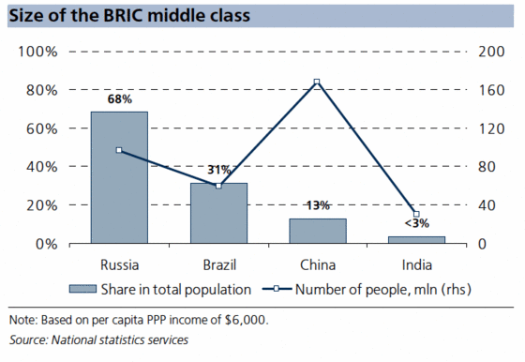
BRIC middle class

Slide 10
Russia’s media system: Paradoxes
First paradox: Media market
On the one hand, this is ranked 10th in the world by economic indicators (Pankin 2010)
On the other hand, nearly 80% of the press consists of non-market publications affiliated closely with financial-industrial groups and partially serve as a cloak for business, or state-owned organizations with financing from regional and local budgets

Slide 11
Russia’s media system: Paradoxes
Second paradox: Marriage of liberalism and authoritarianism
On the one hand, the same logic of commercialization, concentration, convergence as in the West - to homogenization of media systems and the triumph of the liberal model
On the other hand, the authoritarian approach of the government: “instrumentalization of media” (Zassoursky 2004) and “market authoritarianism” (Shevtsova 2005)

Slide 12
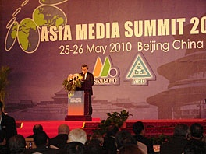
Russia’s media system: Paradoxes
Third paradox: Profession itself
On the one hand, journalism is a dangerous job: “Over 300 killed, majority in home cities”
(Pavel Gutiontov, Russian Union of Journalists in 2000)

Slide 13
Russia’s media system: Paradoxes
On the other hand, journalism is a very fashionable occupation: the growth of journalism schools, number of applicants, many from wealthy families
Journalism shines as PR and show business, where big money moves and personal career advancement is achieved, especially in large cities

Slide 14
Russia’s media system: Paradoxes
Fourth paradox: Democracy vs. job
On the one hand, the deterioration in the quality of democracy with a decline of media freedom
On the other hand, the satisfaction of the majority of journalists with their jobs

Slide 15
World Audit Democracy: Russia http://www.worldaudit.org/countries/russia.htm
Out of 150 countries Russia occupied place 134 – between Yemen and Chad
Democracy rank in last 13 years from place 106 to 136
Press freedom rank 130
Corruption rank 127 – twice worse than China’s (61) and what Russia had 10 years back (76)
15

Slide 16
Editorial autonomy 1992-2008

Slide 17
Satisfaction increased
Number of independent reporters decreased from two thirds in 1992 to one fifth in 2008
Main constraints in the work in 2008 were the local authorities and the editorial bosses
Who were satisfied with their jobs increased in 2008 (72%) in comparison to 1992 (62%)

Slide 18
Two main trends of Russian media system
Etatization
Gives obvious guarantees against market uncertainty
At the same time it does not impede
Commercialization
Journalism finds itself being with the state and market
Typical journalist is a happy journalist with two identities: loyal staff employee and market freelancer

Slide 19
China as point of comparison (Sparks 2010)
Russia and China - the fourth media model authoritarian corporatist
China’s specifics: no change in the political structure
Communist Party recruits the young and talented, still ideologically hegemonic
China provides a refutation of repeated assertion that the middle class is the natural bearer of democracy
19
19

Slide 20
China’s specific (Sparks 2010)
State broadcasters and market oriented
High importance of connections, personal power networks and family privileges
Non-transparency of media ownership
Political control with strong market orientation
Corruption in the media and political intervention of the party committees
20
20

Slide 21
Russia with similar specifics
State (in)directly control Russian media
Unclear who really owns media, non-transparency of media market as in Russian economy at large
Journalists do not look fighters for democracy
Corruption is taken as a private matter
Family privileges and personal networks
21

Slide 22
Russia and China
Political control over media
Market-driving orientation of media and journalists
Conformism by default among professionals

Slide 23
Protest growing in both countries
Communist Party rule is challenged by widespread discontent amongst workers and peasants, often spilling over into savage anti-authority riots
In China 450 riots in year have been suppressed
In Russia social networks (Facebook, vkontakte) had played the important role in rise of protest movements on winter 2011-2012
They forced to change agenda of internet media (Morev 2012)

Slide 24
Thanks for your attention!
Kaarle.Nordenstreng@uta.fi
http://www.uta.fi/cmt/en/contact/staff/kaarlenordenstreng/index.html
Svetlana.Pasti@uta.fi
http://www.uta.fi/cmt/en/contact/staff/svetlanapasti/index.html

