Slide 1
Journalism in post-Soviet Russia: From political enthusiasm to private interest
Svetlana Pasti, University of Tampere
July11, 2010 Eichstaett, Germany

Slide 2
Questions
2
2
How has Russian journalism changed in post-Soviet decades in
professional structure?
job conditions?
professional orientations?

Slide 3
Method
Two surveys: 1992 and 2008
1992 – survey in the regions
2008 – two stages: (1) Congress of Journalists in Sochi, (2) the regions
Questionnaires based on Weaver’s research with additional questions relevant to Russia
Mixed technique of interviews
3

Slide 4
Conditions
Primary data lacking on the number of media and journalists
1992 – there were not hard data on media and working journalists (Zassoursky 1998)
2008 – over 100,000 media outlets registered (Roskomnadzor 2008), but only a half of newspapers and magazines registered was really published (Russian Press Market 2009)
4

Slide 5
Regions
1992 – ten regions representing the basic national geographic and socio-economic features
2008 – thirty six cities from all six economic zones of the RF including big cities (1 million and over), middle sized cities (200-999 thousand) and smaller cities (under 200 thousand) with two capitals Moscow and St Petersburg
5

Slide 6
Respondents
1992 – 1000 respondents
Full-time working journalists in press, radio and television providing information on general topics.
2008 – 800 respondents
Full-time working journalists in press, radio and television, the internet media providing local news, political and economic issues, culture, leisure, youth topics
6

Slide 7
Historical context
1992 – Atmosphere of liberalism. Political enthusiasm in the profession and society after Gorbachev’s perestroika and glasnost, the collapse of communism and accessibility of the West. Euphoria from freedoms. Great expectations for happiness
2008 – Atmosphere of etatism. Business enthusiasm, when the temptation of big money in the media market was not yet darkened by the global crisis. Political apathy, private interest. Media contracted by the state and business

Slide 8
Respondents: Age
1992 – 32%: under 35
2008 – 31%: under 30
25%: under 40
8

Slide 9
Two generations in 1992
Old (Soviet) generation came into Soviet media
New generation came after 1991

Slide 10
Three generations in 2008
10
10
The Old (Soviet) generation (until 1992): 34% (267 journalists)
Transitional generation (1992-1999): 31%
(249 journalists)
The New (Post-2000) generation: 34%
(270 journalists)

Slide 11
Gender
1992 – Male: 63%
Female: 37%
2008 – Male: 40%
Females: 60%
11

Slide 12
Figure 1 Representation of men and women in generations of journalists in 2008
12
12

Slide 13
Figure 2. Proportion of men and women in different media in 2008
13
13

Slide 14
Gender distributions in fields of coverage in 2008 Figure 3
14
14

Slide 15
Education
In 1992 – highly educated 86%, among them 56% with journalism education
In 2008 – highly educated 86%, among them
44% with journalism education and 48% with
other education

Slide 16
Salary in 1992
No clear data
Significant part of the respondents could not answer to this question, because of inflation and changing payments, which, in turn were depending on subsidies from the state, circulations, bulk of advertising, support of sponsors and founders and the media own commercial services (Zassoursky 1998)
16

Slide 17
Salary level by employment in a second job in 2008
17
17

Slide 18
Membership
In 1992 – member of journalistic unions: 60%
In 2008 – member of journalistic unions: 42%, among them the old generation: 76%
and the new post-2000 generation: 17%

Slide 19
Motivation
In 1992 – three strongest reasons to go to journalism: an interesting work, freedom and independence of the media, and the political line of the media
In 2008 – a way of self-expression and self-realization, individual creativeness and wide communication including travelling

Slide 20
Job conditions
Professional autonomy in newsroom
Restrictions in job
Satisfaction in job

Slide 21
Job conditions
Professional autonomy in newsroom:
I. If you get a good idea for a publication and you consider it is important, how often are you successful in realizing it, and to make a material?
II. How independent are you in the selection of news, topics, problems of coverage?
III. How independent are you in emphasizing ideas or aspects which in your opinion are important to your material?

Slide 22
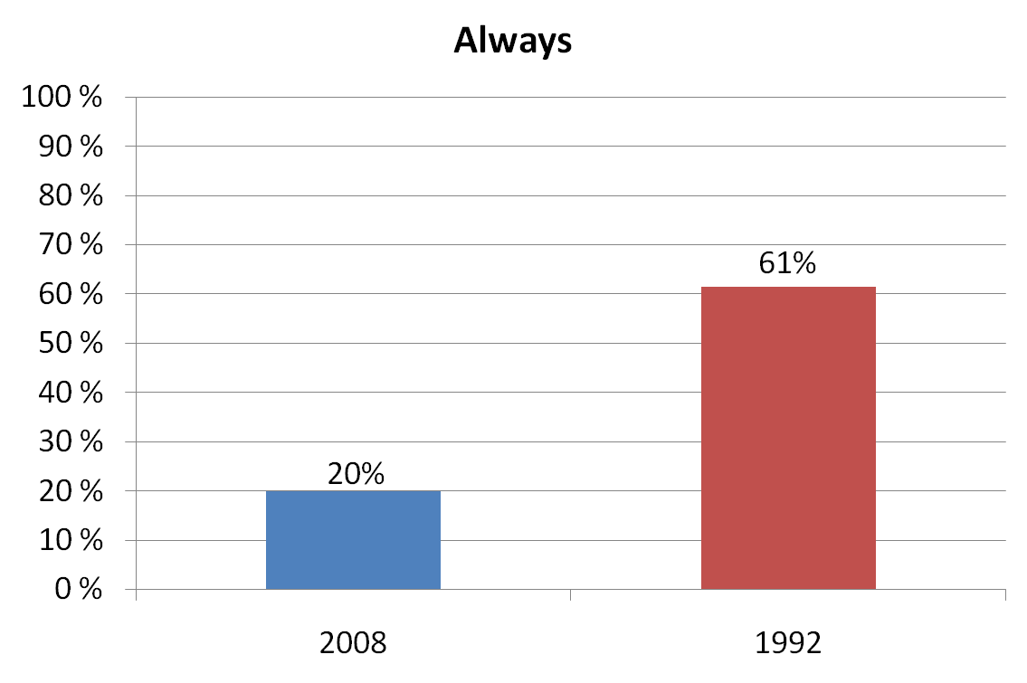
I. If you get a good idea for a publication and you consider it is important, how often are you successful in realizing it, and to make a material?
22
22

Slide 23
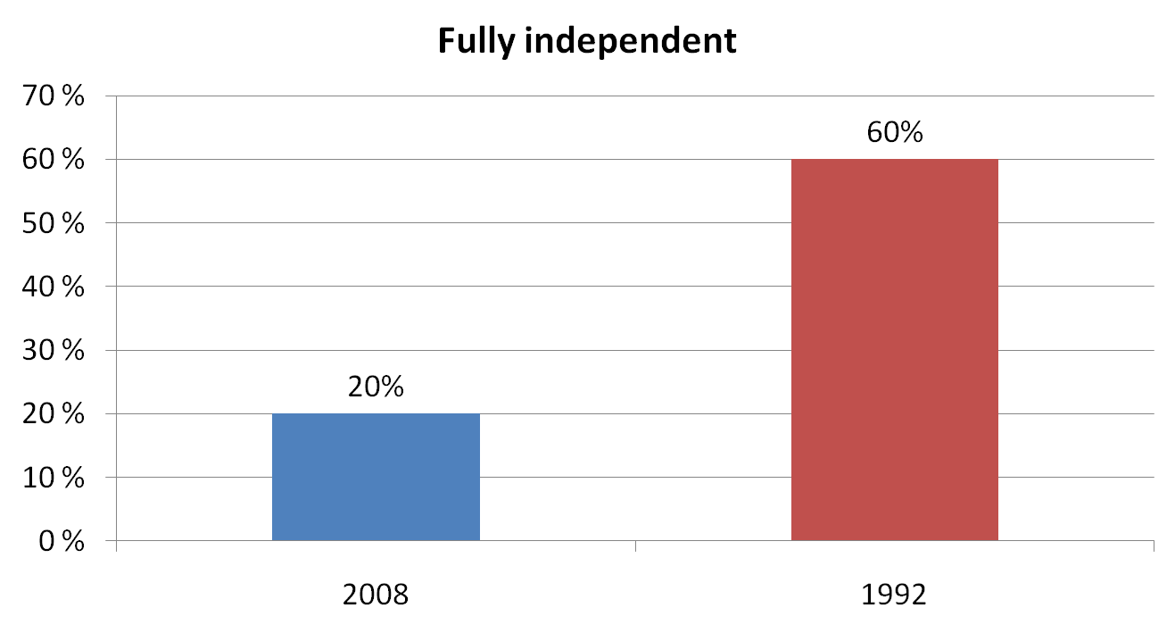
II. How independent are you in the selection of news, topics, problems of coverage?
23
23

Slide 24
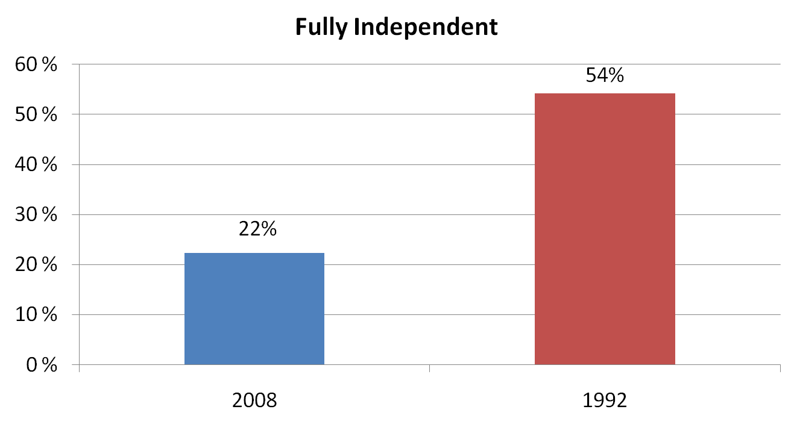
III. How independent are you in emphasizing ideas or aspects which in your opinion are important to your material?
24
24

Slide 25
How much are you independent in the selection of news, topics, problems of coverage?
25

Slide 26
How independent are you in emphasize those ideas or aspects which in your opinion are important to your material?

Slide 27
Table 1 Restrictions in the job by generation factor in 2008
Restrictions: Cumulative % | Soviet generation | Transitional generation | New post-2000 generation
1. local power: 29.4 | 40.9 | 25.0 | 22.3
2.Interference of the boss: 23.0 | 23.9 | 21.7 | 23
3. Character of media audience: 19.4 | 20.1 | 19.3 | 18.9
4. Specialisation of the media: 16.5 | 10.8 | 17.2 | 21.5
5. Ethics: 14.6 | 18.1 | 17.6 | 8.7
6. Point of view of advertisers: 14.5 | 8.5 | 18.0 | 16.6
7.Political line of media: 13.7 | 16.2 | 11.1 | 14.0
8. Media owner: 9.9 | 8.5 | 11.5 | 9.8
9. Influence of the federal power: 7.1 | 10.4 | 8.2 | 2.6
10. Nothing: 5.5 | 4.6 | 3.3 | 8.3
11.Other: 3.9 | 4.6 | 5.7 | 1.5
12. Colleagues’ opinions: 3.4 | 2.7 | 2.9 | 4.2
27

Slide 28
Table 2 Barometer of Job satisfaction in 2008
Reasons for satisfaction | Fully and chiefly satisfied in %
1. to independently decide how and what to write, to tell | 64.7
2. to help people | 64.2
3. Political line | 60.1
4. Job security, social security | 51.6
5. Opportunities for better qualification | 51.1
6. to influence society | 48.9
7. Opportunities for second job | 48.4
8. Opportunities to grow in the post | 42.1
9. Salary | 38.8
10. for a career via journalism in politics, state service, business | 37.7
11. Political independence of the profession | 37.1
12. Extra privileges | 36.7
28

Slide 29
Table 3 Job satisfaction by Generation in 2008
Reasons for satisfaction (fully and chiefly) % | Soviet until 1992 | Transitional 1992-1999 | post-2000
1. to independently decide how and what to write, to tell | 70.7 | 62.7 | 61.2
2. to help people | 65.3 | 63.5 | 64.9
3. Political line | 60.9 | 61.4 | 58.3
4. Opportunities for better qualification | 50.2 | 48.7 | 55.1
5. to influence society | 46.5 | 46.9 | 53.8
6. Opportunities for second job | 44.8 | 48.0 | 52.8
7. Job security, social security | 43.4 | 52.1 | 59.7
8. Opportunities to grow in the post | 39.8 | 40.9 | 45.5
9. Salary | 42.7 | 40.0 | 34.4
10. for a career via journalism in politics, state service, business | 38.6 | 35.8 | 39.0
11. Political independence of the profession | 34.0 | 32.4 | 44.9
12. Extra privileges | 30.5 | 35.9 | 43.9
29

Slide 30
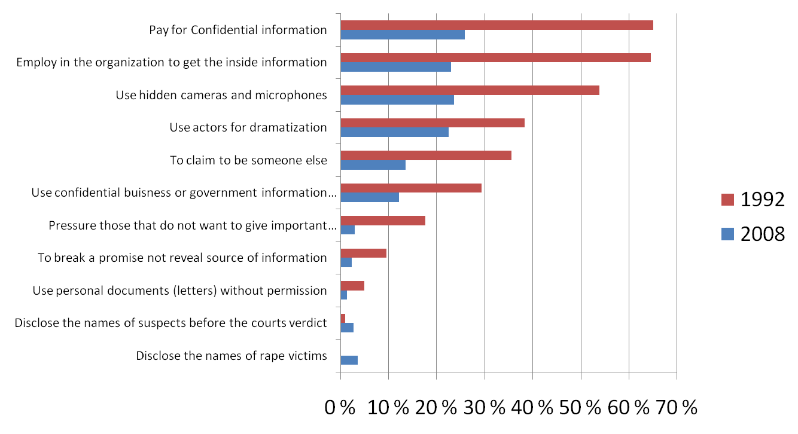
Working methods approved
30
30

Slide 31
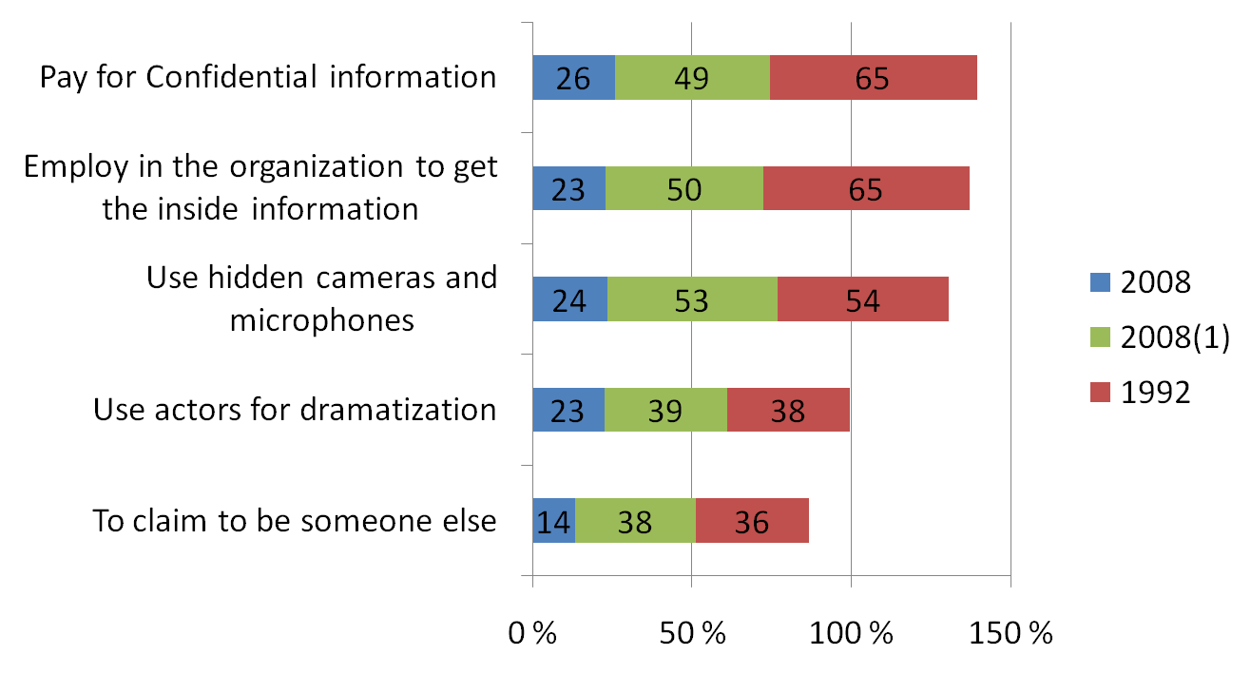
Working methods approved
1) According to situation
31
31

Slide 32
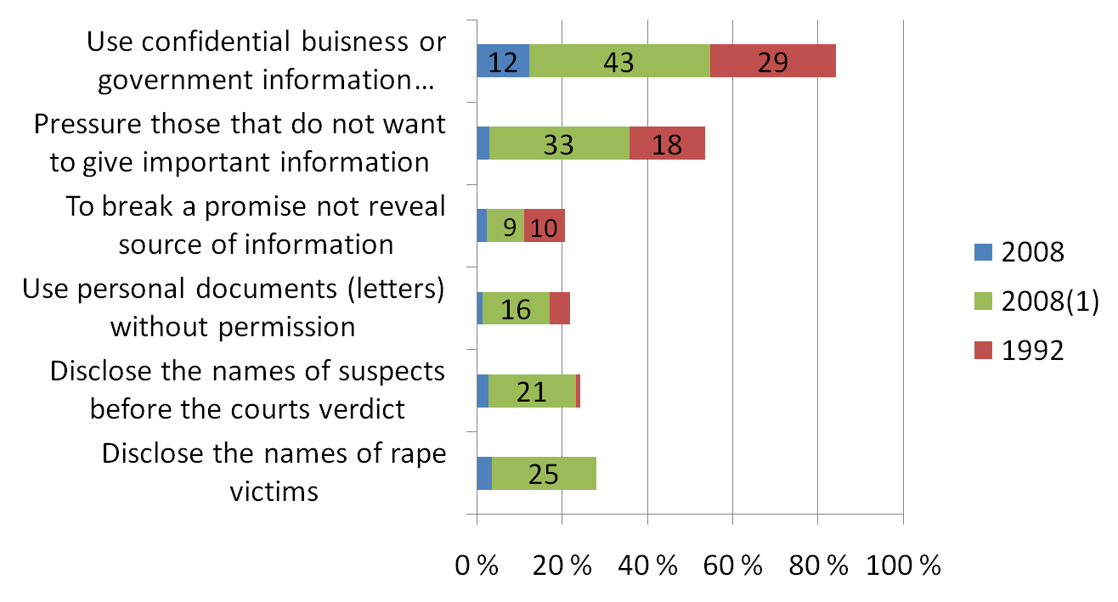
Working methods approved
1) According to situation
32
32

Slide 33
Audience
I. Our audience is more interested in news than analysis
II. The majority of the audience has little interest in serious journalism
III. Audience is gullible and easily deceived

Slide 34
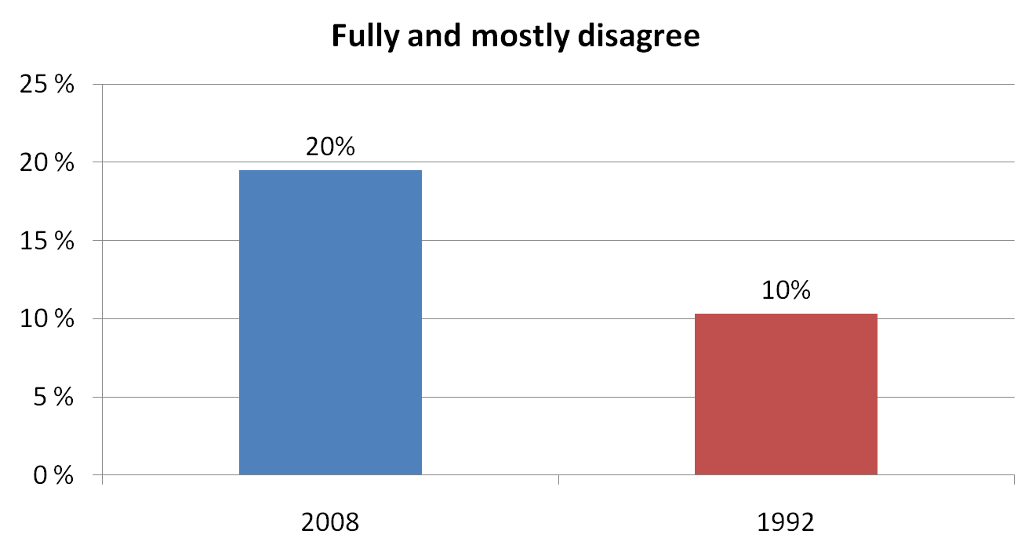
Our audience is more interested in news than analysis
34

Slide 35
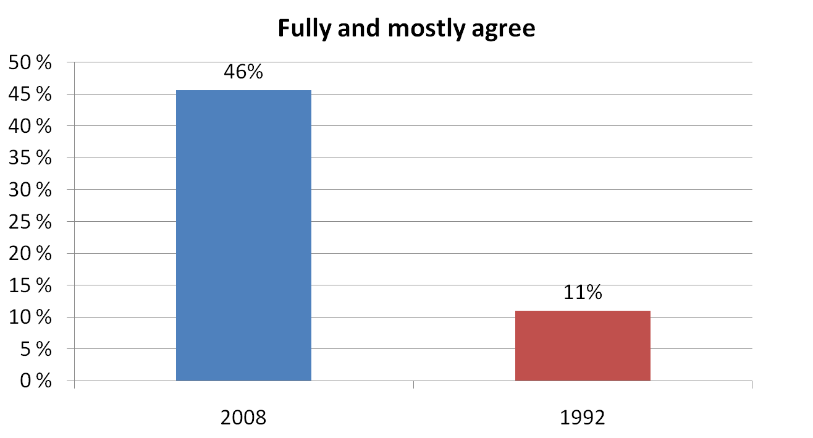
The majority of the audience has little interest in serious journalism
35

Slide 36
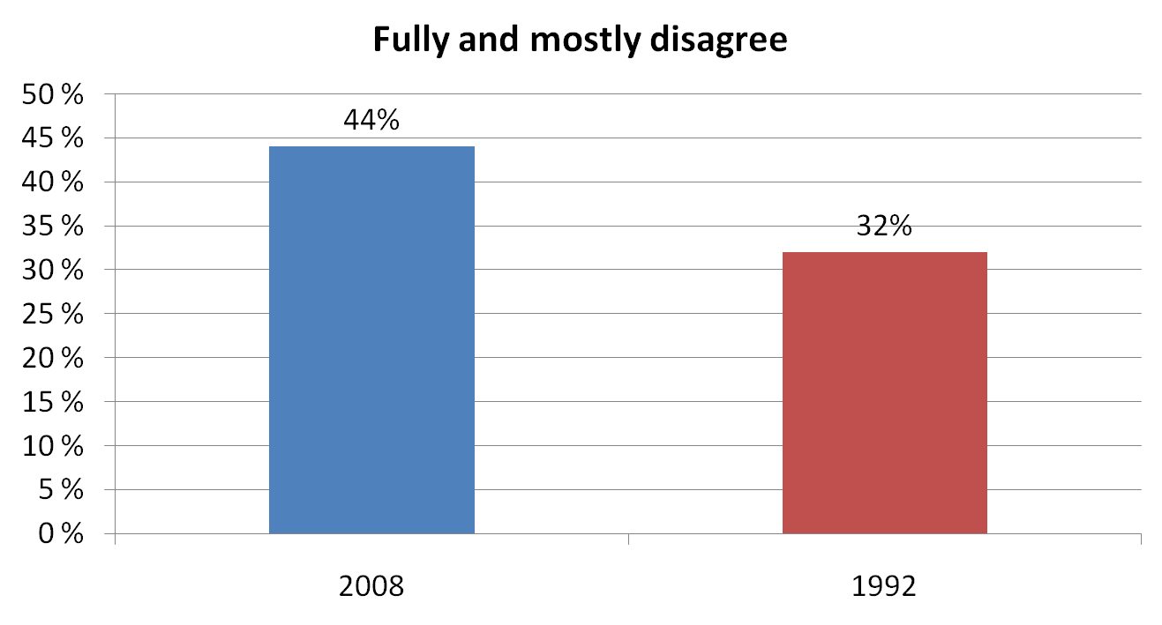
III. Audience is gullible and easily deceived
36

Slide 37
Audience
1992 – reading nation, citizens participating in the political and social reforms
2008 – TV watching nation, apolitical, consumers with individual plural interests in informational services, entertainment, advertising and goods. Moving into a private life
37

Slide 38
Conclusion
Journalism becomes a profession for young and women
Two thirds are post-Soviet generations
Generation change is related to womanization: 67% among young
It becomes a realm for the offspring of the middle class attracted with privileges for a second job and good income, glamour lifestyle, access to elite circles (elitization of journalism)
38

Slide 39
Conclusion
From a wish to participate in democratic reforming via journalism in 1992 (political enthusiasm)
to private interest/self-interest in the profession in 2008: creativity, self-realization, commerce, popular culture, personal promotion, political indifference
39

Slide 40
Conclusion
Enthusiasm of 1992 shifted abstention from potential risks
From adherent fighters for democracy in 1992 journalists turned into situational journalists observing corporate interests and business of their media organizations, their clients
Post-2000 generation is the most satisfied in the profession
40

Slide 41
Conclusion
Professional autonomy decreased but number of satisfied (over 60%) – the same
Probably owing to Situational factor
Political conditions: to keep a low profile (fear of the state: local authorities and legal suits; editorial line) Obedient journalists under self-censorship
Market ample offers: pursuit for profit
Profession’s habitus: second job, clientelism including corruption, atomization of community
Personal strategies of success: mercenaries (pro-government media), artists (popular media) and experts (quality media)
41

Slide 42
Conclusion
West is worried (Freedom House 2010: Russia is “well-established authoritarian regime” )
But Russian journalists not, majority are satisfied
Towards the consolidation of professionals
Money replaced freedom
In one boat: Adaptation successfully took place

Slide 43
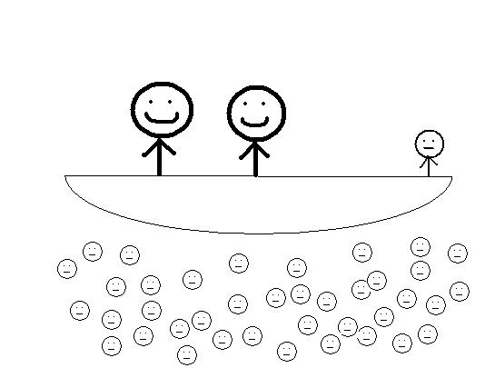
No need to rock the boat
State capital
Private capital
Media tool
Official
Businessman
Journalist
Boat of prosperity
43

Slide 44
Role of Institutes in Russia (Levada Centre Survey, 2010)
 | 2001 | 2005 | 2010
President | 1 | 1 | 1
Oligarchs, bankers | 2 | 2 | 3
Government | 3 | 6 | 2
Media | 4 | 4 | 8
Governors | 5 | 8 | 9
Directors of big plants | 6 | 10 | 14
Army | 7 | 7 | 6
FSB | 8 | 3 | 5
Sovet Federat. Upper Chamber P. | 9 | 3 | 10
Church | 10 | 11 | 12
Presidential Administration | 11 | 5 | 4
Public prosecutor’s office | 12 | 9 | 7
State Duma | 13 | 14 | 13
Court | 14 | 12 | 11
Political parties | 15 | 15 | 15
Intelligensia | 16 | 16 | 16
Trade Unions | 17 | 17 | 17

