Slide 1
Why Are Russian Journalists Happy in Not Free Media?
Svetlana Pasti, University of Tampere
9 November 2011
Aleksanteri Conference, Helsinki

Slide 2
World Audit Democracy: be in the top ten http://www.worldaudit.org/democracy.htm
2
2
2
Country Democracy Rank Press Freedom Rank Corruption Rank
Finland 1 1 4
Sweden 1 1 4
Denmark 1 4 1
New Zealand 4 7 1
Norway 5 1 10
Switzerland 6 6 8
Netherlands 6 7 7
Canada 8 16 6
Australia 9 22 8
Ireland 9 9 11

Slide 3
World Audit Democracy: Russia - place 134
3
3
3
Russia occupied place between Yemen and Chad in the list of 150 countries having:
democracy rank - 136
press freedom rank - 130
corruption rank - 127

Slide 4
World Audit Democracy: Russia
4
4
4
http://www.worldaudit.org/countries/russia.htm
Political Rights place 6 (from 1-7)
Civil Liberties place 5 (from 1-7)
Press Freedom place 131 (0-150)
Corruption place 117 (0-149)

Slide 5
Press Freedom
5
5
Examination of the level of press freedom in each country is divided into three broad categories:
Legal environment
Political environment
Economic environment

Slide 6
Press Freedom: Types of countries
6
6
Each country is rated in three categories
The higher number being the least free
Free-press: a score of 0-30 places
Partly- free press: 31-60 places
Not free-press: 61-100 places
Russia has 131 place – Not free press

Slide 7
Deaths of Journalists in Russia: http://journalists-in-russia.org/journalists
7
7
Database of Russian Union of Journalists:
332 journalists since 1993
This database includes the violent, premature or unexplained deaths of journalists in Russia
offers a narrative account of the journalist's work and death based mainly on monitoring information gathered in Moscow by the Glasnost Defence Foundation and the Centre for Journalism in Extreme Situations.

Slide 8
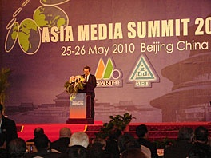
Russian Union of Journalists: “over 300 killed, majority in home cities” 100528-1.htm
8
8
Pavel Gutiontov 2010: Speech of the Secretary of the Russian Union of Journalists Pavel Gutiontov at the Asian Media Sammit in Beijing). 12 October 2010

Slide 9
Change for the worse for last 13 years
9
9
Democracy rank: From place 106 to place 136
Not Free Media – 131 place (0-150)
Corruption rank: From place 76 to place 127
Deaths of over 300 journalists
http://journalists-in-russia.org/journalists

Slide 10
State at the media market
10
10
10
10
10
10
10
Russia – effort to preserve state-owned media: state broadcasters have 75% of the audience, in the regions nearly 80% of all press─ non-market publications – that means more political control
Other post-Soviet countries CIS: Armenia, Georgia, Latvia, Lithuania, Moldova, Estonia legislated to prohibit and restrict the State’s opportunities to operate mass media

Slide 11
Paradox of media market
11
11
11
11
Media market is ranked 10th in the world by economic indicators
But media market has non-market character:
the overwhelming majority of the regional and local newspapers exist owing to administrative resources - Neo-sovetisation
Television is under state control
The main trend is decrease of the commercial capital and the increase of the state capital and mixed (state and commercial) capital

Slide 12
Questions
12
12
How do Russian journalists estimate conditions in their profession?
How are they satisfied in their profession?

Slide 13
Method
13
13
13
13
13
13
13
Two surveys: 1992 and 2008
1992 – survey in the regions
2008 – two stages: (1) All-Russian Congress of Journalists, (2) survey in the regions
Questionnaires based on Weaver’s research with additional questions relevant to Russia

Slide 14
Regions
14
14
14
14
14
14
14
1992 – ten regions representing the basic national geographic and socio-economic features
2008 – thirty six cities from all six economic zones of the RF: big cities (1 million and over), mid-sized cities (200-999 thousand) and smaller cities (under 200 thousand) with two capitals Moscow and St Petersburg

Slide 15
Respondents
15
15
15
15
15
15
15
1992 – 1000 respondents
2008 – 800 respondents
Full-time working journalists in press, radio and television, the internet media (2008) providing local news, political and economic issues, culture, leisure, youth topics

Slide 16
Job conditions
16
16
16
16
Editorial autonomy
Satisfaction in job

Slide 17
Editorial autonomy
17
17
17
17
17
17
I. If you get a good idea for a publication and you consider it is important, how often are you successful in realizing it, and to make a material?
II. How independent are you in the selection of news, topics, problems of coverage?
III. How independent are you in emphasizing ideas or aspects which in your opinion are important to your material?

Slide 18
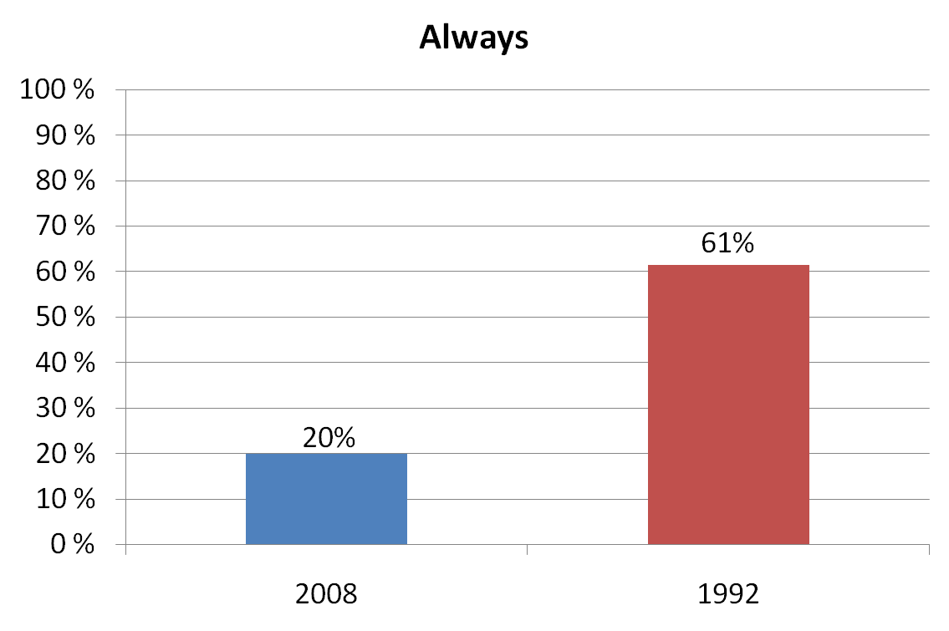
I. If you get a good idea for a publication and you consider it is important, how often are you successful in realizing it, and to make a material?
18
18
18
18
18
18
18
18

Slide 19
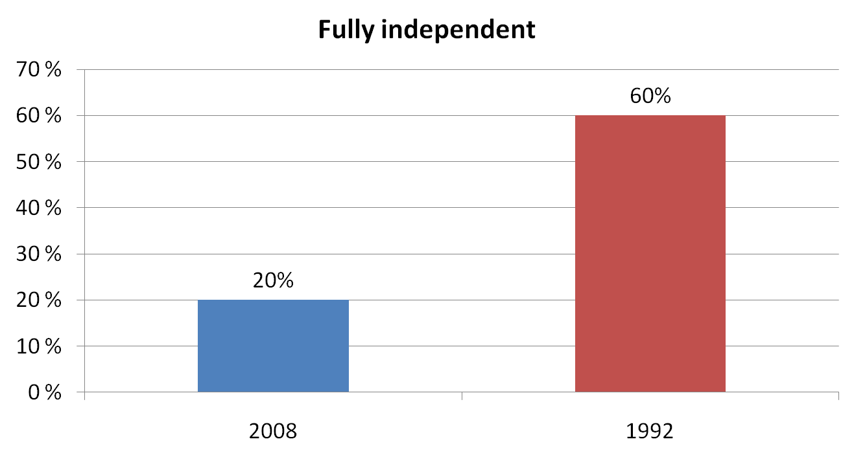
II. How independent are you in the selection of news, topics, problems of coverage?
19
19
19
19
19
19
19
19

Slide 20
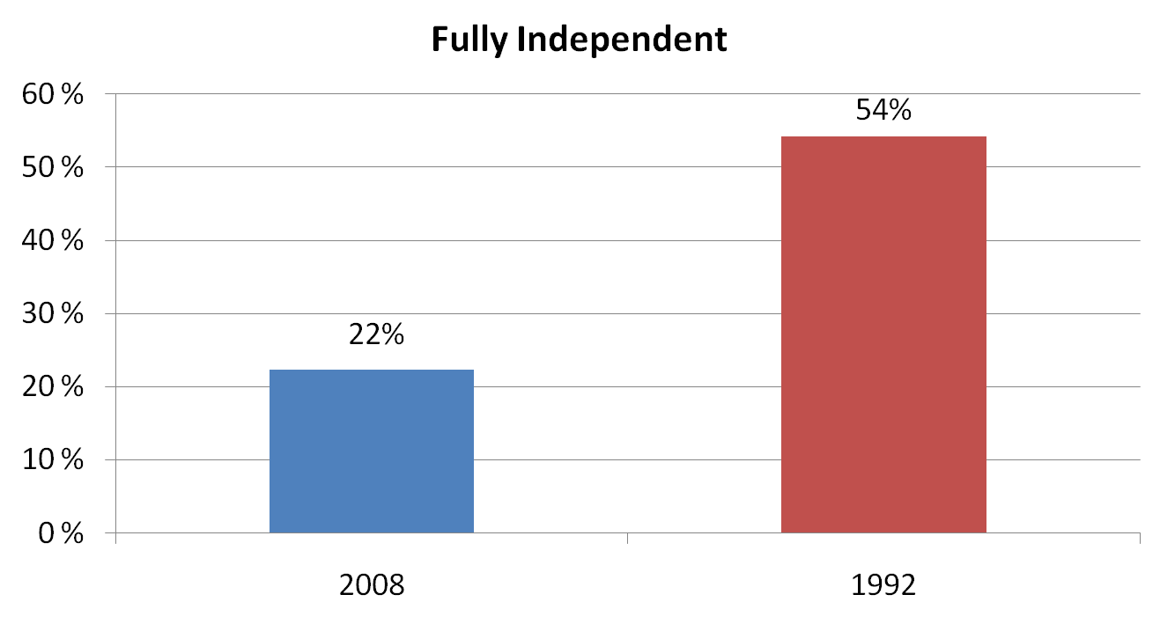
III. How independent are you in emphasizing ideas or aspects which in your opinion are important to your material?
20
20
20
20
20
20
20
20

Slide 21
Job Satisfaction
21
21
21
21
21
21
21
72% satisfied (very and chiefly) in 2008
62% satisfied (very and chiefly) in 1992

Slide 22
Facing the dilemma
22
22
22
22
22
22
22
22
Democracy less
Press Freedom less
Corruption more
Happy journalists more

Slide 23
Job satisfaction in 2008
Sources of satisfaction | Fully and chiefly satisfied %
1. To independently decide how and what to write, to tell | 65
2. To help people | 64
3. Editorial policy | 60
4. Job security, social security | 52
5. Opportunities for better qualification | 51
6. To influence society | 49
7. Opportunities for second job | 48
8. Opportunities to grow in the post | 42
9. Salary | 39
10. For a career via journalism in politics, state service, business | 38
11. Political independence of the profession | 37
12. Extra privileges | 37
23
23
23
23
23
23
23
23

Slide 24
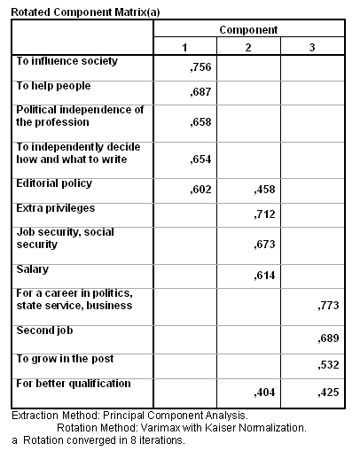

Slide 25
Factor analysis: Power
25
25
25
25
25
First factor
To influence society 0,756
To help people 0,687
Politic. independence of the profession 0,658
To independently decide how and what to write 0,654

Slide 26
Factor analysis: Wealthy
26
26
26
26
26
Second factor
Extra privileges 0,712
Security that job provides 0,673
Income 0,614

Slide 27
Factor analysis: Social mobility
27
27
27
27
27
Third factor
A career via journalism in politics, state service, business 0,773
Second job 0,689
Growing in the post 0,532
Bettering qualification 0,425

Slide 28
Privileged profession Journalism
28
28
28
28
28
Resource of Power – Political capital
(it is consolidated with information capital, which journalists possess under authority of their profession )
Resource of Wealth – Economic capital
(elitist earnings on the markets of media, advertising, and PR services including political campaigns - elections
Resource of Social mobility – Cultural capital
(in)formal or social networks, family privileges were and are the most significant resources for social mobility; the tradition of political culture where rational-legal authority is weak

Slide 29
Social differentiation
Place in social stratification is determined by accessibility of the whole complex of political, economic and cultural resources. These resources are situated in social fields (Bourdie)
Significant resources of social fields:
Socio-Political field: power and management
Socio-Economic field: property, income
Socio-Cultural field: education, profession, self-identification, needs, interests, values;
Role of informal networks or social networks (cultural capital) favouring upward mobility

Slide 30
Journalism as privileged profession
30
30
30
It accumulates three kinds of capital:
Political, Economic and Cultural
It opens access to Social mobility
Journalism operates as a Social lift

Slide 31
Socail background by locality
Social background | Place of resident
 | Big city | Mid-sized city | Small city
 | % | % | %
Top manager | 8 | 7 | 4
Mid manager | 25 | 18 | 17
Supervisor | 3 | 6 | 4
Journalist or editor | 4 | 4 | 1
Other professional | 27 | 29 | 11
Clerk | 9 | 9 | 10
Urban worker | 12 | 18 | 28
Rural worker | 4 | 5 | 21
Other | 6 | 4 | 4
 | 100,0 | 100,0 | 100,0
31
31
31
31
31
31

Slide 32
Social background by generation
 | Generation
 | In 1991 or earlier | 1992-1999 | 2000 or later
 | % | % | %
Top manager | 7 | 6 | 8
Mid manager | 22 | 20 | 20
Supervisor | 6 | 6 | 3
Journalist or editor | 3 | 4 | 4
Other professional | 18 | 25 | 33
Clerk | 1 | 9 | 8
Urban worker | 20 | 20 | 12
Rural worker | 10 | 5 | 5
Other | 4 | 5 | 7
 | 100,0 | 100,0 | 100,0
32
32
32
32

Slide 33
Elitization of journalism by locality and generation
33
33
33
33
33
33
33
33
33
Large city and mid-sized city – journalism becomes bourgeois – majority comes from middle class and elite families
Smaller city – journalism more democratic – a half comes from working class and clerks families
Post-2000 generation –decreasing working class offspring: 30%: 17% (Sov.: Young) and increasing from middle class: 18%: 33% (S:Y)

Slide 34
Lifting to higher social class
From working class in the middle class ─ mostly in small cities
From middle class occupations to elite positions in journalism ─
appointment of ‘own people”, (non) journalists to the posts of chief editors by a new government became a regular matter after the elections – Political appointments – Neo-sovetisation
From the media to parliaments (politicians)
From journalistic status to establishing his/her own media or holding (entrepreneurs)
34
34

Slide 35
Motivation shift
In 1992 – mostly, political enthusiasm: an interesting work, freedom and independence of the media, and the political line of the media
In 2008 – a way of self-expression and self-realization, individual creativeness and wide communication including travelling
35

Slide 36
Values shift
From political values to participate in the collective post-communist reforming via independent media in 1992
To apolitical values in the profession and self-interest in personal achievement and success

Slide 37
Behavior shift
37
37
37
37
37
Enthusiasm of 1992 shifted abstention from potential risks: Killing of journalists as powerful warning
From adherent fighters for democracy in 1992 journalists turned into happy journalists having an access to three kind of symbolic capital which provide them rich opportunities for Social mobility

Slide 38
Conclusion
38
38
38
38
38
38
38
38
38
38
38
Since 2000 presence of the State increased in the media market
Many journalists want to work in (pro) state media which offer better salaries, job security and perspectives for social mobility
Number of satisfied journalists in 2008 is more (72%) than it was in 1992 (62%)
Yet Russian media are rated as not free (World Audit Democracy 2010)

Slide 39
Conclusion
39
Journalism provides access to three important resources: power, wealth and social networks
This combination of resources makes journalism a privileged profession
Freedom of speech is not a great value in society while individual freedom it valued more important

Slide 40
Role of Institutes in Russia (Levada Centre Survey, 2010)
 | 2001 | 2005 | 2010
President | 1 | 1 | 1
Oligarchs, bankers | 2 | 2 | 3
Government | 3 | 6 | 2
Media | 4 | 4 | 8
Governors | 5 | 8 | 9
Directors of big plants | 6 | 10 | 14
Army | 7 | 7 | 6
FSB | 8 | 3 | 5
Sovet Federat. Upper Chamber P. | 9 | 3 | 10
Church | 10 | 11 | 12
Presidential Administration | 11 | 5 | 4
Public prosecutor’s office | 12 | 9 | 7
State Duma | 13 | 14 | 13
Court | 14 | 12 | 11
Political parties | 15 | 15 | 15
Intelligensia | 16 | 16 | 16
Trade Unions | 17 | 17 | 17
40
40
40
40

Slide 41
Public opinion: Survey of Levada Centre, 21-24.1.2011
41
What political system is best? Answers of respondents
Soviet – 33%, the present -19%, Western democracy -23%
What economic system is best?
State plan and distribution – 51%,
Private property and market – 31%
What type of state for future Russia would be best?
Socialist state like the USSR -23%
Like the West, democracy and market economy - 30%
Absolutely special system and its own way of development – 36%
http://www.polit.ru/research/2011/02/08/politsistema.html

Slide 42
Thanks for your attention!

