Slide 1
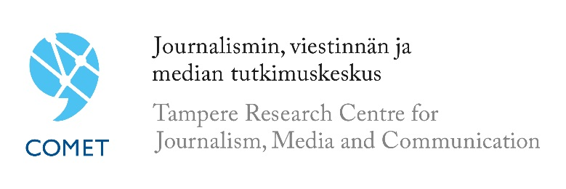
Paradoxes of Privacy
Esa Sirkkunen
Reseacher, COMET
Privacy in the Big Data Era
13/11/2015

Slide 2
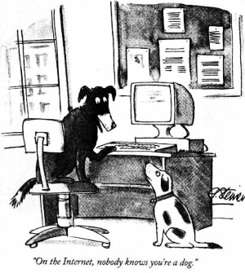
1993: anonymity
Image from The New Yorker cartoon by Peter Steiner, 1993.

Slide 3
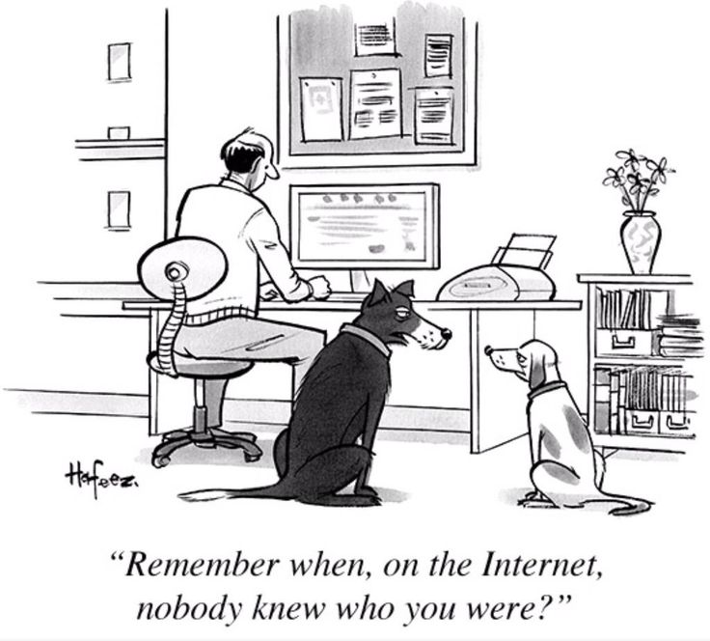
2015: surveillance
Image from The New Yorker cartoon by Kaamran Hafeez, 2015.

Slide 4
Survey & Project
The survey was conducted in the end of April 2015, interviews, n=1000, ages between 15-79
The report on the results: http://www.uta.fi/cmt/en/research/comet/projects/privacy-and-anonymity/prianoraportti%20ENGLISHa.pdf
Privacy and Anonymity in the Net -project (PRIANO); funded by the Helsingin Sanomat Foundation
Blog: https://blogs.uta.fi/priano/

Slide 5
Finns are concerned
The majority of respondents (68%) were concerned about the fact that more and more information about internet users is collected for different purposes, for instance for targeted advertising
The majority of the respondents (76%) wanted to know in more detail what information is collected and what it is used for.
Even more respondents (87%) would like to decide themselves how their personal data should be used.

Slide 6
We trust banks but not Google or FB
In the view of the respondents, the organisations that best safeguard personal data in digital services and databases are banks and insurance companies (72%);
hospitals, health centres and medical clinics (69%); the government (59%); municipal and city authorities (55%); and educational institutions (54%).
Confidence in user personal data protection was particularly low in connection with Google (18%) and Facebook (13%).

Slide 7
But we use Google and FB anyway…
The majority of survey respondents said that there was no alternative to accepting the terms and conditions and data collection
69% believed that their data was collected anyway and there was nothing they could do about it
64% said they were forced to surrender their data in return for using a service or receiving some kind of other perk

Slide 8
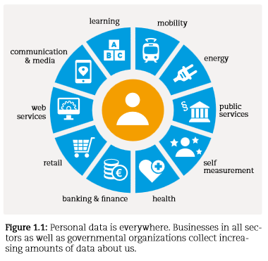
We are surrounded by sensors
Source: Antti Poikola, Kai Kuikkaniemi, Harri Honko: MyData. A Nordic Model for human-centered personal data management and processing. Ministry of Transport and Communications.
http://www.lvm.fi/c/document_library/get_file?folderId=3759139&name=DLFE-27119.pdf&title=MyData-nordic-model

Slide 9
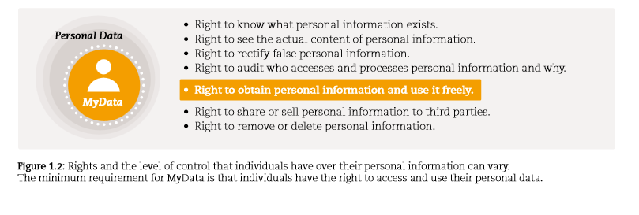
Do we have rights to our own data ?
Source: Antti Poikola, Kai Kuikkaniemi, Harri Honko: MyData.

Slide 10
China is planning new social credit system
Where you go, what you buy, who you know, how many points are on your driving licence, how your pupils rate you. These are just a few of the measures which the Chinese government plans to use to give scores to all its citizens.
China’s Social Credit System (SCS) will come up with these ratings by linking up personal data held by banks, e-commerce sites and social media. The scores will serve not just to indicate an individual’s credit risk, but could be used by potential landlords, employers and even romantic partners to gauge an individual’s character.
Source: https://www.newscientist.com/article/dn28314-inside-chinas-plan-to-give-every-citizen-a-character-score/
American Civil Liberties Union: https://www.aclu.org/blog/free-future/chinas-nightmarish-citizen-scores-are-warning-americans

Slide 11
Did the train leave already?
Is is possible to give the users right to decide how their personal data is being handled?
Are there efficient ways to control global corporations like Google, Amazon, Facebook and Apple?
Are there more efficient business models than the trade off –model: giving away your personal data for easy to use tools and applications?

