Slide 1
Political System of the Modern Russia
Professor PH. D
Dmitri Gavra
St-Petersburg State University
School of Journalism & Mass Communications

Slide 2
Russia: The Type of the State
Republic
Presidential republic
?Semi-presidential republic?
!Super presidential republic!
Federal State
Parliamentary democracy

Slide 3
Constitution
Russia is a democratic federative state based on rule of law and a republican form of government.
State power in Russia is exercised by the President, the Federal Assembly, the Government and the courts.

Slide 4
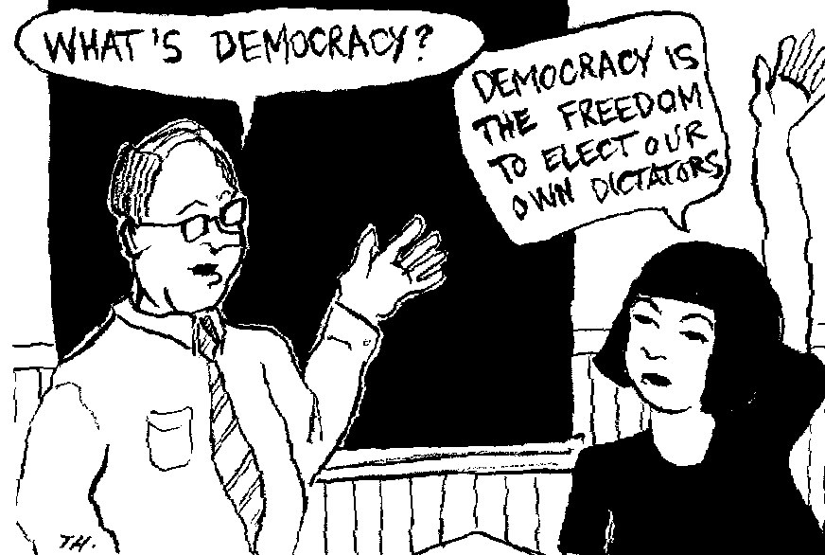

Slide 5
The 1993 constitution: how and why?

Slide 6
The 1993 constitution: how and why?

Slide 7
Constitution: Distribution of Power in Russia
The state power in the Russian Federation is exercised through separation of the legislative, executive and judicial powers.
The bodies of the legislative, executive and judicial powers are independent.

Slide 8
Distribution of Power: Ideal Model

Slide 9
Distribution of Powers: reality

Slide 10
Russian president. The status
The President is at the summit of the system of state power.
He ensures that all the state institutions are able to carry out their responsibilities and keeps watch over them
Each institution of state power is only partially responsible for enforcing the Constitution.
Only the President has the responsibility of safeguarding the state system, the state’s sovereignty and integrity overall.

Slide 11
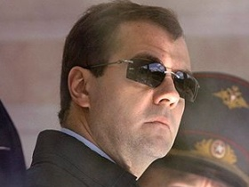
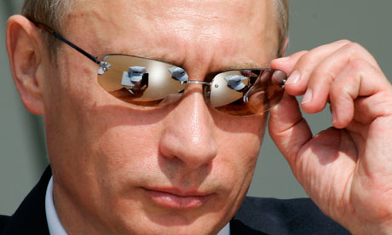
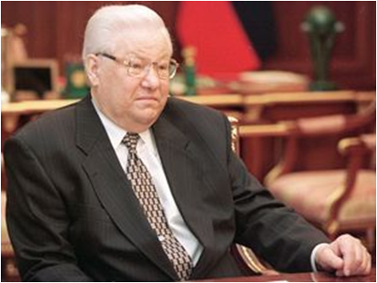
President of the Russian Federation
The head the of State
But not of the executive branch of the state power
A guarantor of the Constitution of the Russian Federation and the rights and freedoms of the individual and the citizen

Slide 12
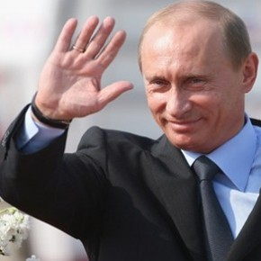
To become President of Russia… It’s possible… & some words about words
Elected for a term of 6 years (4 until 2012) by citizens of the Russian Federation on the basis of universal, equal and direct suffrage by secret ballot.
The age of 35 and reside in the Russian Federation for not less than 10 years
In the office for not more than 2 consecutive terms.

Slide 13
President & … others

Slide 14
Government: appointment

Slide 15
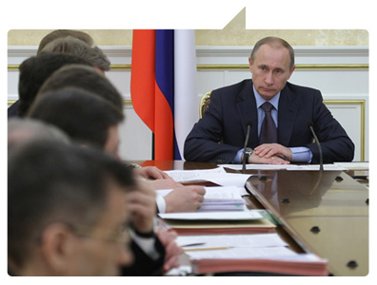
The President & The Government
Appoints the Chairman of the Government with the approval of the State Duma
Appoints Vice-chairmen
Has the right to chair meetings of the Government
Supervises Force Ministers
Resigns the Government personally

Slide 16
President versus Government
The decisions and orders of the Government in case of their incompatibility which the Constitution, federal laws and decrees of the President, may be revoked by the President.
The President of the Russian Federation may take the decision on the resignation of the Government of the Russian Federation.

Slide 17
Government: who’s the boss
President: ministers
Defence
Interior (Police)
International Relations
Emergency Situations
Federal Security
Intelligent Service
Justice
Prime minister: ministers
Labour
Economics
Finance
Health care
Transport
Energy
Science & Education
Culture

Slide 18
President & Courts

Slide 19
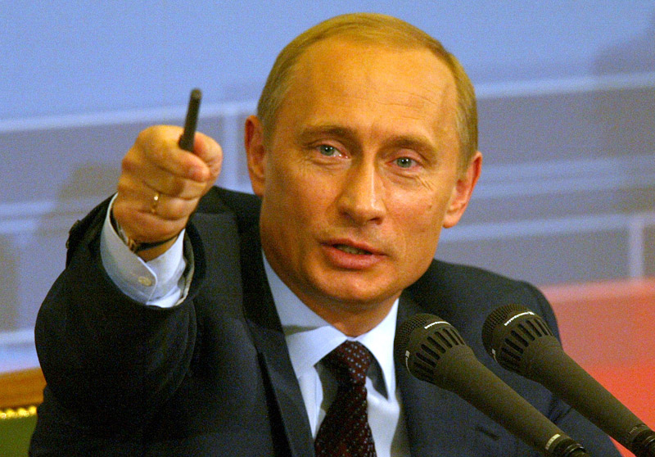
President & Courts
Submits to the Council of the Federation nominations for the posts
of judges of the Constitutional Court of the Russian Federation,
of the Supreme Court of the Russian Federation,
of the Higher Court of Arbitration of the Russian Federation
of the General Procurator of the Russian Federation;

Slide 20
Legislation and the President
Has the right to issue decrees and orders, obligatory to the government, regional governments and local governments.
Though they are not the laws, the function as next to laws normative acts.
The government in its everyday activities realises constitution, laws, decrees and orders of the President.
In case the decisions of the government are in contradiction with constitution, federal laws or the decrees of the president he has the right to revoke these decisions
President has the right of legislative initiative in any field

Slide 21
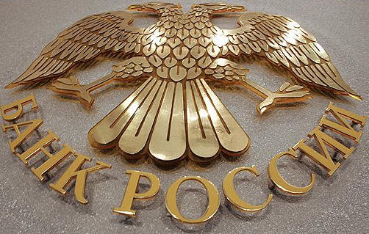
President & The Central Bank
Submits to the State Duma the nomination for the Chairman of the Central Bank of the Russian Federation;
Raises before the State Duma the question concerning the release from duty of the Chairman of the Central Bank of the Russian Federation;

Slide 22
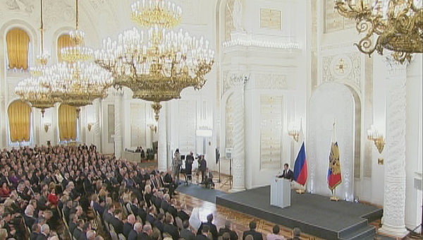
Federal Assembly
the parliament of the Russian Federation, a representative and legislative body of the Russian Federation.

Slide 23
Federal Assembly
The Council of the Federation
The State Duma
two representatives from each subject of the Russian Federation: one each from the representative and executive bodies of state power

Slide 24
Figure 1: Elections to the Federal Assembly 1993 – 2007

Slide 25
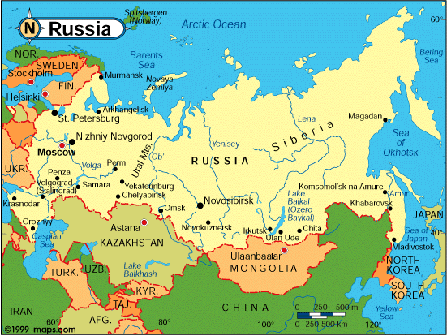
The jurisdiction of the Council of the Federation
a) approval of alternation of borders between the subjects of the Russian Federation;
b) approval of the decree of the President of the Russian Federation imposing martial law;
c) approval of the decree of the President of the Russian Federation imposing a state of emergency;

Slide 26
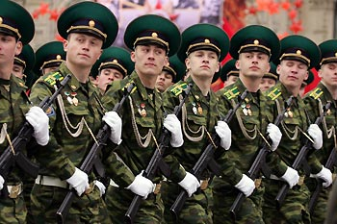
The jurisdiction of the Council of the Federation
d) decisions on using Armed Forces of the Russian Federation outside the territory of the Russian Federation
e) setting the election of the President
f) removal of the President from office

Slide 27
The jurisdiction of the Council of the Federation
appointment of judges of the Constitutional Court of the Russian Federation, the Supreme Court of the Russian Federation and the Higher Arbitration Court of the Russian Federation;
h) appointment of the General Procurator of the Russian Federation and his dismissal from office;
i) appointment of the Vice-Chairman and half the auditors of the Accountants' Chamber and their dismissal from office.

Slide 28
The jurisdiction of the State Duma
a) giving its consent to the President of the Russian Federation for the appointment of the Chairman of the Government of the Russian Federation
b) decisions on a vote of confidence in the Government of the Russian Federation
c) appointment of the Chairman of the Central Bank of the Russian Federation or his dismissal from office
d) appointment of the Chairman and half the auditors of the Accountants' Chamber or their dismissal from office

Slide 29
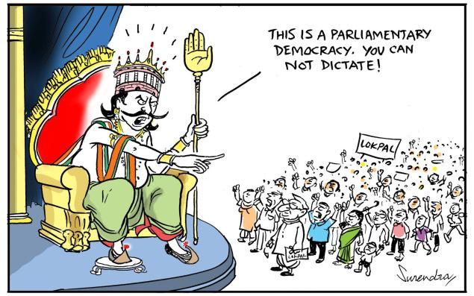
The President & the Parliament
a) calls the elections of the State Duma according to the Constitution of the Russian Federation and to the federal law;
b) dissolves the State Duma in cases and according to the procedure provided for by the Constitution of the Russian Federation;

Slide 30
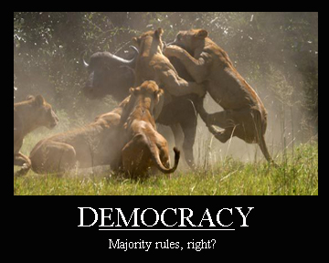
President+Government versus Parliament

Slide 31
President+Government versus Parliament
In case the State Duma refuses to give its approval for the nomination of the Chairman of the Government of the Russian Federation even at the third time, the President of the Russian Federation may
appoint a Chairman of the Government of the Russian Federation,
dissolve the State Duma
and set new elections.

Slide 32
President+Government versus Parliament
In case the State Duma refuses to give its approval for the nomination of the Chairman of the Government of the Russian Federation even at the third time, the President of the Russian Federation may appoint a Chairman of the Government of the Russian Federation, dissolve the State Duma and set new elections.
The State Duma having given the Government a vote of no confidence, the President of the Russian Federation shall have the right either to declare the resignation of the Government or not accept the decision of the State Duma.

Slide 33
President+Government versus Parliament
The State Duma may give the Government of the Russian Federation a vote of no confidence..
The State Duma having given the Government a vote of no confidence, the President of the Russian Federation shall have the right either to declare the resignation of the Government or not accept the decision of the State Duma.

Slide 34
Government of the Russian Federation
In case the State Duma within three months has once again given the Government of the Russian Federation a vote of no confidence, the President of the Russian Federation shall either declare the resignation of the Government or dissolve the State Duma.
In case the State Duma within three months has once again given the Government of the Russian Federation a vote of no confidence, the President of the Russian Federation shall either declare the resignation of the Government or dissolve the State Duma.

