Slide 1
talking ABOUT profession
Reflections on journalistic professionalism survey in contemporary China
Raymond Ruiming Zhou
Fudan University, China

Slide 2
Outline
Review: Results and conclusion from China team’s AJS article
Reflection 1: Is there significant distinction on ideas between traditional and online?
Reflection 2: Is there a solid professional community for journalists?
Reflection 3: Does the talk on profession constantly about journalistic professionalism?

Slide 3
Revisit Journalistic Professionalism
Two objectives
Detect social profiles, functions of journalism, roles of journalists, and ideas of professionalism
Examine the differences between journalist from perspectives of organizational forms and geographic factors

Slide 4
Revisit Journalistic Professionalism
Method
Face-to-face interviews with 146 journalists
4 cities: Beijing, Shanghai, Guangzhou, Wuhan
State-owned news media, news websites or grass-root media
From March 2014 to January 2015

Slide 5
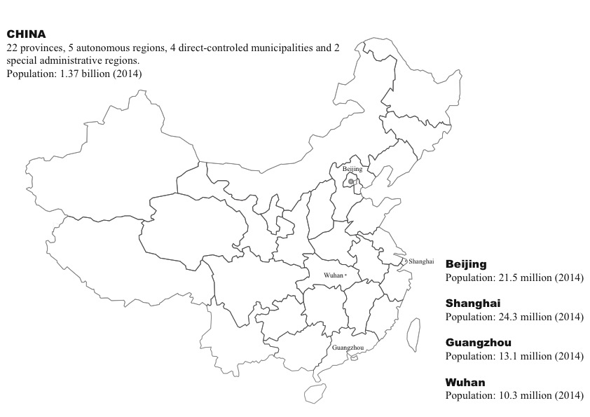

Slide 6
Functions of Journalism
City | Media Type | Function 1 | Function 2 | Function 3
Beijing | Traditional | Provide Info | Guide the opinion | Social supervision
 | Online | Provide Info | Promote objectivity | Protect society
Shanghai | Traditional | Provide Info | Guide the opinion | Provide a picture
 | Online | Provide Info | Interpret issues | Help form opinions
Guangzhou | Traditional | Provide Info | Educate | Enlighten
 | Online | Provide Info | Search for solutions | Educate
Wuhan | Traditional | Provide Info | Search for solutions | Entertain
 | Online | Provide Info | Provide a picture | Guide the opinion

Slide 7
Functions of Journalism
City | Media Type | Function 1 | Function 2 | Function 3
Beijing | Traditional | Provide Info | Guide the opinion | Social supervision
 | Online | Provide Info | Promote objectivity | Protect society
Shanghai | Traditional | Provide Info | Guide the opinion | Provide a picture
 | Online | Provide Info | Interpret issues | Help form opinions
Guangzhou | Traditional | Provide Info | Educate | Enlighten
 | Online | Provide Info | Search for solutions | Educate
Wuhan | Traditional | Provide Info | Search for solutions | Entertain
 | Online | Provide Info | Provide a picture | Guide the opinion

Slide 8
Functions of Journalism
City | Media Type | Function 1 | Function 2 | Function 3
Beijing | Traditional | Provide Info | Guide the opinion | Social supervision
 | Online | Provide Info | Promote objectivity | Protect society
Shanghai | Traditional | Provide Info | Guide the opinion | Provide a picture
 | Online | Provide Info | Interpret issues | Help form opinions
Guangzhou | Traditional | Provide Info | Educate | Enlighten
 | Online | Provide Info | Search for solutions | Educate
Wuhan | Traditional | Provide Info | Search for solutions | Entertain
 | Online | Provide Info | Provide a picture | Guide the opinion

Slide 9
Roles of Journalists
City | Media Type | 1st Role | 2nd Role | 3rd Role
Beijing | Traditional | Info disseminator | Supervisor | Social observer
 | Online | Info disseminator | Info recorder | Bridge (gov’t & public)
Shanghai | Traditional | Info disseminator | Opinion guider | Social promoter
 | Online | Info disseminator | Opinion guider | Social promoter
Guangzhou | Traditional | Info disseminator | Supervisor | Bridge (gov’t & public)
 | Online | Info disseminator | Social promoter | Info recorder
Wuhan | Traditional | Info disseminator | Supervisor | Order maintainer
 | Online | Info disseminator | Opinion guider | Opinion expresser

Slide 10
Roles of Journalists
City | Media Type | 1st Role | 2nd Role | 3rd Role
Beijing | Traditional | Info disseminator | Supervisor | Social observer
 | Online | Info disseminator | Info recorder | Bridge (gov’t & public)
Shanghai | Traditional | Info disseminator | Opinion guider | Social promoter
 | Online | Info disseminator | Opinion guider | Social promoter
Guangzhou | Traditional | Info disseminator | Supervisor | Bridge (gov’t & public)
 | Online | Info disseminator | Social promoter | Info recorder
Wuhan | Traditional | Info disseminator | Supervisor | Order maintainer
 | Online | Info disseminator | Opinion guider | Opinion expresser

Slide 11
Roles of Journalists
City | Media Type | 1st Role | 2nd Role | 3rd Role
Beijing | Traditional | Info disseminator | Supervisor | Social observer
 | Online | Info disseminator | Info recorder | Bridge (gov’t & public)
Shanghai | Traditional | Info disseminator | Opinion guider | Social promoter
 | Online | Info disseminator | Opinion guider | Social promoter
Guangzhou | Traditional | Info disseminator | Supervisor | Bridge (gov’t & public)
 | Online | Info disseminator | Social promoter | Info recorder
Wuhan | Traditional | Info disseminator | Supervisor | Order maintainer
 | Online | Info disseminator | Opinion guider | Opinion expresser

Slide 12
Reflection 1
Is there significant distinction on the ideas between traditional media and new media?
Journalists in contemporary China generally share the same ideas in two groups, regardless of where they are
Functions of journalism: provide information / interpret social reality
Roles of journalists: information disseminator / social reality interpreter

Slide 13
Functions of Journalism
City | Media Type | Function 1 | Function 2 | Function 3
Beijing | Traditional | Provide Info | Guide the opinion | Social supervision
 | Online | Provide Info | Promote objectivity | Protect society
Shanghai | Traditional | Provide Info | Guide the opinion | Provide a picture
 | Online | Provide Info | Interpret issues | Help form opinions
Guangzhou | Traditional | Provide Info | Educate | Enlighten
 | Online | Provide Info | Search for solutions | Educate
Wuhan | Traditional | Provide Info | Search for solutions | Entertain
 | Online | Provide Info | Provide a picture | Guide the opinion

Slide 14
Functions of Journalism
City | Media Type | Function 1 | Function 2 | Function 3
Beijing | Traditional | Provide Info | Guide the opinion | Social supervision
 | Online | Provide Info | Promote objectivity | Protect society
Shanghai | Traditional | Provide Info | Guide the opinion | Provide a picture
 | Online | Provide Info | Interpret issues | Help form opinions
Guangzhou | Traditional | Provide Info | Educate | Enlighten
 | Online | Provide Info | Search for solutions | Educate
Wuhan | Traditional | Provide Info | Search for solutions | Entertain
 | Online | Provide Info | Provide a picture | Guide the opinion

Slide 15
Roles of Journalists
City | Media Type | 1st Role | 2nd Role | 3rd Role
Beijing | Traditional | Info disseminator | Supervisor | Social observer
 | Online | Info disseminator | Info recorder | Bridge (gov’t & public)
Shanghai | Traditional | Info disseminator | Opinion guider | Social promoter
 | Online | Info disseminator | Opinion guider | Social promoter
Guangzhou | Traditional | Info disseminator | Supervisor | Bridge (gov’t & public)
 | Online | Info disseminator | Social promoter | Info recorder
Wuhan | Traditional | Info disseminator | Supervisor | Order maintainer
 | Online | Info disseminator | Opinion guider | Opinion expresser

Slide 16
Roles of Journalists
City | Media Type | 1st Role | 2nd Role | 3rd Role
Beijing | Traditional | Info disseminator | Supervisor | Social observer
 | Online | Info disseminator | Info recorder | Bridge (gov’t & public)
Shanghai | Traditional | Info disseminator | Opinion guider | Social promoter
 | Online | Info disseminator | Opinion guider | Social promoter
Guangzhou | Traditional | Info disseminator | Supervisor | Bridge (gov’t & public)
 | Online | Info disseminator | Social promoter | Info recorder
Wuhan | Traditional | Info disseminator | Supervisor | Order maintainer
 | Online | Info disseminator | Opinion guider | Opinion expresser

Slide 17
Reflection 1
As Lu & Pan (2002) say, journalistic professionalism is a discourse on journalistic practices and institution (Fairclough,1992), an ideology based upon the notions of public service and public interests (Schudson, 1978), and a model of social control (Freidson, 2001).
According to the empirical data, journalistic professionalism still have multiple traditions, faces constraints from various forces, and reveal itself in a fragmented and localized form. However, it signifies the deepening of human and social liberation.

Slide 18
Reflection 2
A fragmented and localized form of journalistic professionalism constructed in contemporary China could be regarded as a process of ongoing “boundary work” (Gieryn, 1999; Carlson, 2015).
Is there only boundary-making in a so-called community?
Is there a solid professional community for journalists in contemporary China?

Slide 19
Reflection 2
Two dimensions for those who report a feeling of professional community:
Doing pack journalism in key public events on hot moments, especially on national disasters
Imagining, even doing collective actions to defend their basic human rights from violence, and their autonomy on independent journalistic practices from the authorities on hot moments

Slide 20
Reflection 2
In conclusion, the ongoing construction of journalistic professionalism is an ongoing construction of journalistic community. It is not a professional community, but an interpretive community (Zelizer, 1993) on key public events. Journalists maintain their boundaries to defend professional autonomy on hot moments, which is a basic line upon common ideas.

Slide 21
3 Most Important Predictors By Cities
City | Media Type | 1st Predictor | 2nd Predictor | 3rd Predictor
Beijing | Traditional | Good writer | Engage in ethics | Objective
 | Online | Objective | Engage in ethics | Competent
Shanghai | Traditional | Curiosity | Good writer | Erudite & Scholarly
 | Online | Curiosity | Competent | Independent
Guangzhou | Traditional | Competent | Engage in ethics | Independent
 | Online | Competent | Objective | Unbiased
Wuhan | Traditional | The ability to judge news value | Engage in ethics | Good writer
 | Online | The ability to judge news value | Engage in ethics | Erudite & Scholarly

Slide 22
3 Most Important Predictors By Cities
City | Media Type | 1st Predictor | 2nd Predictor | 3rd Predictor
Beijing | Traditional | Good writer | Engage in ethics | Objective
 | Online | Objective | Engage in ethics | Competent
Shanghai | Traditional | Curiosity | Good writer | Erudite & Scholarly
 | Online | Curiosity | Competent | Independent
Guangzhou | Traditional | Competent | Engage in ethics | Independent
 | Online | Competent | Objective | Unbiased
Wuhan | Traditional | The ability to judge news value | Engage in ethics | Good writer
 | Online | The ability to judge news value | Engage in ethics | Erudite & Scholarly

Slide 23
3 Most Important Predictors By Cities
City | Media Type | 1st Predictor | 2nd Predictor | 3rd Predictor
Beijing | Traditional | Good writer | Engage in ethics | Objective
 | Online | Objective | Engage in ethics | Competent
Shanghai | Traditional | Curiosity | Good writer | Erudite & Scholarly
 | Online | Curiosity | Competent | Independent
Guangzhou | Traditional | Competent | Engage in ethics | Independent
 | Online | Competent | Objective | Unbiased
Wuhan | Traditional | The ability to judge news value | Engage in ethics | Good writer
 | Online | The ability to judge news value | Engage in ethics | Erudite & Scholarly

Slide 24
3 Most Important Predictors By Cities
City | Media Type | 1st Predictor | 2nd Predictor | 3rd Predictor
Beijing | Traditional | Good writer | Engage in ethics | Objective
 | Online | Objective | Engage in ethics | Competent
Shanghai | Traditional | Curiosity | Good writer | Erudite & Scholarly
 | Online | Curiosity | Competent | Independent
Guangzhou | Traditional | Competent | Engage in ethics | Independent
 | Online | Competent | Objective | Unbiased
Wuhan | Traditional | The ability to judge news value | Engage in ethics | Good writer
 | Online | The ability to judge news value | Engage in ethics | Erudite & Scholarly

Slide 25
Reflection 3
Does the talk on profession constantly refer to something about journalistic professionalism?
NO, it includes something beyond the concept. In other words, there is a package of journalists’ talk as empirical data about something unrelated to the concept “journalistic professionalism”.

Slide 26
Reflection 3
What is the ability to judge “news value”?
The ability to construct agenda on key public events
The ability to make news strategically
The ability to follow “news routine” (Tuchman, 1978)

Slide 27
Reflection 3
It shows:
the interpretive role of journalists, to construct key public issues critically so as to enlighten people, to promote solutions, etc.
the improvised activities (Pan, 2000)of journalists away from social control of interest groups, especially from the instruction of modifying even deleting their stories
A danger of innocent journalists who just take it as a common job, regardless of public interest

Slide 28
Thank you!

