Slide 1
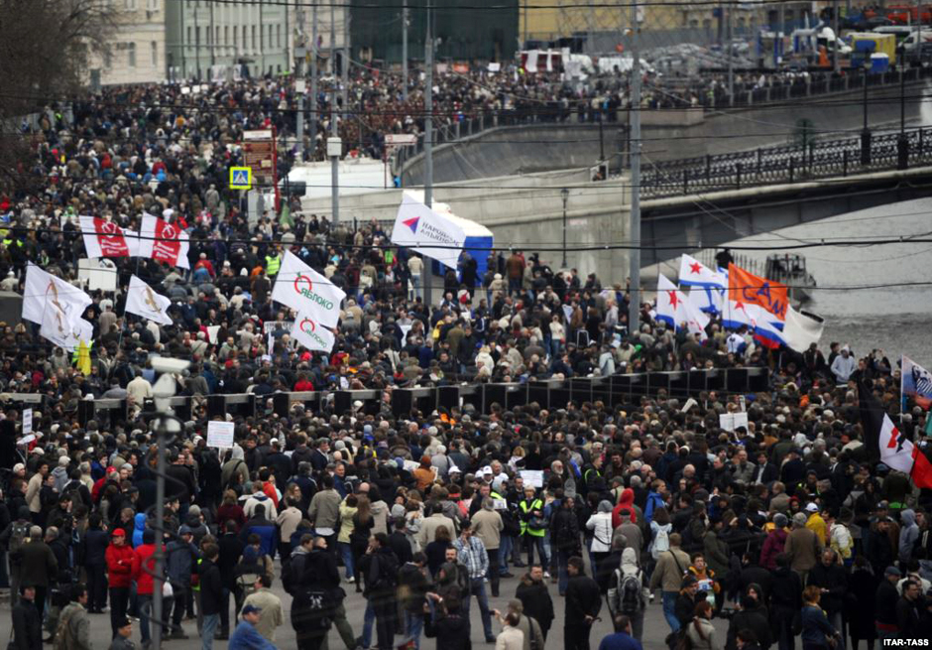
Lessons from Russia: Hybrid Authoritarian Media System
Prof. Dmitrii Gavra
St-Petersburg State University

Slide 2
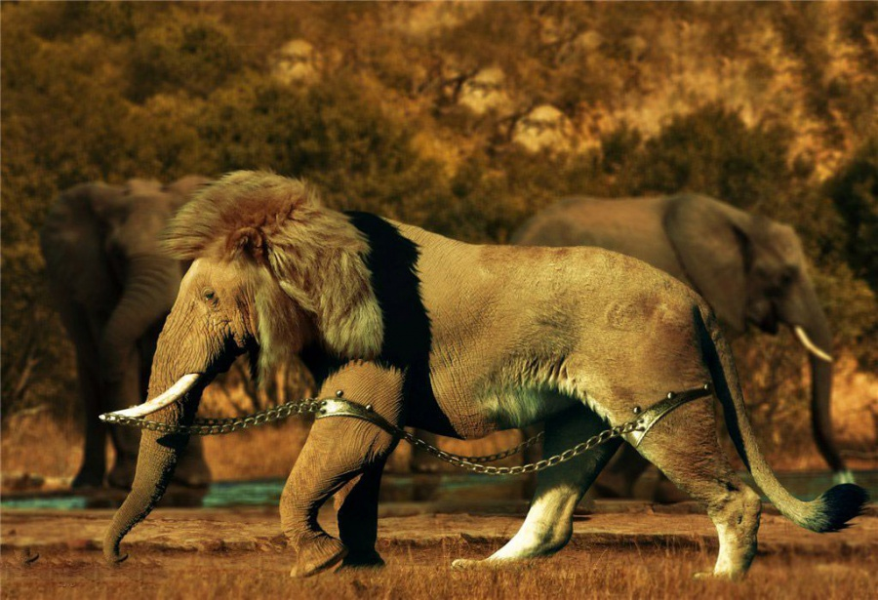
Prerequisites and Diagnosis
Prerequisite: Authoritarian tradition
Value and ideological basis: The Moscow Consensus Value System
Diagnosis: Hybrid Authoritarian Media System

Slide 3
Authoritarian tradition
To understand the core of Russian life and, consequently, Russian journalism, it is worth taking into account an authoritarian tradition which has been an essential part of the political powers and simultaneously stamina for the media development.

Slide 4
Authoritarian tradition and authoritarian innovation
Authoritarian tradition was strengthened during the communist period, and the new democratic evolution in relations between the state and the media started only in the late 1980s before the dissolution of the USSR.
The New Cold War after 2011 mass protests against electoral fraud and 2014 Ukrainian crisis produced evolution of the Russian media system in the authoritarian direction.

Slide 5
Russian Media system in transition
From authoritarian tradition to innovative hybrid authoritarianism

Slide 6
The value basis. Different approaches – the same meaning
In Russia it’s called Sovereign Democracy:
democracy based on the national tradition,
conservative values,
symphony and collaboration between the state and traditional confessions, first of all Orthodox and Muslim
and strict protection of the Russian political space from the foreign interference.

Slide 7
The value basis. Different approaches – the same meaning
Western political scholars name this model – Neo-Authoritarianism or Contested Authoritarianism
Some theorists still are discussing modern Russia in terms of Post-Soviet model, stressing the reincarnation of the Soviet ideological, political and imperial heritage.

Slide 8
My version- Hybrid Authoritarianism

Slide 9
The value basis.
The concept of the so-called “Moscow consensus” for the post-communist states developed by David Lewis http:/opendemocracy.net-The%20Moscow%20Consensus%20Constructing%20autocracy%20in%20post-Soviet%20Eurasia.pdf)

Slide 10
Moscow consensus (Lewis+Gavra)
The “Moscow Consensus” is a term referring to the way how post-Soviet political regimes manage to survive in the globalizing modern world with WWW and internalization of communicative flows.
Why “Moscow Consensus”?
Because is regarded as a model of the political system design silently accepted by the majority of Post-Soviet countries now being in the field of the Russian influence or in zone of the Russian regional or sub regional leadership.
I mean Belorussia, Kazakhstan, and Central Asian States.
What about China? To think about.

Slide 11
Moscow consensus basic assumptions-1
a view of political order that is essentially Hobbesian, promoting a strong state and hierarchical political elite as a bulwark against chaos, and subordinating all other actors to the political regime;
a visible and often populist leader;
existence of legal political opposition, state controlled circulation of oppositional political narratives;
managed civil society;
soft governmental control of media and information without direct censorship, allowed areas of systemic criticism and oppositional opinions expression;

Slide 12
Moscow consensus basic assumptions-2
a profound suspicion of western influence, combined with a constant search for international respect, status and acceptance;
strong influence of intelligence and security services in the political and informational spaces;
a view – shared with Machiavelli – of the masses, as “ungrateful, fickle, false, cowardly, covetous”, prone to manipulation by western intelligence agencies or unscrupulous opposition leaders;
the active use of new technology, Web 2.0., social networks and PR to produce their own legitimizing narratives, the management and construction of civil society in ways that support the political status quo.

Slide 13
Communicative or hybrid authoritarianism
My idea is to name this kind of political regimes “communicative authoritarianism or the “hybrid authoritarianism”. Why hybrid?
Because it combines two competing models with domination of authoritarian control

Slide 14
Let us welcome the concept of the Hybrid Authoritarian Media System (HAMS)
It is not close to Soviet or even Post-Soviet.
It is neither totalitarian nor pure authoritarian like it was in the XX century.
It’s flexible and innovative.
And it means in terms of classical “4 theories of the press” by Siebert, Schramm and Peterson that in Russia we have an example of some new model

Slide 15
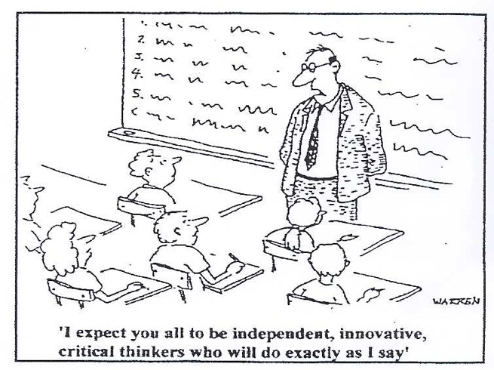
Hybrid Authoritariam Media System

Slide 16
Concept of the Hybrid Authoritarian Media System (HAMS)
Hybrid Authoritarian Media systems appear within more or less soft authoritarian political regime
on the stage of media hybridization and interference of the traditional and new media based on Web 2.0 and later platforms with the increased role of the User Generated Content.
HAMS becomes impossible when political regime turns into totalitarian.
In any case Hybrid Authoritarian Media system is closer to Non-Democratic media systems.

Slide 17
Concept of the Hybrid Authoritarian Media System (HAMS): Exchange Concept
Hybrid Authoritarian Media systems is an important component of the communicative strategy of innovative authoritarian political regime.
Here some kind of exchange is realized.
The allowance of reasonable amounts of openness and contestation are exchanged on greater legitimacy both domestically and internationally.

Slide 18
Concept of the Hybrid Authoritarian Media System (HAMS)
For HAMS autocrats” the mass media is the most important tool in controlling the capacity of citizens to make informed choices.

Slide 19
HAMS: The word has changed. Authoritarianism as well
Political elite recognize that in today’s globalised world they cannot, without great cost, seal their citizens off from alternative messages, as did totalitarian and authoritarian leaders of old.

Slide 20
HAMS: Reasons for Russia
Reasons – many
Cold War 2.0
War on terrorism
Cyberterrorism
Anglobalisation and Cocacolonisation
Colour revolutions
Most important – negative Ukrainian experience (EUROMAIDAN)
Information warfare along axis Ukraine – Crimea - sanctions

Slide 21
HAMS: WHY HYBRID?
Hybrid Authoritarian Media systems assert a rhetorical commitment to a free press, thus giving for the media some free space within limited areas.
Censorship as classical totalitarian institution exits no more.
The mechanisms for controlling media are soft and more invisible than in Soviet or traditional authoritarian systems.

Slide 22
Russian media system: current situation
Discussing Russia’s political system, most researchers agree that the government maintains tight control over politics and economics, and to a lesser extent over critical aspects of the media and society.
As Jonathan Becker writes, the center of power asserts control over the most popular forms of communication, usually television, while allowing relative autonomy in media that have a more limited reach and impact.

Slide 23
Control over media: hybrid (Becker + Gavra)
State control over the media system is hybrid.
Federal TV is tightly controlled by the Kremlin and is an important tool of political control.
However, other media are given more independence and freedom, to write and report on what they wish.
The state has held up the number of independent newspapers, radio stations, and Web-native outlets as proof that the Government does not control the media, and that even if it wanted to, it could not do so.

Slide 24
HAMS: islands of freedom in the ocean of control
There exist windows of pluralism, privately owned channels, offering criticism of leaders and their policies.
There exist opposing print media or radio, or at least publications of both right and left wings that are independently owned, relatively autonomous, accessible to the population, and highly critical of the regime.

Slide 25
From theory to practice: OWNERSHIP
One of the key trends in Russian media ownership since the 2000s has been a transformation of media ownership from commercial capital to state and mixed (state and private, non-media) capital. (Elena Vartanova. July 2012. )

Slide 26
From theoretical model to Russian practice 2014-2016
Under Russia’s law on mass media amended in autumn 2014, foreign owners are restricted to 20% of shares in media organisations in the country.
The law has triggered major changes in the Russian media market and was used to replace international investors with locals loyal to the Kremlin.

Slide 27
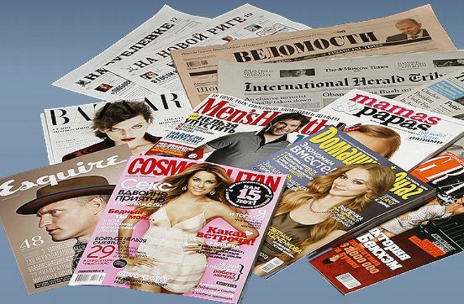
Farewell to foreign media ownership
The Russian edition of Forbes magazine, formerly owned by Axel Springer and known for its independent editorial policy, was sold to businessman Alexey Fedotov.
Finland’s Sonoma Independent Media, America’s Dow Jones and the UK’s Pearson also had to sell their shares in Vedomosti, the main business newspaper known for its critical opinion pieces.

Slide 28
Mass media law amendments Dec. 2015
In December 2015, another bill with new amendments to the “law about mass media”
It contains more limitations for media organisations.
The bill suggests new legal background — violation of anti-extremism legislation — for denying or revoking distribution permit for foreign publishers.

Slide 29
Foreign funding under control
Another bill requires Russian media organisations to inform Roskomnadzor (The Federal Service for Supervision in Mass Communications) about foreign funding,
including funding from foreign states,
international organisations
and Russian NGOs that were considered “foreign agents”

Slide 30
New restriction for media founders
Another block of amendments suggests that those, who have unspent or unexpunged convictions for crimes against the constitutional order, public security and public safety, can not found a media organisation.
Those crimes – from hooliganism and repeated violation of rules of organizing or holding rallies and demonstrations to espionage and treason.
But the most ambivalent are incitement of hatred and abasement of human dignity (Article 282), public calls for extremism (Article 280) and public calls for infringement of the territorial integrity of Russia (Article 280.1.

Slide 31
Russian media system: Hybrid Web control
Russian government unlike China and Iran does not technically filter the Web, whereas China and Iran have two of the most advanced technical filtering systems in the world.

Slide 32
Russian media system: Hybrid Web control
In 2012, the anti-extremism law was amended to empower Roskomnadzor, the state media and communication watchdog, to launch the United Register of Banned Websites.
The modifications also enabled the agency to add websites that have “extremist content” without judicial approval.
Once a site is added to the list, Russia’s Internet services providers are obliged to block it.

Slide 33
Russian media system: Hybrid Web control
In August 2014, the Russian State Duma adopted a number of amendments to communication legislation.
The so-called “bloggers law” required sites with more than 3,000 visitors a day to register with Roskomnadzor and observe the same rules as much larger media outlets.
Under the amendments, all site owners and social media users are required to disclose their names and email address on their websites.
Moreover, Roskomnadzor received the right to request personal information from all site owners and users.

Slide 34
Russian media system: Hybrid Web control
From 1 January 2016, the “bloggers law” requires all websites and social media platforms to keep all personal data of Russian users on servers within Russian territory.
Failing to do this means Roskomnadzor can block the site or service. Companies can either comply or cease doing business in Russia.

Slide 35
Russian media system: Hybrid Web control
Under the 2015 amendments, pay channels can air advertisements if their share of foreign programming does not exceed 25 percent.
Observers remained concerned that foreign commercial stations could be excluded from the market.

Slide 36
Russian media system: Hybrid Authoritarian even on TV
Television remains largely controlled by the Kremlin: the top five television stations by audience reach (Perviy Kanal, Rossiya 1, NTV, TNT and Pyatiy Kanal) are all controlled by the state or state enterprises.
About 90 percent of the population prefers to get news from television and around 50 percent cite it as the most trusted form of communication.
But! Even on the president-centric television, news and current events programs occasionally have alternative voices, debates and disagreements, and the opposition can even make the occasional appearance.

Slide 37
Lessons : 2016
Russian Hybrid Authoritarian Media System is an important part of the Russian political system in general
Russian HAMS combines tradition and innovation and uses all arsenal of Web technologies
Russian HAMS differs from the Chinese one
Russian HAMS is stable in the short and middle term
Russian Hybrid Authoritarian Media System is a model for a number of post-communist states
It’s difficult to make long-range prognoses for the Russian media system

