Slide 1
Online Journalism in Brazil

Slide 2
20 Years of Online Journalism in Brazil
1995: Jornal do Brasil
Online content
Folha de São Paulo
Real-time

Slide 3
A Big Change: Whatsapp
June of 2013: Newspaper Extra
Introduced the application into the newsroom
Constantly shown on computers
26,000 registered readers– C Class

Slide 4
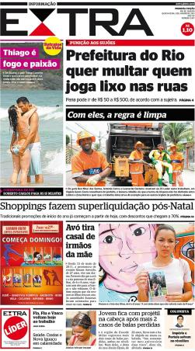
Newspaper Extra
Rio de Janeiro, 1998: 15 years
InfoGlobo
Hyperlocal news
Does not have subscriptions: print and online

Slide 5
Newspaper Extra: Distribution and Audience
Distribution of the printed news: only in Rio de Janeiro
Daily average in 2013: 225,622 copies*
Difference between 2012 and 2013: 7.67%*
Site viewers:
December, 2013: 347,366 single visitors**
*Source: http://www.anj.org.br/maiores-jornais-do-brasil
**Source: https://www.infoglobo.com.br/Anuncie/TabelaAudiencia.aspx

Slide 6
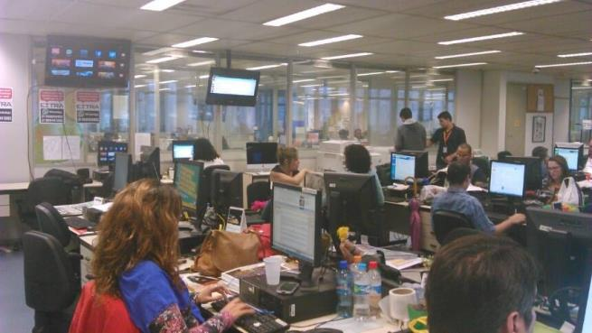
Extra’s Newsroom
Social networks on the screen and Whatsapp on the computer

Slide 7
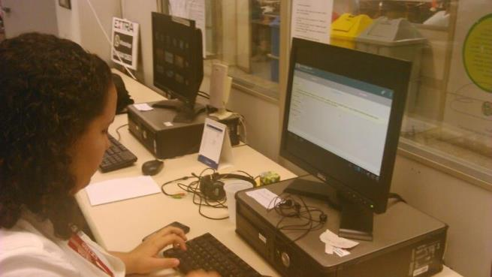
Extra’s Newsroom
Extra journalist using Whatsapp

Slide 8
Advantages of Use of Whatsapp in Journalism
Stable platform
Cheaper than text messaging
User-friendly
‘Hyper proximity’ with the reader
Younger newsroom

Slide 9
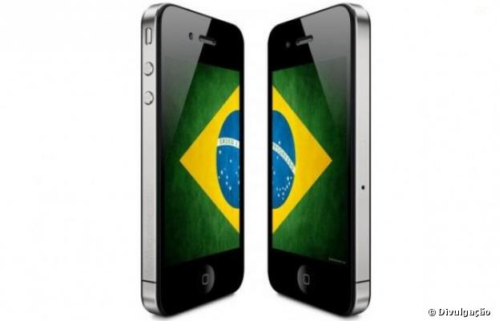
Preference for Whatsapp
90% of population has a cell phone
47% have a computer with internet access

Slide 10
Other Social Networks
PR Newswire Study in 2012 with 305 Brazilian journalists
Most used:
*Source: http://www2.prnewswire.com.br/downloads/paper_pesquisa_portugues.pdf

Slide 11
Twitter
Source of information
Former agenda brought to the editor for publication- Person who listened to the radio constantly to try to find news stories
Distribution of the news

Slide 12
Phases of the Internet in Brazil
Exists simultaneously with three phases
Online press
News tools and little interactivity
Numerous tools and high interactivity

Slide 13
Other Media Outlets
*Source: file:///C:/Users/User/Downloads/PESQUISA%20BRASILEIRA%20MIDIA%202014.pdf

Slide 14
Multitasking Journalist
Joining of the newsrooms:
Press + Online
Increasing roles

Slide 15
Facebook
Great importance
72% of Brazilian population
People from all ages and social classes
Significant daily use

Slide 16
Blogs
Most viable tool
Easy and cheap
Blogs on newspaper sites
Independent Blogs – administered by the journalists themselves

Slide 17
Most Popular Blogs*
1° – Kibe Loco 2° – Mundo das Tribos 3° – Não Salvo 4º – Ah Negao 5° – Não Intendo 6° – Testosterona 7° – Jacaré Banguela 8° – Sedentário e Hiperativo 9° – TecnoBlog 10° – Insoonia 11° – Le Ninja 12° – Bobagento
*Source: Technorati. Views vary from 140,000 to 420,000 per day.

Slide 18
Most Popular Journalist Blogs*
1º - Ricardo Noblat (O Globo) 2º - Reinaldo Azevedo (Veja) 3º - Juca Kfouri (UOL) 4º - Ricardo Boechat (Isto É) 5º - Mirian Leitão (O Globo) 6º - Luis Nassif (O Globo) 7º - Cláudio Humberto (Diário do Poder)
*Views vary from 80,000 to 110,000 per day

Slide 19
Profile of the New Journalist
145,000 journalists in Brazil
Online media outlets: median age of journalists is 25 years old and majority are women
Study that analyzes the available data in Brazil to the global context
Determine the relation between volume and production quality.

Slide 20
Media Journalists
*Source: http://perfildojornalista.ufsc.br/files/2013/04/Perfil-do-jornalista-brasileiro-Sintese.pdf

Slide 21
thank you!

Slide 22
Professor Dr. Raquel Paiva
Associate Professor-Communications Department (ECO)
Federal University of Rio de Janeiro (UFRJ)
CNPq Research Fellow
Coordinator of Laboratory Studies in Communal Communications (LECC)
http://leccufrj.wordpress.com/
www.pos.eco.ufrj.br
raquelpaiv@gmail.com
Skype: raquelpaivasoares

