Slide 1
BRICS and Media
Media Systems in Flux: The Challenge of the BRICS Countries
Project hosted at the University of Tampere
http://uta.fi/cmt/tutkimus/BRICS.html
Funded by the Academy of Finland
Coordinated by Professor emer. Kaarle Nordenstreng
kaarle.nordenstreng@uta.fi

Slide 2
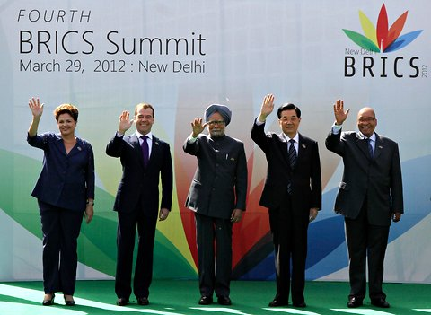
BRICS and Beyond

Slide 3
Percentages of World GDP for Selected Countries
Source: IMF World Economic Outlook Database

Slide 4
2017 Projected GDPs in US$bn at PPPs
Source: IMF World Economic Outlook Database

Slide 5
Top ten Internet users, in millions

Slide 6
Presentations
Jukka Pietiläinen (Tampere, Finland)
Raquel Paiva & Leonardo Custodio (Rio, Brazil)
Dmitry Strovsky (Yekaterinburg, Russia)
B.P. Sanjay (Tamil Nadu, India)
Yuezhi Zhao (Beijing, China & Vancouver, Canada)
Herman Wasserman (Grahamstown, South Africa)

