Slide 1
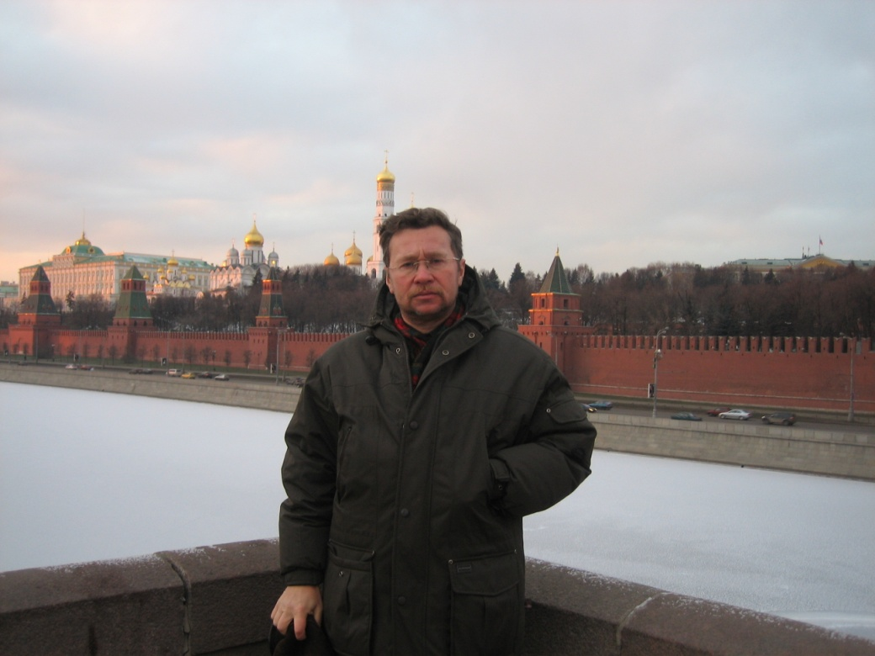
Online media & online journalism in Russia: problems, professionalism & values
Prof. Dmitrii Gavra
St-Petersburg State University

Slide 2
It’s already here
The poll by VCIOM in November 2013 on media preferences:
68 percent of the population used the Internet as a source of information
and 38 percent - as media.
That is, by the popularity of the Internet is starting to catch up with the press,
but no with television, which still remains the principal and as a source of information (74%) and as media (73%)

Slide 3
FAPMC Report on Internet in Russia - 2013

Slide 4
Online media legal definition according to the Russian Federal Law
The definition of online media is legalized by the amendment to the main Federal Media Law in 2011.
“A website in the Internet registered as mass medium in accordance with this law” (Russian Media Law - Zakon o sredstvah massovoi informatsii 2011)
Amendments concerning blogs – from August, 1-st 2014
Blog is regarded as media in case it has 3000 visitors per day
It should registered as media and has got all regulations and duties as media/but not the rights
Recriminalisation of the defamation legislation

Slide 5
Tendencies
Media in Russia has been undergoing major changes,
with limitation of space for independent media outlets like Rain TV struggling for existence
and enforcing government agencies like RIA Novosti being rapidly restructured.
The tendency – state moves in strict media control direction.
Reasons – many
Most important – negative Ukrainian experience (EUROMAIDAN)
Information warfare along axis Ukraine – Crimea - sanctions

Slide 6
Russian media system: current situation
Russia could be regarded as formal electoral democracy, and some argue it represents a new type of hybrid regime that might be called ‘contested authoritarianism.’
However discussing Russia’s political system, most researchers agree that the government maintains tight control over politics and economics, and to a lesser extent over critical aspects of the media and society.
The system is not nearly as restrictive as the Soviet Union, but it is also far from free

Slide 7
Control over media
State control over the media system is mixed.
Federal TV is tightly controlled by the Kremlin and is an important tool of political control.
However, other media are given more independence and freedom, to write and report on what they wish.
Putin has held up the number of independent newspapers, radio stations, and Web-native outlets as proof that the Kremlin does not control the media, and that even if it wanted to, it could not do so.

Slide 8
Russian media system: Web control
Russian government unlike China and Iran does not technically filter the Web, whereas China and Iran have two of the most advanced technical filtering systems in the world.
OpenNet Initiative (ONI) testing confirms that Russia does not engage in ‘first generation’ technical filtering of the Web.
However, ONI argues that Russia instead engage, and may even be a model for, second and third generation controls over the Internet,
marked by attempts to engage and shape the online space through paid bloggers,
influence over major ISPs and Internet companies, and a legal framework that allows it engage in surveillance and control of the Internet, especially during times of heightened political tensions.
In Russia, legal tools include SORM II, which requires ISPs to give the FSB access to any and all content online

Slide 9
Freedom indicators
In terms of freedom of the press (80 points) Russia is among the countries where the press is non-free (Russia: Freedom House 2013).
But, the level of freedom on the Internet, Russia is partly free (52 points of 0-100).
There was not notable political censorship and applications blocked on Web 2.0, but there were arrests of bloggers, limits on content, obstacles to access and violations of user rights (Freedom on Net: Freedom House 2013).

Slide 10
Most influential Russian Internet – Media – March 2014 (Medialogia)
Position (Rating) | Media | Citation index
1 | Lenta.ru | 16 493,16
2 | Gazeta.ru | 13 282,76
3 | Lifenews.ru | 9 707,41
4 | Vesti.ru | 4 547,46
5 | Bfm.ru | 3 550,59
6 | Newsru.com | 3 287,70
7 | Fontanka.ru | 2 703,92
8 | Mignews.com | 1 437,56
9 | Slon.ru | 1 159,42

Slide 11
Trust to the Online media
59%
Trust
Well educated
Live in the capitals
25-34 years old
65%
Distrust
30%
Low level of education
Income more than average
Old age pensioners
67%
47%
67%
36%
38%
37%

Slide 12
Media trust. Real Audience. Dec 2013, VSIOM
Russian TV, newspapers
Internet & Foreign media
Rural population
Low income
Pensioners
Low level of education
Women
Trust
Trust
Capitals, megapolis
Well educated
Young
Distrust
High income
Moscow, St-Petersburg
Males
Distrust
Rural population
pensioners
Low level of education

Slide 13
It becomes powerful, produces political risks
if the credibility of the Internet as a source of information will continue to grow, the elections to the State Duma in year 2016 and 2018 presidential elections will take place in completely new information realities, where the main role will be the Internet (Civil Society Development Foundation 2013: 4).
And government reacts - since May 2012 recriminalized defamation, expanded blacklisting websites, bloggers faced detention and criminal prosecutions.
Government seriously intends to control the media and the Internet, to systematically monitor all information which appears not only in the media but also on forums, blogs and social networks (FARMC 2013: 79-86)

Slide 14
And the Government reacts
As a response, the authorities since May 2012 recriminalized defamation, expanded blacklisting websites, bloggers faced detention and criminal prosecutions.
Government seriously intends to control the media and the Internet, to systematically monitor all information which appears not only in the media but also on forums, blogs and social networks (FARMC 2012: 79-86)
Legal innovations on bloging regulation of April 2014

Slide 15
Sample
Sample (based on Worlds of Journalism Study approach)
24 journalists from 12 traditional media and 24 journalists from 12 new online media (2 journalists per media) in each of four cities (capital, 2nd metropolis, 2 provincial cities) = 48

Slide 16
Localization & Relevance
The capital – Moscow – the global city
Metropolitan city – St-Petersburg
Large city (over 1 000 000) – Ekaterinburg
Middle scale city (more than 100 000) – Petrozavodsk
Different cities – different social structure, different media structures & different media communities
Still – relevant for the Russian urban media communities typology

Slide 17
Basic hypothesis: not Twins, even not Brothers. But Cousins.
BH - Online media journalists differ from traditional media journalists in three dimensions of
Social-demographic parameters
Professionalism and professional values
Political values

Slide 18
What do they think themselves? Is there any difference between online and traditional media journalists?
City | Middle |  | Metropolitan |  | Large |  | Russia general
Media type | Online | Tradit | Online | Tradit | Online | Tradit | New | Tradit
No | 18,2 | 25 | 67 | 50 | 22,2 | 10 | 35,8 | 28,3
Yes | 81,8 | 75 | 33 | 50 | 77,8 | 90 | 64,2 | 71,7

Slide 19
H1 – Confirmed. The difference: self-portrait
Online journalist:
We are younger, around 30.
We are faster in perceptions, response time, in the everyday work.
The internet media is like a news agency: we are available 24/7.
We have long working hours, and there is no border between work and private life.
Our online media often represents multi-platforms combining the internet newspaper, television, radio, news agency and advertising agency.
Owing to this, journalistic work becomes multi-functional that sometimes works against quality - lost depth, no idea, often bloopers.

Slide 20
Distinctions between online and off line journalists
Age and experience (in the new media an overwhelming number of journalists were very young, under 31 representing a new post-2000 generation).
In terms of education both online and off line journalists are highly educated, some of them with two diplomas.

Slide 21
Hypothesis H2: online media journalists – less paid, less professional – not true
In the literature we can find the opinion about online journalism as less professional than offline journalism.
Traditional media are regarded as producing barriers to low qualified bad professionals.
There is a stereotype that solid professionals prefer to work in the professional \understand traditional\ media, whereas weak and non-professionals, come to social media and online media.
Not verified.

Slide 22
Salary: online - better
 | Russia general
Media type | New | Tradit
two & more times less than average | 6,1 | 0
less than average (less than 2 times) | 4,4 | 16,7
about average | 13,3 | 18,9
higher than average (less than 2 times) | 49,3 | 31,1
More than 2 times higher than average | 27,9 | 24,2

Slide 23
What makes professionalism of the journalist? Very close. But…
 | Russia general
Media type | New | Tradit
general culture & education | 20,5 | 10,7
honesty | 15,1 | 22,3
competence, understanding of the subject | 18,6 | 17,4
writing scills | 19,2 | 11,6
independence | 10,3 | 10,6
following ethical standards | 14,2 | 13,8

Slide 24
What brings professional satisfaction? Similar!
 | Russia General
Media Type | New | Trad
High quality of publications | 17,0 | 14,6
Creative activities and self realisation | 31 | 33,8
Feedback from the audience | 24 | 24,6
Ability to influence | 4,4 | 9,9
Respect from the colleagues | 10,4 | 7,8
New impressions | 9,1 | 8,3

Slide 25
Reasons of dissatisfaction. Close.
 | Russia general
Media type | New | Tradit
Low salary | 8,1 | 5,4
Pressure from the owners, state, lack of freedom | 14,2 | 16,6
Bad management bureaucracy | 15,4 | 9,9
Ethical disorders | 3,9 | 0

Slide 26
Attitude to the social media. Unexpected!
 | Russia general
Media type | New | Tradit
Positive | 68,8 | 79,5
Negative | 3 | 0
Ambivalent | 26,8 | 15,3

Slide 27
Discussion: dimension 2 - professionalism
Now we can argue that the leading online media do not differ from the leading mainstream media as far as their professional profile is concerned. Both are run by professional journalists with close understanding of professionalism
Moreover, the journalists interviewed did not see difference between themselves, those working in the new media and those from the traditional media.

Slide 28
The third distinction – political values
Reasonable to suppose that Russian new media journalists
would be more likely to share liberal political values,
that they are more ready to support political protests,
that they are more reluctant about any kinds of censorship and press freedom restrictions,
that they are more integrated with the civil society

Slide 29
Political values of online journalists
Questions:
Do you agree that 'journalists should not cover subjects that play into the hands of our country's enemies?'
What do you think about control of Internet and
Is there a need to control the content of political materials in media?
Your attitude to active political protest.

Slide 30
Q: “Do you agree that 'journalists should not cover subjects that play into the hands of our country's enemies?
Answer | Russia general
Media type | New | Tradit
False question. We have no enemies | 11,7 | 16,8
Yes, journalists should play in their country team | 10,2 | 18,9
No. We should write about everything. | 57,7 | 47,8
Sometimes yes, sometimes no. It depends…. | 19,1 | 14,5

Slide 31
Citations
1. (online media, female, 22 years old, in journalism since 2005) “Today the very term “country’s enemy doesn’t exist. It’ somewhere from 1940-th”.
2. “We have no enemies, but we have particular problems to write about” (online media, female, 24 years old, in journalism since 2008)

Slide 32
Q: “Sometimes banning of the Internet could be useful”
Answer | Russia general
Media type | New | Tradition
Never | 42,1 | 34,8
Ban – no, control - yes | 8,1 | 23,3
Banning only dangerous content – pornography, extremism, etc. | 26,8 | 39,5
Yes in general | 11,3 | 2,7

Slide 33
Citations
“Nobody has the right to tell grown-up citizen what to read and what not to” (on-line media, male, 40 years old, in journalism since 1995)..
“Limitation of the Internet by the state bureaucrats is evil. It’ll bring political censorship and corruption” (online media, male. 22 years old, in journalism since 2008).

Slide 34
Q: “Is there a need to control the content of political materials in media?'
Answer | Russia general
Media type | New | Tradit
No, never | 52,3 | 45,9
Yes | 29,1 | 49,5
Yes, from the state | 1,3 | 17,1
Yes from the civil society | 1,3 | 2,3
Yes from the professional community | 14,1 | 10,7
Self control | 9,3 | 2,3

Slide 35
Your attitude to active political protest
Answer | Russia general
Media type | New | Tradit
positive | 35,3 | 32,8
conventionally positive | 19,9 | 16
negative | 0 | 11,9
conventionally negative | 6,5 | 2

Slide 36
The third dimension – political values. Difference is significant
Russian online media journalists are more integrated with the civil society and protests than the traditional media journalists was also confirmed by the results of the analysis.
In terms of political values online journalists in general are sharing liberal ideas and values of civil society to a greater extent than their colleagues from traditional media.
Representatives of online journalistic community are radically opposing the very idea of the state control of the political media content.

Slide 37
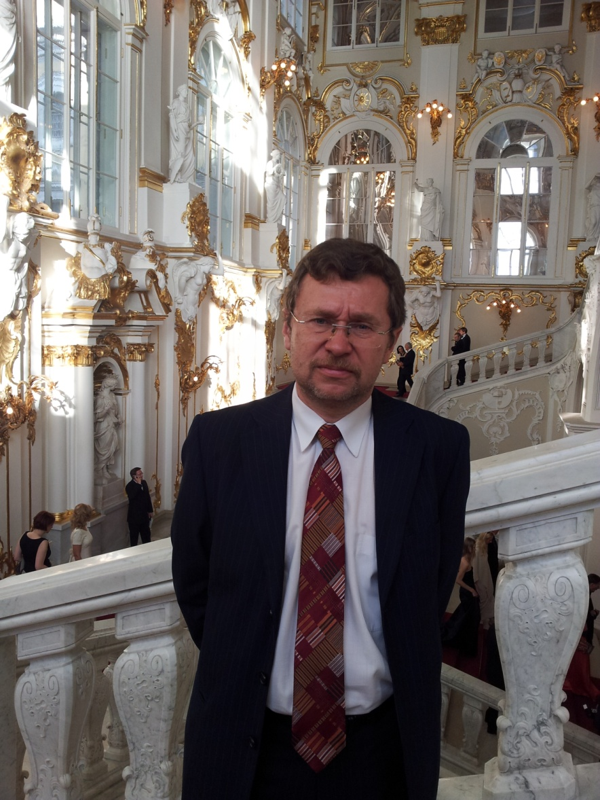
Thank you for your attention!

