Slide 1
Russia in BRICS: Initiator
President Putin’s proposal
September 2006: a series of high-level meetings of BRIC countries in New York City
May 2008: meeting of diplomats in Yekaterinburg
2010 President Medvedev: “Russia would like the cooperation between the BRIC countries to become a major factor of multilateral diplomacy and to make a substantial contribution to promoting the nascent multipolarity and development of collective leadership by the world’s leading countries.”

Slide 3
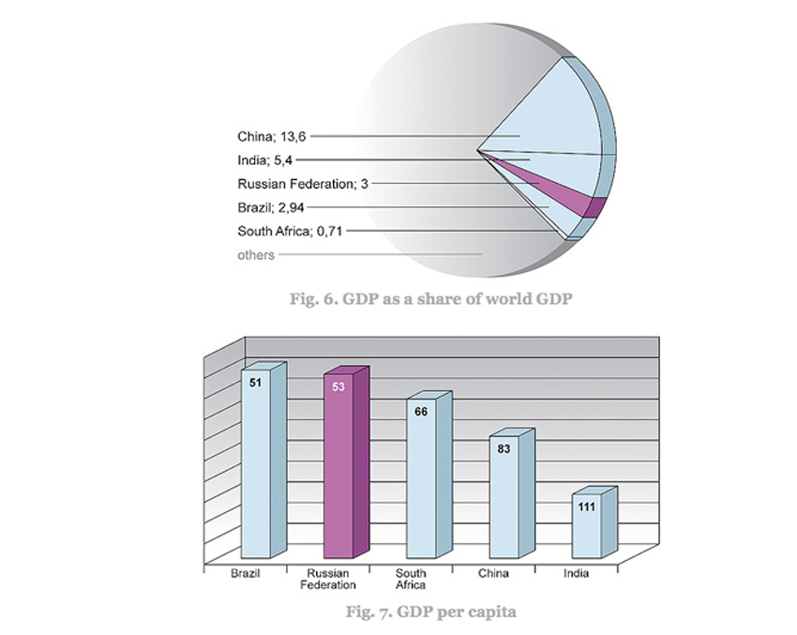

Slide 4
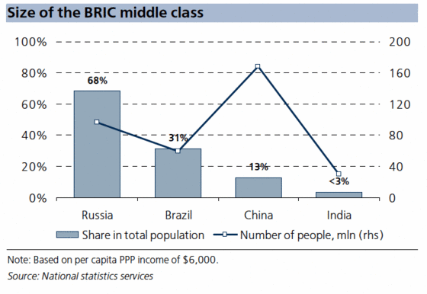
BRIC middle class

Slide 5
Key changes in former communist countries, particularly Russia vs. China (Colin Sparks 2010, http://ijoc.org)
From communist rule to other forms – China not
Institutional continuity in state, education & media – China yes
Personal continuity of elites – China yes
Privatization with theft of state property – China yes but not media
Economic order with corruption & political intervention – China yes
Unclear political outcome – China not: continuation of CP rule but with discontent
In sum, a spectrum ranging from western democracy through authoritarian regimes (Russia) to communist rule (China). Different political solutions – not uniform development suggested by transitology.

Slide 6
Project by the Academy of Finland Media Systems in Flux: The Challenge of the BRICS Countries
1. Theoretical concepts of
a) media system
b) role of media and journalists in democracies
c) freedom and independence of media
2. Empirical mapping of
a) citizen participation in and through media
b) professional orientation of journalists
c) education of journalists
http://uta.fi/cmt/tutkimus/BRICS.html

