Slide 1
Media, Litigation, and Regional Discrimination in College Admission in China
Ran Zhang
Assistant Professor
Peking University
rzhang@gse.pku.edu.cn
June 5, 2012

Slide 2
Context and Background: Gaokao in China

Slide 3
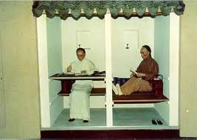
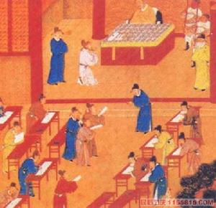
Historically
Rooted in the traditional Imperial Examination (Keju) .
As a major approach of official selection. At the same time, it affords social mobility to test-takers.

Slide 4
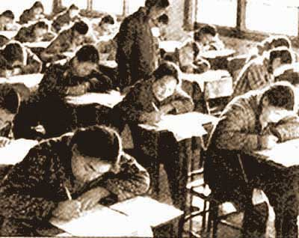
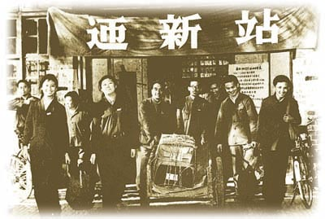
Since 1949
1949: Colleges and Universities decide how to admit students.
1952: National College Admission Examination (Gaokao)
1966: Abolished during the Cultural Revolution.
1977: Resumed after the Cultural Revolution.

Slide 5
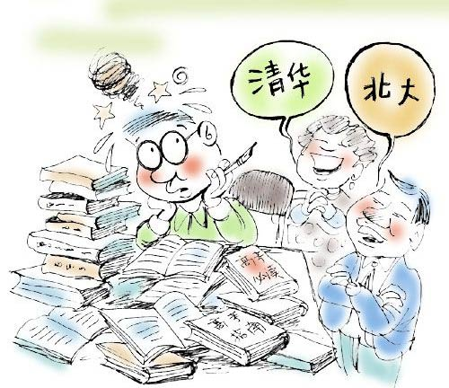
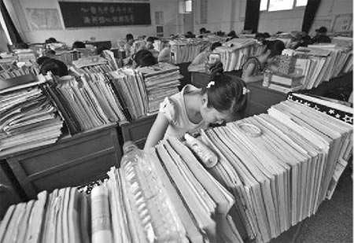
Preparing for Gaokao
Parents’ expectation
A scene of classroom

Slide 6
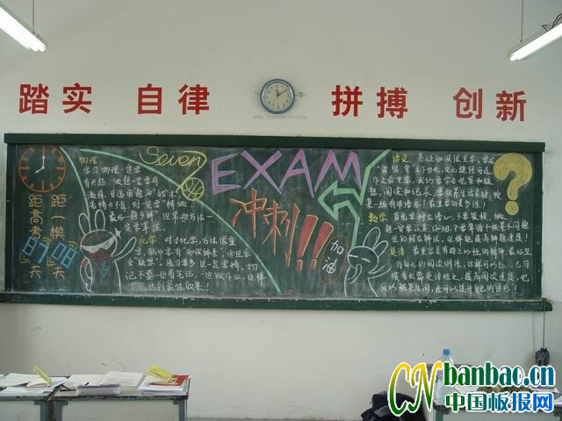
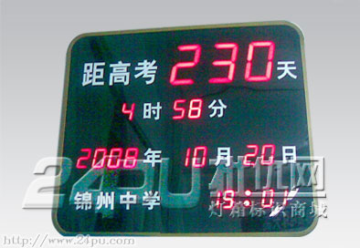
Countdown
on the back of classroom
a product in an online store

Slide 7
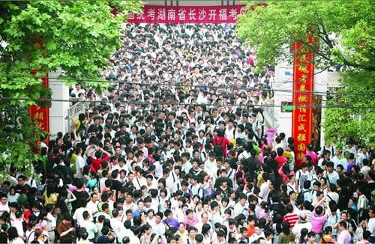
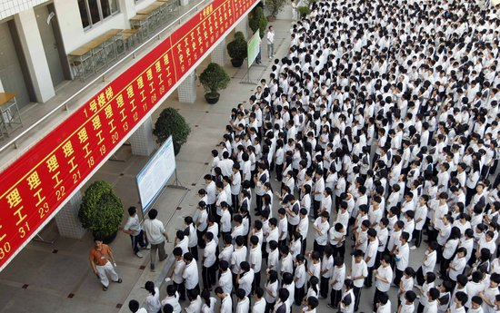
Taking Gaokao
Before the exam
Right after the exam

Slide 8
How Competitive is Gaokao?

Slide 9
Change of Competition Battlefield
Access to higher education is no longer a big deal.
Access to a top-tier university or at least not a bottom-tier institution has become the real battlefield for test-takers.

Slide 10
How is College Admission Operated?
Based on a quota system.
The numbers of students a university can admit from different provinces are approved by the Ministry of Education beforehand every year.
Each province has its own admission cutoff scores, and admission scores of a college are usually different in different provinces.

Slide 11
Media, Litigation, and Regional Discrimination in College Admission in China
One Study

Slide 12
Conceptual Perspectives
From “law on the book” to “law in action” (Ewick & Silbey, 1998; Merry, 1990; McCann, 1994; Nielsen, 2000)
The Media and social movements (Gamson, 1993)
Litigation and social movements (Grossman and Sarat, 1981; Scheingold, 2004)

Slide 13
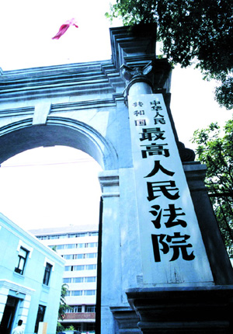
The Qingdao Case
In 2001, three high school graduates from Qingdao filed a lawsuit against the Ministry of Education at the Supreme People’s Court for regional discrimination.

Slide 14
Facts
The three plaintiffs scored 522 (science track), 506 (humanity track), and 457 (humanity track) in that year’s Gaokao.
If they had been residents in Beijing, they would have had a chance to be admitted to a first-tier college, since their scores surpassed the minimum line for the admission into first-tier colleges in Beijing.
However, it was just because that they were born and took the test in Shandong, they were not accepted to any general higher education institutions.

Slide 15
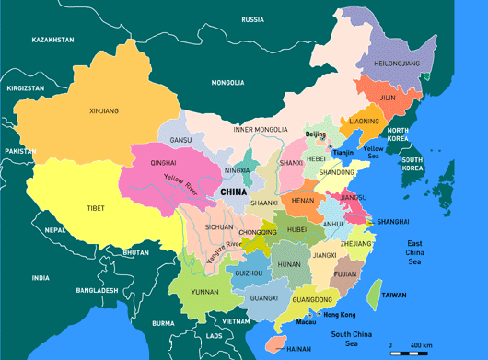
Shandong Province
Illustrious education tradition
  Home Province of Confucius
With a population of 90 million
  The second largest in China
→ A large number of high performing students competing for a limited number of college seats

Slide 16
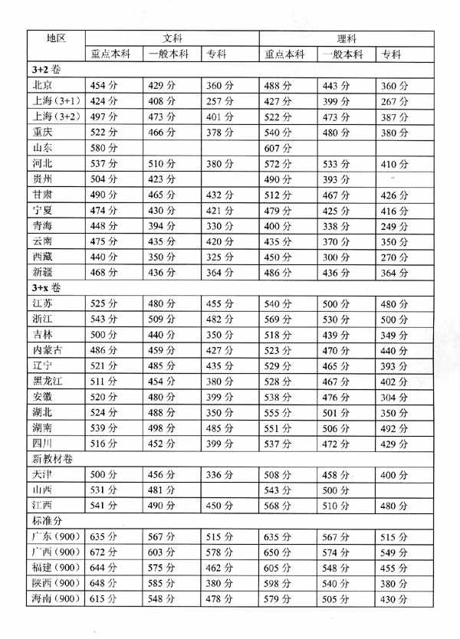
Cutoff Admission Scores across Provinces, 1991
Cutoff Scores for top-tier universities in Beijing:
  Science Track: 488
  Humanity Track: 454
The three plaintiffs in Shandong Province:
  Science Track: 522
  Humanity Track: 506、457

Slide 17
Students’ Claims
They asked the Supreme People’s Court to
  rule that the national enrollment plan of 2001 issued by the Ministry of Education was illegal,
  order the Ministry of Education to take remedial action and make compensation to the plaintiffs, and
  send a judicial letter to the Ministry of Education and the State Council with a recommendation that such discriminatory action be avoided in the future.
→ In these three claims, the three students not only addressed private grievances but also expressed a call for system change.

Slide 18
A legal analysis of the Equal Protection Claims

Slide 19
Right to Education
Constitution (1982):
  Article 46. Citizens of the People's Republic of China have the duty as well as the right to receive education.
Education Law (1995)
  Article 9: Citizens of the People's Republic of China shall have the right and duty to be educated.

Slide 20
Equal Protection
Constitution (1982)
  Article 33 All citizens of the People's Republic of China are equal before the law.
Education Law (1995)
  Article 36 Education receivers shall enjoy equal rights in going to school, entering higher school, employment and etc.

Slide 21
Higher Education Law (1998)
Article 9
  Citizens have the right to higher education according to law.
  The state adopts measures to assist students of minority nationalities and students with financial difficulties to receive higher education.
  Institutions of higher learning must admit disabled students who meet the admission standards set by the state and must not refuse to admit them for their disabilities.

Slide 22
Roles of the media

Slide 23
The Role of the Media: Before the Case
“Incubator” for the lawsuit
  Heated public discourse on the regional disparity in college admission scores had blossomed in the media (i.e.,Liu Jian, 2001; n/a, 2001a; Pan Hongqi, 2001; Yang Zengxian, 2001).
  A “controversy” over disparate admission cutoff scores was already full-blown (Cao Yonggang, 2001).
  The explicit call for “fairness” and “justice” in the discourse gives the future dispute a competitive normative edge.
The media set up a stage for the climactic drama to unfold.

Slide 24
The Role of the Media: During the Case
Ally and witness
  The media worked side by side with the student plaintiffs and their lawyers as an ally.
    Some day or next-day report: writing the complaint, arriving in Beijing, and filing the lawsuit.
    In a sympathetic tone
The media was not just tracing a piece of news after it happened. Rather, the media was awaiting and witnessing an event take place.

Slide 25
The Role of the Media: at the End of the Case
On September 3, 2011, a judge from the Supreme People’s Court phoned the plaintiffs and informed them that the Court would not hear their case because of inappropriate jurisdiction (Hu Yinbin, 2001).
  The judge cited Article 14 of the Administrative Litigation Law (1989), which stipulates that an administrative lawsuit against a ministry shall be first filed to an intermediate court.
  Yet, Article 16 of provides the Supreme People’s Court with direct jurisdiction over “significant and complicated cases in the whole country.” → A challenge to the state college admission system could be significant enough to constitute such an instance.

Slide 26
The Role of the Media: at the End of the Case
Students’ Action
  The three plaintiffs neither challenged the Supreme People’s Court’s refusal nor continued pursuing their litigation as instructed by the First Intermediate Court of Beijing.
  Instead, they announced a high-profiled withdrawal in the media.

Slide 27
The Role of the Media: at the End of the Case
As their lawyers told the media, the students and their parents believed “the successful launching of this litigation was itself a victory.”
To them, the “extremely intensive” societal concern over this litigation had spread their call for equal educational opportunity.
In addition, words had been heard that the Ministry of Education was considering reform of the system. In other words, their “goals for the litigation” had already been accomplished (Hu Yinbin, 2001).
→ They have won the case in the terrain of public opinions in spite of their legal failure.

Slide 28
Analysis
These announcements show, the students and their parents did not really place too much hope on the direct redressing power of litigation. In fact, litigation was like a “gesture.” It was used to signal citizen concern and rally public support.
The real terrain of this act was indeed public opinion as mediated by the media rather than the courtroom. The media was not just a stage for the drama, but part of the drama and even the core of the drama.
When the litigation receded from the drama, the issue remained volatile and the public opinion drama continued unfolding…

Slide 29
Aftermath

Slide 30
Responses from the MoE
An official response: At the end of 2001, Education Daily (the state official education newspaper )published an article authored by the head of the student affairs department of the MoE.
  The article acknowledged the problem but attributed it mainly to different level of development across regions.
  No similar published work report existing for the years before or after 2001.
Policy adjustment: the 2002 college admission policy
  included “regional distribution” as one factor to be considered in the drafting of the annual enrollment plan;
  encouraged colleges and universities to assign more quotas to provinces with large and high-quality student populations but with few higher education institutions; and
  allowed universities to reserve a block of enrollment to be used for adjusting regional disparity in the admission process.

Slide 31
Responses from Universities
China University of Politics and Law
  “The China University of Politics and Law is not a political science and law university for Beijing but rather a political science and law college for the whole of China!” declared Xu Xianming, the President of the China University of Politics and Law and also a National People’s Congress delegate in March 2006.
  In that year, the university used the total population number as the base criterion in assigning admission quotas to each province. As a result, the admission quotas for highly populated provinces such as Shandong, Henan, and Sichuan reached and exceeded 100 for the first time, while the quota for Beijing dropped by 13.51 percent.
In the media, the China University of Politics and Law is portrayed as a pioneer in rectifying regional discrimination, reinforcing the righteousness tone of the cause.

Slide 32
Public Opinions and Public Participation
Sustained public concern:
  As an unfading topic in media coverage
  In an online survey conducted in March 2009, about three quarters of participants believed that the existing college admission system was not fair.
  A college student’s online post triggered legislative bills at both the National People’s Congress (NPC) and the Chinese People's Political Consultative Conference (CPPCC).
    In the student’s word, “no matter what the final outcome is, it is at least something that reflects public opinions (minyi). The act itself is very significant already”.

Slide 33
Responses from the Academic Circle
Before the launching of the Qingdao case, the plaintiffs’ lawyers sought advice from Jiang Ping, a widely and highly respected senior legal scholar in China. Jiang espoused the litigation and regarded it as a test case of constitutional lawsuit in China.
In 2009, Peking University Constitutional and Administrative Law Center released a report on college admission testing system.
  The report deemed the existing college admission system “violating constitutional principle and depriving (citizens) of equal opportunities.”
  The report also reviewed college admission systems of other countries (i.e., Britain, U.S., Australia, Japan, India, and etc.) and discussed their potential implications for China.

Slide 34
Responses from the Academic Circle
Around the time of two national legislative conventions of 2010, twenty legal scholars, lawyers, and NGO leaders signed an Open Letter, calling for equal opportunity in higher education.
  The letter was directly addressed to Prime Minister Wen Jiabao and Minister of Education Yuan Guiren, and it was submitted in the official feedback solicitation process with regard to the draft of National Long-term Educational Reform and Development Program (2010-2020).
At the institutional level, eleven professors at Peking University wrote a letter to the university president in November 2010, asking the university to take the lead in going beyond the test scores driven evaluation criterion in admission.

Slide 35
Conclusions

Slide 36
Conclusions
QINGDAO CASE AS SOCIAL MOVEMENT
The Qingdao case constituted one of the few groups of lawsuits in China that carried an explicit social reform agenda, combining what Grossman and Sarat called “remedy-seeking” and “reform-oriented” participation in the judicial process.
  Their individual grievances presented a vivid and even somewhat shocking instance of the victimization of students through the college admission system.
  They were presented to the judges as well as to the general public.
  Transcending their own individual rights and interests, they sent out the message of citizens’ pressing for system reform.

Slide 37
Conclusions
SOCIAL MOVEMENT AND LITIGATION
Grossman and Sarat (1981) have suggested reform-minded litigation was most effective when it stopped before it reached the limit of law. Litigation can become a battlefield of narrowly defined legal language, and it creates two defensive actors rather than a constructive process to find meaningful solutions for social problems. In these situations, lawsuits are impoverishing (Scheingold, 2004)
In this sense, students’ termination of litigation in the Qingdao case was done to a turn. Students stopped when they have successfully created an atmosphere conducive to the cause.

Slide 38
Conclusions
THE ROLE OF MEDIA IN SOCIAL MOVEMENT
Winning the battle in public opinion can be more crucial for achieving social reform goals than gains and losses in a particular lawsuit. Through side-by-side media coverage, the Qingdao case successfully triggered intensive public attention and concern on the issue.
In the meanwhile, the media helped to escalate the issue from a grievance of three high school graduates to a national movement, to legitimate the movement, and to mobilize support for the movement from various sectors from Chinese societies.

Slide 39
Conclusions
LITIGATION, MEDIA, AND SOCIAL MOVEMENT
The legal drama of the Qingdao case came to a close when it struck its most powerful beat, and the public opinion drama kept unfolding.
The litigation and the public opinion “induced” the administrative agency to address citizen claims, at least rhetorically. It also triggered educational institutions to take high-profile voluntary corrective action, which sent the public opinion drama to another climax.
In the years following the initial litigation, the issue of regional discrimination in college admission has kept burning in the media and sparked the discourse of the national legislature.
The public opinion drama over college admission is still ongoing.

Slide 40

Thank you!
Ran Zhang
Assistant Professor
Peking University
rzhang@gse.pku.edu.cn

Slide 41
Other Equal Protection Issues
Test takers no longer have to be “unmarried” and “below 25 years old.”
More individuals with disabilities are eligible to take Gaokao (physical eligibility requirements). 1985 → 2003
Students in vocational high schools now can also take Gaokao.
Proposal to set aside certain quota for rural students?
In 2010, Hepatitis B Virus (HBV) carries further won a long-lasting battle, as unauthorized HBV testing in school admission is banned → another story of media, litigation, and admission discrimination.

Slide 42
A quick review of Gaokao

Slide 43

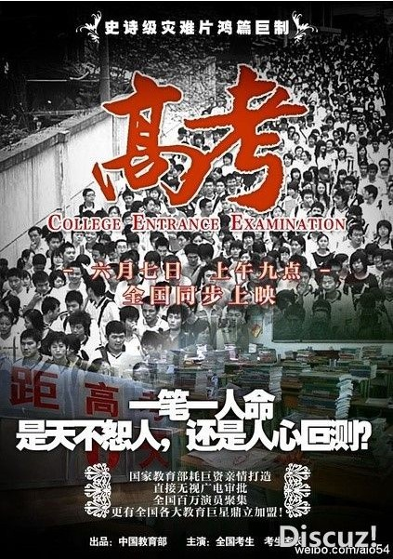
Importance of CEE
CEE
★ Chinese people believe that, they can change their life by CEE.
★The youth can get away from rural area to urban area through CEE,in which circumstance would be much better.
★ CEE is a fair chance to every senior school students.
Problems
Although CEE has many advantages, it also has disadvantages meanwhile.

Slide 44
The Cruelty of Gaokao
CEE
Proportion is low
Single standard
Too much time
Although the admission rate was high，the proportion of students that would have chance to enter the top universities such as Peking University was extremely low.
College entrance examination scores are the sole criterion for admission，and the examination may define the rest of student`s life.
Before take the exam, students always spend a quantity of time on preparing.

Slide 45
The problems of Gaokao
CEE
So many subjects
Regional difference
Unfair
Exam-oriented
The exam contains lots of subjects, including 3 essential subjects, such as Chinese, Math, English. And there are also elective courses, which include maxima 6 subjects.
Because of the different regional economic development levels, there is a huge difference in different regions in education.
It is unfair that students must take the exam in their own province because of the Chinese registration system.
Students pay more attention to reciting the standard answers of questions in the paper. So there’s a lack of creativity for most Chinese students.

Slide 46
Recent direction in gaokao reform

Slide 47
Reforms of the Gaokao System Itself
“3 Plus” Gaokao plan
More autonomy for colleges and universities
  “Admission Office” now plays a supervising role
Twice a year in some provinces, i.e. Shandong
Independent recruitment
Remove some discriminatory eligibilities requirements

Slide 48
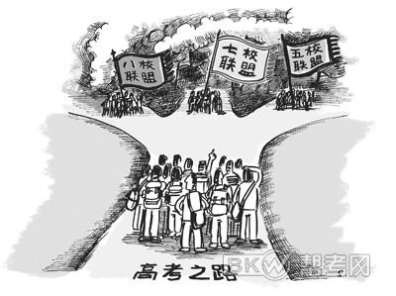
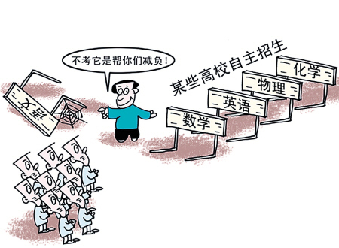
Independent Recruitment
the Independent Recruitment

Slide 49
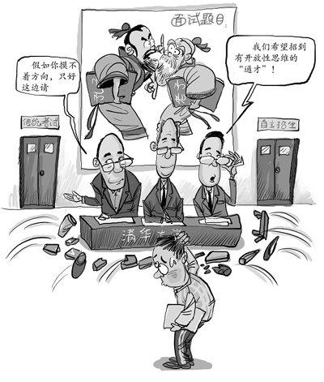
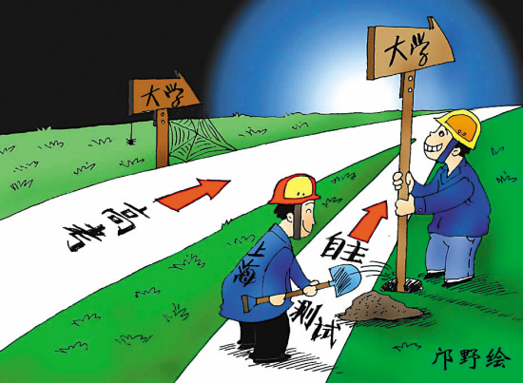
The Concept of Independent Recruitment
Independent Recruitment
What is Independent Recruitment

Slide 50
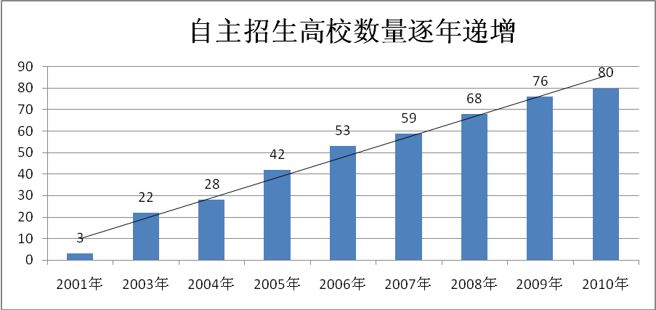
Independent Recruitment
The independent recruitment policies and implementing situation

Slide 51
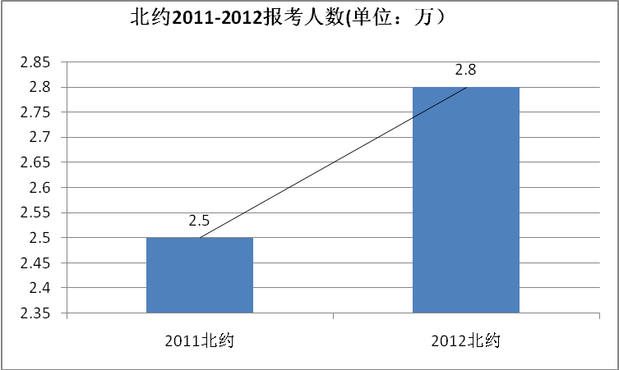
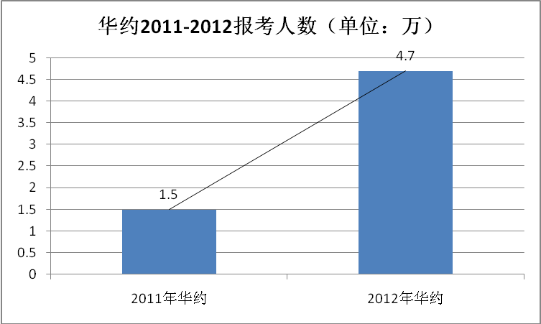
Independent Recruitment
Number of participants of the independent recruitment

Slide 52
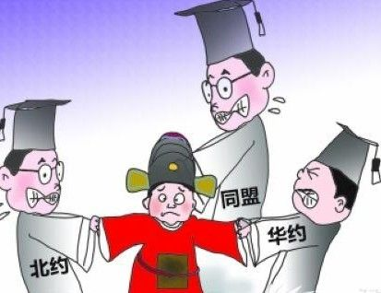
Independent Recruitment
Independent recruitment’s impact on education equity
two main aspects
unequal problems, which are caused by independent recruitment system itself.
unequal problems, which are caused by corruption and the lack of integrity.
Unequal problems will certainly result in public’s doubt in institution autonomy, which will block the reform and development of higher education.

Slide 53
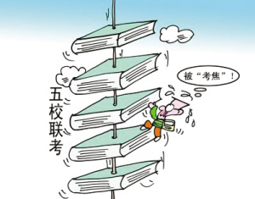
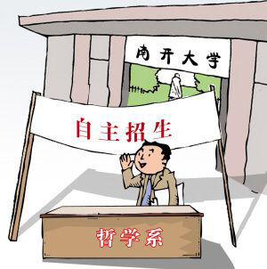
Summary of Independent Recuirtment
Independent Recruitment
Independent recruitment, as an important supplement of the college entrance examination, is a remarkable tendency in reforming the admission systems of higher education．It plays an important role in enhancing institutional autonomy and promoting the quality of students. However, independent recruitment causes problems in implementation, evaluation, supervision and other aspects.

