Slide 1
Chinese education reforms and implication for Finnish education export
CEREC Lecture Series
8 February 2012
Professor: Seppo Hölttä
Adjunct Professor: Yuzhuo Cai
Chinese Education Research & Exchange Centre, HEG
School of Management, University of Tampere

Slide 2
Main topics
Structure of Chinese education system
National Higher Education Entrance Examination (gaokao) and its impact on basic education
Reforms in Chinese education
Reform and development plan 2010-2020
Internationalisation of education
Implications for Finland

Slide 3
Structure of Chinese education system

Slide 4
Chinese Education System
Universities or research institutes Doctorate study 3y
Universities or research institutes Master’s study 3y
Universities Bachelor 4y
Vocational Colleges / Polytechnics Dazhuan (Associate Degree) 3y
Senior middle schools 3y
Vocational schools 2-3y
Junior middle schools 3y
Compulsory
Primary schools 6y

Slide 5
Major statistics (MOE, 2010)
Level of education (Excl. adult education ) | Inst. | Teachers | Students
Higher Education | 2 358 | 1 343 127 | 23 856 345
Senior Secondary | 14 058 | 1 518 194 | 24 273 351
Secondary Vocational | 8 735 | 788 434 | 20 193 663
Junior Secondary | 54 823 | 3 523 382 | 52 759 127
Primary Education | 257 410 | 5 617 091 | 99 407 043
Special Education | 1 706 | 39 650 | 425 613

Slide 6
National Higher Education Entrance Examination

Slide 7
gaoka0
The National Higher Education Entrance Examination
Usually taken by students in their last year of senior secondary school
Although no age restriction since 2001
Offered once a year, takes two days
Determine the fate of more than 10 million Chinese students every year

Slide 8
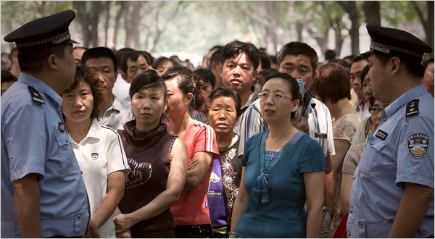
Nervous parents waiting outside

Slide 9
Impact on basic education
Students study very hard already in primary schools
Severe competition for access to better junior secondary schools and senior secondary schools
Students are overloaded
Students are trained for exams but lack of creativity

Slide 10
Chinese tradition in education
“while every individual is affected by the quickening flow of world events, he is still strongly influenced by the way of living and thinking in his own nation and culture” Nakamura (1964, p. 3)
A good scholar can be an official and he who excels in study can follow an official career (a Confucian slogan for education)

Slide 11
Reforms in Chinese education

Slide 12
Education reforms in the P.R.China
1950s Soviet Model
Cultural revolution 1966-1976
1978, the Third Plenary Session of the 11th
Central Committee of the CCP held in December 1978
1985, the First National Education Conference, Decision on Reforming the Education System
1993, the Outline for Education Reform and Development in China
2010, the Outline of National Plan for Medium and Long-term Education Reform and Development (2010-2020)

Slide 13
1993 onward reforms
“It was not until the 1990s, when the Outline for Reform was announced, that major reforms were massively implemented” (Yang, 2000, p. 32)

Slide 14
Key policies after 1993
1993 Teachers’ Law
1995 Education Law
1995 Interim Provisions on Chinese-Foreign Cooperation in Running Schools
1995 The Various Opinions on Deepening Higher Education System
1996 Vocational Education Law
1996 Temporary Provisions for Charging Tuition Fees in Higher Education Institutions
1998 Higher Education Law
1998 Action Plan for Invigorating Education for the 21st century (1998-2002)
1999 Decision on Deepening of Education Reform and Advancement of Qualification–Oriented Education in an all Encompassing Manner
2002 Private Education Law
2003 Regulations on Chinese-foreign Cooperation in Running Schools
2004 Action Plan for Invigorating Education (2003-2007)

Slide 15
Reform Strategies
“to introduce market forces to liberate education, create impetus for change, and encourage competition for improvement”,
“to use legislation to regulate new social relationships, practices and behaviour arising from the first strategy” (Law, 2002: 579).

Slide 16
Dramatic Enrolment Expansion (Unit: 1000 students)

Slide 17
Gross Enrolment Ratios 1978-2007

Slide 18
Privatisation in educational provision
Recognising the fact that the state alone can never meet growing educational needs, the Chinese government has deliberately devolved responsibilities to other non-state sectors to engage in educational provision and development.
Put the governance of private higher education on a more solid legal footing.
By 2008, 640 private universities and colleges (with degree-granting status), enrolment in the sector accounting for 20 % of total higher education enrolment.

Slide 19
Financial diversification
The shift of financial responsibilities from the State to non-state sectors through privatisation of higher education
Further transfer of financial responsibility to individuals and families; by 1997, all university students had to pay tuition fees.
Universities have been encouraged to engage in business and market-like activities to generate more incomes, under the financial constraints aggravated by dramatic enrolment expansion since 1999.

Slide 20
Decentralisation of administration
While the State exercises macro control through legislation, funding and planning, individual institutions are granted much more autonomy and decision-making power in education matters.
Devolution of power gradually from the central government to provincial governments.
Many colleges and universities which had originally been under administration of ministries were either transferred to the Ministry of Education, or the provincial educational authorities.

Slide 21
Numbers of mergers 1990-2005

Slide 22
Building key and world class universities
“211” project, since 1995
In the 21st century, develop approximate 100 key universities with intensive government funding.
112
“985” project, since 5 (May), 1998
To establish a number of first-rank and internationally recognised universities
34

Slide 23
The Outline of National Plan for Medium and Long-term Education Reform and Development (2010-2020)

Slide 24
Problems identified by Education 2020
Concept of education and teaching contents and methodology are relatively outdated.
Schoolwork burdens on primary and middle school students are too heavy.
The promotion of quality education is arrested.
Students are weak in their adaptability to society.
Innovative, practical and versatile professionals are in acute shortage.
Schools lack vitality in their operations.
The structure and geographical distribution of education resources are not balanced (disparity between poor and developed regions, between urban and rural areas).
Financial sources cannot keep up with the increasing education demands.

Slide 25
Why the reform?
To solve all the mentioned problems.
To respond to the needs arising from the transformation labour-intensive economy to knowledge economy/innovation system.
To increase international competitiveness.

Slide 26
Goals
Goal One: Universal education
Goal Two: Equitable education for all
Goal Three: High-quality education
Goal Four: Life-long education system
Goal Five: Dynamic educational system

Slide 27
Major reforms
To increase educational resources up to 4% GDP
To reinforce the support for the poor regions in the middle and west China
To enhance teachers’ training
To give vocational education more priority
To strengthen interactions between (vocational and higher) education and industry
To improve the quality of education, research and service,
To build world-class universities

Slide 28
Major reforms
To support the development of private education
To reform gaokao in the effort to terminate the practice that a single round of examinations decides the destiny of a student, to orient the education towards cultivation of innovative personnel.
To further separate government functions from school management
To promote and upgrade international exchanges and cooperation
To introduce high quality education resources abroad

Slide 29
Internationalisation of higher education

Slide 30
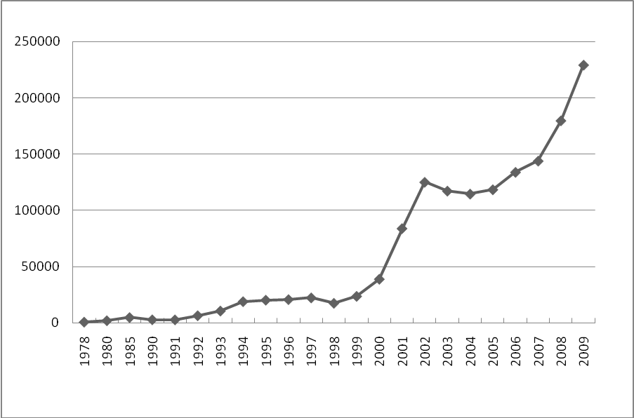
Student mobility (outward)

Slide 31
Top 5 Destinations for Chinese Students studying abroad 2004 – 2006 (UNESCO/OECD )

Slide 32
Students’ planed study destinations (INTO, 2009)

Slide 33
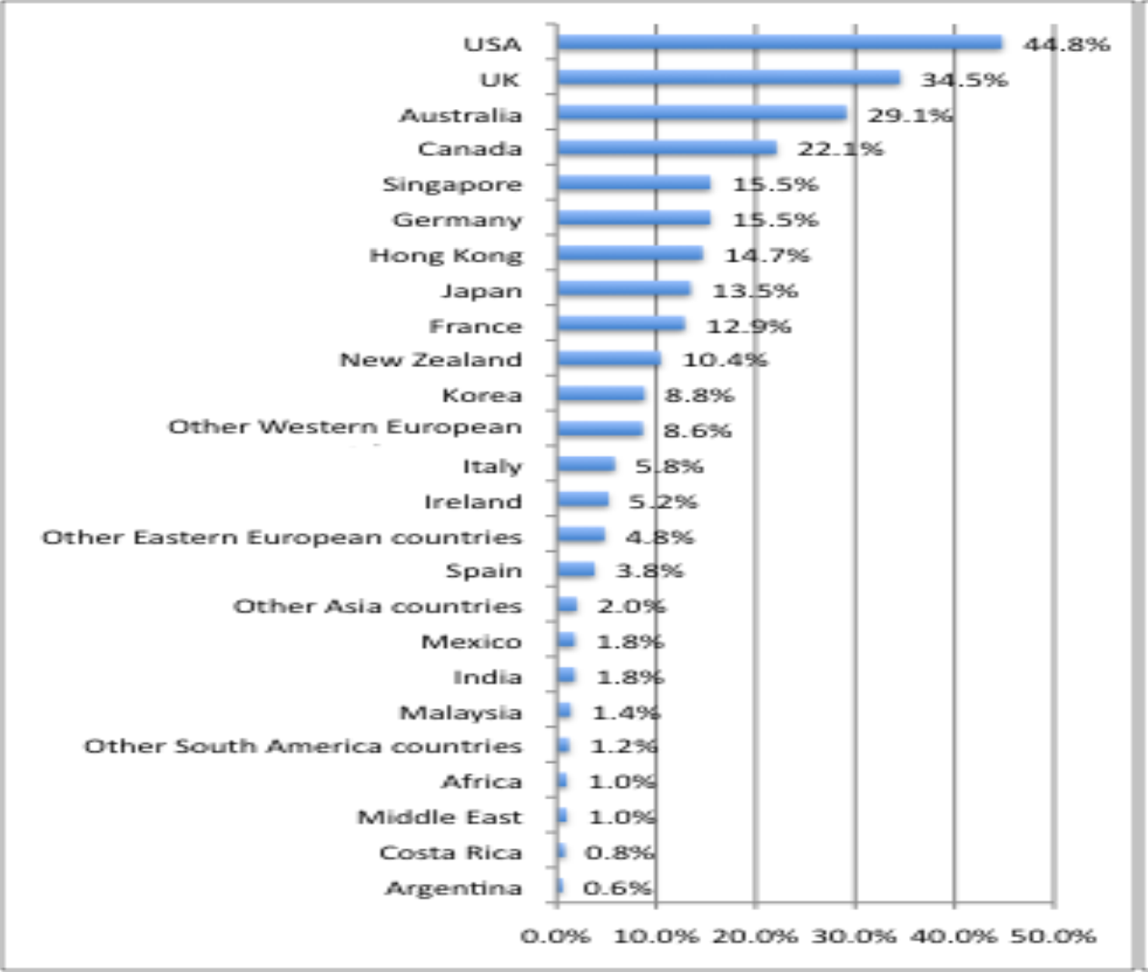

Slide 34
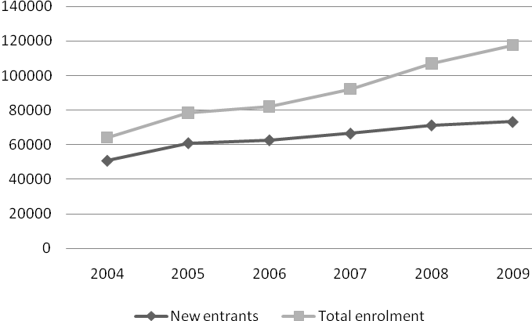
Student mobility (inward)

Slide 35
Entrants of international students in 2009

Slide 36
International research and teaching
English text books
English or bilingual teaching
Programmes leading to international professional qualifications
Participating in international research projects
Opening foreign researchers to Chinese national projects

Slide 37
Sino-Foreign cooperation in running schools
Foreign education institutions can engage in education provision in China in cooperation with local educational institutions
High-quality foreign education resources are expected
Fast growing between 1995-2005
By June 2004, 754 joint programmes in China,
of which 169 are qualified to award overseas degrees hosting 51, 893 students

Slide 38
Countries of origin of overseas partnership institutions

Slide 39
Challenges
Ideological conflicts
Low-quality foreign education resources introduced to China
Unbalanced development
Brain drain
Lack of degree programmes taught in English
Lagging behind legislative and administrative environment

Slide 40
Future tendencies
More highly talented high school graduates go to study abroad
Influx of returned overseas students
New area of Sino-Foreign joint education provision in China
Expansion of Chinese education export

Slide 41
Implications for Finnish education export

Slide 42
A fit between both countries' strategies?
The cooperation between China and Finland can go well only when there is a fit between both countries’ strategies on internationalisation of higher education
How can Finnish strategies reconcile the Chinese expectations?

Slide 43
Finnish objectives and Chinese needs
Finland
Export education
High quality of education
The demand in the targeting market is growing
China
Meeting local educational demands
Improving the quality of skilled labour
Increasing international preparation and competitiveness

Slide 44
Is there a match?
Yes, but only when the Finnish higher education is correctly perceived and appreciated by the Chinese stakeholders

Slide 45
General Challenge to be solved
Information asymmetry between the consumers and producers
Students and other clients use classification or rankings and the general reputation of universities in their decision making.
Existing rankings are based mainly on research output, not on educational quality
Finnish HEIs are not at the top, most of them totally invisible
How to show the quality to potential students and their families?

Slide 46
Need to follow closely relevant policy processes
Education policy
Other sectoral policies, e.g. public administration, innovation policy, industrial development policy
Main instruments
Research
Stakeholder coopeartion

Slide 47
Attractiveness of Finnish higher education to China
Asymmetry between students and universities exists: quality of education or programmes
We need to emphasise also the other education related qualities of Finnish society
Finland is one of the global leaders in developing information society and innovation systems.
Finland has won top positions in a number of international comparisons, such as PISA study, education system and quality of life.
Finland as a traditional welfare state attaches an importance to the balance between education as a public good and as an industry.

Slide 48
Attractiveness of Finnish higher education to China
Finland as country being successively controlled by Sweden and Russia for hundreds of years understands the need of preserving the national tradition and culture.
Finland has the highly developed quality culture in higher education as well as the most advanced quality assurance system in the world.
Finnish government has a strong role in higher education development that is comparable to the Chinese system.
The curricula and training in Finnish higher education has a close link to labour market.
All international programmes in Finnish higher education are taught in English.

Slide 49
Thanks for your attention!
You are welcome with questions!

