Slide 1
The Institutional Logics of Governance in China Xueguang Zhou Stanford University

Slide 2
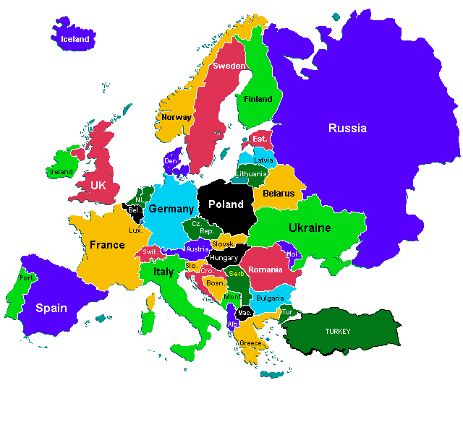
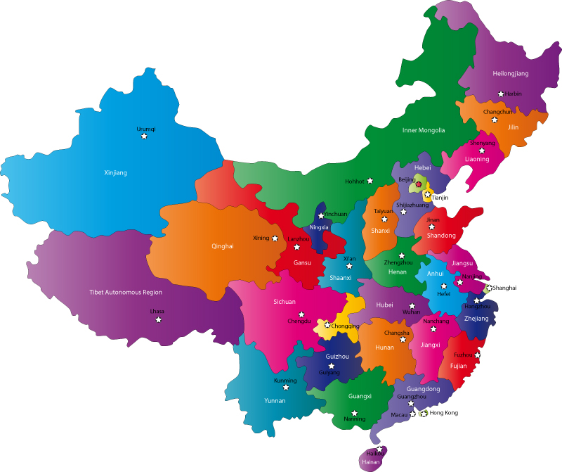
Bureaucratic governance in China
Europe
China
Taiwan

Slide 3
“It was China’s unique destiny to persevere as a civilization long after other ancient civilizations has perished; and this perseverance involved not fossilization but a series of rebirths.”
Philip Kuhn (1980, p. 11)
“Why Europe and the West? Why not China?”
David S. Landes (2003)

Slide 4
Phenomena and Issues
Stagnation or resilience?
Contemporary China:
Macro-level
Centralization-decentralization cycles
Continuous but ineffective political education/propaganda
Frequent political campaigns
Micro-level
Problems in implementation: ineffectiveness and distortion
Flexible adaptation, collusion

Slide 5
Research Issues
These phenomena take place in different areas, different periods, and different localities
But they are stable and recurring
➔ The institutional logics of state governance –
the theme of this presentation

Slide 6
Outline
Develop a theoretical framework to shed light on the connection and underlying logics of these phenomena.
Theme: the tension between the authoritarian state and effective governance is the main challenge of the Chinese state.
These phenomena：
Some reflect the fundamental tension between the two
Some are the response mechanisms resulting from this tension
Some are the unanticipated consequences of these response mechanisms

Slide 7
Four questions
What is the tension between authoritarian state and effective governance?
What are the mechanisms that sustain the authoritarian state?
What are the response mechanisms to address the fundamental tension?
What are the unanticipated consequences of these response mechanisms?

Slide 8
Issue 1: The fundamental tension between the authoritarian state and effective governance

Slide 9
The Fundamental Tension (1)
Authoritarian state
Uniform policy, top-down decisionmaking process
Centralization and redistribution of resources
Control of personnel flow in the Bureaucracy
The ultimate, arbitrary power of the state
Effective governance
The capacity and effectiveness of solving local problems.
Extracting resources
Public goods provision
Resolving local conflicts

Slide 10
The fundamental tension (2)
The authoritarian state: top-down, uniform policy making process
Diverse cultural, economic and social environments across regions and localities
Rural-urban, coastal-inner land, state-owned vs. private
Effective governance requires differential policies and solutions in different localities – allocate decision rights and resources at local level.
But authoritarian state tends to centralize both decision rights and resources.
Tension, inconsistencies, and conflicts between authoritarian state and effectiveness in governance

Slide 11
The strong authoritarian power of the state and the high degree of centralization of the state are at the expense of the effectiveness of governance at the local level. Conversely, the more decentralized the governance structure, the more dispersed resources are allocated, the more effective local governance is, the more likely that it will undermine and weaken the authoritarian state。

Slide 12
Issue 2： What are the bases of the authoritarian state？

Slide 13
Two pillars of the authoritarian state
The Chinese bureaucracy
hierarchies, personnel control, and incentive design
Centralization of decision rights and top-down implementation process
Centralization and redistribution of resources through the bureaucracy
The institution of values and beliefs
Recognition and acceptance of the centralized authority
The Confucian culture: respect for authority, acceptance of hierarchy
Relationship between the two: Complementary, and (under certain conditions) substitution to each other

Slide 14
A “successful” example: Family planning policy
Marks of success:
400 Million few borns in 30 years
Long duration, great scope, considerable strength of enforcement
An organizational analysis：
Hard constraint (fertility rate）
A huge organizational machine (residential areas, villages)
Heightened and sustained mobilization and inspection
Innovative governance: high-pressure institutional design, digital management
Tremendous effort in propaganda and education
The Cost: administrative, attention, and resources

Slide 15
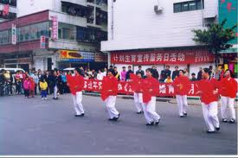
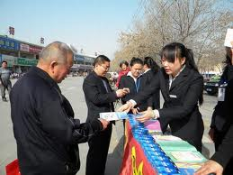
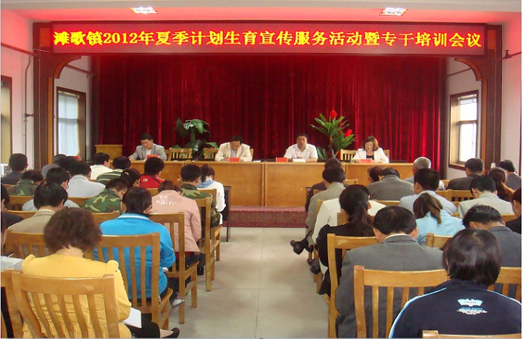
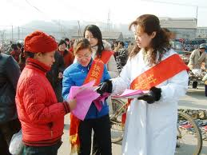

Slide 16
The Crises of the authoritarian state
The limit of bureaucracy：
Bounded rationality
Asymmetric information between the superior and the subordinate
Interest groups
Implementation process: Noise, experience, interests
Gaps between the uniform policies and local variations
Limitated capacities to solve local problems
Crises of values and beliefs：
Confucian culture, official ideology, and modern crises – the cultural revolution
Diversity in beliefs, preferences, and interests

Slide 17
Issue 3： Response mechanisms to the fundamental tension

Slide 18
Response mechanism 1：Uniform policymaking and flexibility in implementation
Uniformity in policy making and symbolic centralization
But permit, encourage, or acquiescence flexibility in local implementation
Administrative subcontracting
Phenomena：
Abstract policy, allowing local government to add specifics
Specific policy, but allow deviations in implementation
Special policy, special zone
Allocation of resources at the local level
This is the “routine” mode of governance in China

Slide 19
The “routine”mode of governance
The state allows local bureaucrats’flexible implementation but discipline their behaviors through incentive design and official ideology.
The top-down policy is the main theme, but different localities are allowed to deviate to some extent and in different directions from the main theme.
In so doing, it makes possible for local bureaucrats to have capacities in effective governance.
In this sense, there is a loose-coupling between central policies and local implementation.
The challenge: How to avoid too much deviation？

Slide 20
Response mechanism 2：Moral (political) education
Governance through morality (official ideology)
Chinese tradition
Continuous political education and propaganda
The failure and crises of official ideology
Mao’s effort to replace Confucian culture with Marxist ideology
Cultural revolution and political campaigns undermine official ideology
The rise of the pluralist society
From weapon of ideological control to symbolic power
Activities in political education becomes a ritual and formality
The importance of rituals in political education
The rituals signal acceptance of the central authority
Collective “consciousness”, and common knowledge

Slide 21
Further issues: Tensions between uniformity in policymaking and flexibility in implementation
What is the boundary of flexibility?
Organizational failures in incentive design
Flexibility vs. deviation/distortion, control vs. loss of control
The danger of flexibility in implementation is that the boundary of flexibility becomes larger and larger, thereby threatening the central authority, leading to crisis in governance.
Therefore, the central authority needs to retain the ultimate power of intervention, the ability to disrupt local governments’actions, and redefine the boundaries of flexibility.

Slide 22
Response mechanism 3：Political campaigns
Arbitrary power of the state: initiate political campaigns to disrupt bureaucratic processes in flexible adaptation.
The distinction between routine power and arbitrary power
Routine power: bureaucratic power in problem solving and carrying out policies within the bureaucratic routines.
Arbitrary power: the higher authority can intervene into local governments’policy processes at any moment, and distrupt the exercise of bureaucratic power.
Features of political campaigns
Arbitrariness in targeting
Not aiming at solving problems (corruption, land seizure)
The goals is to redefine boundary rather than solving problems.

Slide 23
Issue 4: Unanticipated consequences

Slide 24
Political cycles of“Centralization-decentralization”
Starting point: The routine mode of governance：
Symbolic state to allow effective governance
Uniformity in policymaking and flexibility in implementation
“deviations”and loss of control
centralization: political campaigns to retake control
Centralization of resources and decision rights
Local government takes risk-averse attitude
New crises due to the weakening of the effective governance
Decentralization to increase local capacities in
problem solving and effective governance
New policies, new personnel flow
Decentralization of resources
Return to routine mode

Slide 25
Why no other alternatives in Chinese governance？
Why no “legal-rational” authority？
Why no rational bureaucracy？
Why limited professionalization？
The institutional logics of authoritarian state
Mobilizational state vs. the stability of the legal system
The weakening of rationalization of rule-based bureaucracy
The role of arbitrary power in China’s governance

Slide 26
Summary

Slide 27
Final remarks
Both stagnation and resilience
Fundamental tension → crises and dynamics of change based on response mechanisms
The looming crises and China’s future

Slide 28
Thank you！

