Slide 1
Changing Paradigm of Organizational Governance in Chinese Public Universities
Dr.Xiaoguang SHI
Professor of Peking University
2013,Tampere University
contanct email:shixiaoguang@pku.edu.cn

Slide 2
Outline
Background:Changing Chinese Society
University Governance
Challenges and Realities
UGC as Emerging Force in Institutional Structure.

Slide 3
1.Background:
Changing Chinese Society

Slide 4
China as a new emerging country
For the last three decades, China’ rapid growth of economy has created a miracle, it’s becoming the world’s second biggest economy in term of GDP per capita.
As observed by Sir John Bond, former group chairman, HSBC,
“The timing does not matter, but we in the West do need to prepare ourselves, particularly our young people, for a powerful and exciting re-emergence of China on the world scene. The first of the ancient, historic powers [is] to return to glory.
David Smith(2007) The Dragon and the Elephant :China ,India and the New World Order, Gopson Paers Ltd, p.94

Slide 6
1-1.the Change of Economic System:
transfit from the planning economy to market economy, which, as a result, leads to other significant changes of the society.
----the transformation of govermental roles.
The policy making process is more decentralized.
----transformation of Production Modes
With the globalist knowledge economy stepping into China, enterprises have to turn from labor-intensive mode of production into the technology-intensive one.
----the transformation of supply paradigm of labor market from govermental dominance to market force driven
Please see next two slides(changes before and after 1992)

Slide 7

The Old Centrally Planned Economy Model (befroe early 1990s) (quoted from Min's PPT)
--Human Resource developed and
allocated according to the state plan
--Student trained as elements of production
--- HE institutions were segmented and departmentalized
National Economic and Social Development Plan
Manpower Plan
however,the new model geared to market demands
Higher Education Enrollment Plan
Curriculum and Instruction Plan
--Human Resource developed and allocated according to the labor market demand
---policy-making, very much decentralized
---Elimination of segmentation according to labor market demands.
College Graduates Job Assignment Plan
Graduate Entering Workplace

Slide 8
The New Market Oriented Economy Model (after 1990s)
quoted from MIN Weifang (PPT)
expected
benefit from HE
family
income
total
demand
State employment
& Wage policy
LABOR
MARKET
DEMAND
DEMAND FOR HIGH EDUCATION
Wage structure
by education
UNIVERSITES
AND COLLEGES
LABOR
MARKET
SUPPLY
COLLEGE
GRADUATES
state allocation for higher education
Social and industry contribution
MACROECONOMIC
SITUATION AND POLICIES
Notes:
8

Slide 9
---transformation of modes of social life.
Globalization and Western living style influences to the young generation,eg.Coca-Cola is one of the most popular soft drinks. McDonald and Kentucky Fried Chicken are widely spread over China. Nike shoes and fashion blue jeans are new fashion.
---Internet and Opening of Cultural Products Market.
Hollywood movies, Korean pop singers, Japanese cartoons and game software are very popular among youngsters.

Slide 10
1-2.the changes of HEI system
---.HEI system shifting from an elite mode of HEd to a mass one of that.
public sector-- about 2,305 public universities and colleges, including 1,908 regular full-time HEIs,397 part time adult university
---740 ( 4y)
---1,168 (2-3y)
---413 (adult HEIs)
private sector--1,521 new private institutions
297 (3-4y,degree granting institutions),
318 3-4y (independent colleges)
906 (non-degree awarding institutions).

Slide 11
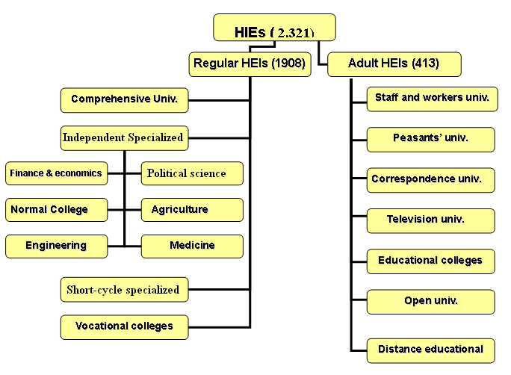
Differentiation by type and nature
2305
1908
397
4

Slide 12

Priority strategy for developing the leading universities
There were 2305 regular Higher Education Institutions in 2009
“211”
“985”
Peking Univ.
Tsinghua Univ.
1090
581
295
107
56
39
9
2
Doctorate-granting universities
Master’s universities
1215
Undergraduate universities
Vocational or professional universities

Slide 13
----transformation from central control to central coordination
Several hundreds of HEIs affiliated to Central govermental agencies,such as MOE, has been transferred to the provincial governments.In the year 1996, 62 central ministries established 366 regular higher education institutions.
In 2006, those managed by the central ministries and commissions amounted to 111, of which 73 were under the supervision of the Ministry of Education, and those at local level to 1,756.

Slide 14
---HE nature shifting from public goods to semi-public goods,or PPP
---Who beneifts , who will pay,no free higher education is provided in China.
---public expenditure is not single resource to finally support the operation of HEIs

Slide 15
The Characteristics of China's Higher Education Financing flow in a mixed economic period()Quoted from Min's PPT

Slide 16
---more institutional autonomy and academic freedom empowered to the HEIs
As per the Law of Higher Education(1998), identities of HEIs are affirmed from a "governmentally affiliated" institutions to independent agencies as legal persons

Slide 17
2.University Governance

Slide 18
2-1.key terms defined
University Governance---
predominantly refers to the internal structure, organization and management of autonomous institutions.The organiztion of internal governance is generally composed of ---a governing board , the university president with a team of administrative chancellors and staff, faculty senates, academic deans, department chairs, and usually some form of organization for student representation.
University governance: a changing conception.....
Kezar and Eckel (2004: 371-398) point out the substance of governance has changed during the last decades with more emphasis put on high stake issues and more incremental decisions made in a less collegial mode.

Slide 19
Dearlove (1997: 56-75) emphasizes that,
under the conditions of mass higher education, no university can avoid the need for some sort of bureaucratic management and organisation, though this does not mean that the importance of informal discipline and profession based authority (internal governance of universities) can totally be ignored.
With debates over the recent trends, university organizations, governing associations, and numerous postsecondary institutions themselves have set forth policy statements on governance.
Without exception, the university governance has been influenced by the international trends

Slide 20
In recent years, the discourse on the University Governance is attracting more attention in the Chinese academic communities as more and more university presidents, administrators and professors/ academics, as well as educationalists seem to be very passionate in exploring issues.

Slide 21
First, the term “the University Governance” (“da xue zhi li” in PinYin) is a relatively new concept in Chinese context.
It was seldom used before the end of 1990s.In other words, people would like to adopt the term “the university administration” (da xue xing zheng) or “the university management”(da xue guang li ) rather than “the university governance”.

Slide 22
Second, replacing University Administration by University Governance is clearly a consequence of influence from the idea of the New Public Managerialism, which represents an international trend of developmental future.
That is one of reasons why I would like to opt the topic for discussion with you today

Slide 23
2-1.key terms defined
University leadership and management
Both "Leadership" and "Management" are important,but different too, as fuctioning differently in university governance procedure.
Leaders---persons who lead the way
Managers--persons who arrange the way

Slide 24
Leadership & Management (Starratt, 2003)
Leadership | Management
Is concerned with growth Is a director Writes a script Based on moral authority Challenges people Has vision Exercises power of shared purpose Defines what is real as what is possible Motivates Inspires Illuminates | Concerned with maintenance Is a stage manager Follows a script Loyalty & bureaucratic authority Keeps people happy Has lists, schedules, budgets Exercises power of sanctions & rewards Defines what is real as what is Controls Fixes Co-ordinates
24
Department of Educational Administration and Policy (http://www.fed.cuhk.edu.hk/eap/)

Slide 25
in Chinese context:
who is playing role of leadership?
who is of management?
why governance is introduced?

Slide 26
2-2.Modes of Leadership in Chinese HEI
A Historical perspective
---the President Responsibility (1950-1958)
---the Limited University Governing Board Responsibility (1958-1960)
---the Amentment of the Limited University Governing Board Responsibility (1961-1966)
---the Exclusive Party Control System (1966-1977)
---the Multi-modes Co-existence System (1978-1998)
---The President Responsibility under Leadership of the Community Party Commision( CPC)or the Mode of CPC led President Responsibility(CPC Led PR) (1998- 2010)

Slide 27
2-3.Power Provision according Law on HE of 1998
the Law on Higher Education of 1998 states that,
---the CPC led PR is a mandatory mode of university governing and operation;
---the core value of university such as academic freedom and institutional autonomy came to be appreciated and guaranteed;
---the idea of operating universities by law has become a consensus so that lots of HEIs start to draft the University Charter, which is considered as a premise for creating a new type of organization structure of university governance.

Slide 28
--- CPC is paramount body of decision- making for the issue of strategic development in universities in a way of holding CPC meeting,such as approval of budget, relocation of campus, major construction plan, important promotion, crucial arrangement, and large scale investment so on and so forth.

Slide 29
2-4. Power Structure in General
Bureaucratic +colleagial modes,very complicated and tricky
----The CPPR & the CFSR (first tier),
The CPPR refers to the Conference of Communist Party Representatives, and the CFSR refers to the Conference of Faculty and Staff Representatives.
Those two conferences are the two most authoritative bodies, which can examine and approve the strategic plans for medium and long term development of higher education at public universities.
The CPPR and CFSR are usually held every five years so that they are not deemed as real administration agencies.

Slide 30
---The Party Committee: University Decision-making Body (second tier)
---Menbership-- uncetain but standing member 9-12 including Party Secretary (1)and several vice secretaries(2)
Standing Membership and Duty of the Party Committee
Name &gender | Post | Concurrent | Duty and obligation
zhou | P.S. | Chair of UGC | whole Partisan affairs, the P. C. ,and UGC affairs
zhu | .vice P S | Pt | whole executive affairs
zhang | vice P.S. | vice Pt. | ideological and moral education; student affair ,league system
Yang | vice P.S. |  | publicity, faculty trade union, the teachers’ representative council
Yu | vice P.S. | P.S. for D.C | Party self-disciplinary & supervision
Wu | . | Standing Vice Pt. | Finance
Ke |  | Standing Vice Pt. | Leading &Managing Medical Faculty
Ao |  | P. S. of MF | managing Medical Faculty
QU |  | vice Pt. | Logistic affair
LI |  | vice Pt. | Int’l Affairs
WANG |  | standing vice Pt. | Teaching affairs
Note: P.S. = Party Secretary, Pt.=President; P.C=the Party Committee ;D.C=disciplinary Committee; MF=Medical Faculty which is emerged from Beijing Medical Univ. into PKU

Slide 31
---main tasks and duties:
to supervise and guarantee that the universities move forward in the right way;
to complete the publicity work, cooperation and coordination between the Communist Party and other minor Parties;
to take in charge of cadres (directors) appointment in the partisan system and beyond,
to prepare and recruit new party members;
to educate and train party members,
to guide and arrange the middle-level party chiefs of the sub-committee at the schools and departments to work. so on and so forth.

Slide 32
--Operation
as the policy-making body, PC has its own mechanism—the Party Commision Meeting (PCM) is held randomly. It will happen only when the university has some important events and needs a collective decision.
PCM is a democratic mechanism of policy-making regarding to university affairs, particularly for important issues. On the meeting, Party Secretary is the chairperson who has right to propose the theme to discuss and decide, but he just has one vote equal to other members of the Party Committee

Slide 33
Structure of party system
Party Commision
Managing group
joint - conference
sector for
propergandizing
sector for
partician united
work
faculty
union
faculty
union
school for party
member training
branch of party
at colleges
branch of party
at colleges
branch of party
at colleges
branch of party
at colleges

Slide 34
---Managing Group: University Executive body (second tier)
In the executive system, the MG is an executive team called as “xing zheng ban zi ”(Administrative Group).
Membership: 6--8 persons included
the President (1) and the vice presidents(5-6) , and one or several assistants to Pt
---duties:
In daily operational work, President and the vice presidents have the right to decide those events in the sphere under their own guidance and supervision.

Slide 35
---operation:
Usually, lots of regular decisions regarding managing universities are made by the President, vice presidents or through holding the President Administrative Group Meeting (PAGM).
---mechanism:
PAGM is held weekly or monthly to discuss how to run the university and to improve its operation. PAGM have no membership limitation, but have core members which comprise of the president, vice presidents and relevant office directors at central administration of universities.
Each time, different persons might be invited to participate in PAGM according to themes and contents.
Apart from the core members, the people who will be involved with the contents of the meetings are invited to participate in PAGM.

Slide 36
structure of administrative system
Managing group
Party Commision
joint - conference
office for
traching
office for
int'l affair
office for
reserch
office for
finance
office for
HR
office for
student
affair
colleges
schools

Slide 37
Other Academic organization: Limited Power Bodies
both universities and schools have established academically centralized unit—the University Academic Councils (UAC) equal to faculty Senate or UAC at Faculty or school level.
member: uncertain
One of the most important events that UAC are responsible for is to deal with academic title promotion every year.
Apart from UAC, there are some other academic committees.The academic committees are deemed as more and more important and necessary, but at present, UAC only plays a very limited role in managing university affairs.they are often called as vases

Slide 38
academic organization system
academic council (1979--)，
degree review commitee（1981--）
teaching working committee（1993--）textbook construction committee（1986--）
academic title promotion commitee（1981）
student affair commitee(1987)，
.......

Slide 39
procedure of academic title promotion
time :once, every year, from Apr. -Aug.
open vacant posts (most time, HR staff,survey and consult with schools)
application:providing CV and report of performance
step:(1) review and discuss qualification of applicants among faculty senate or professorship (school level),and voting to recommend candidates for prof. or associate prof. posts;

Slide 40
(2) oral defence before dicisplinary commitee(might be cross- schools),voting to recommand to higher committee
(3) oral defence (sometimes not necessary )before academic committee (university level), voting to ascertain who wins
(4) approved by PAGM

Slide 41
3.Challenges and Realities

Slide 42
First, the contradiction between the political system and executive system is one of realities
the over-emphasis on the role of party in managing university affairs might, to some extent, limit the free academic development and prosperity, particularly in humanist and social science, because the duty of the party system is to guarantee a mainstream ideological doctrine, such as “Marxist-Leninism”, “Mao Zedong Thought” , “ Deng Xiao Ping Theory” “Three Representatives” aw well as “the outlook of Scientific Development ” to control over political, moral education curricula in HEIs.

Slide 43
Second, over-centralized administrative power poses a big threat to Chinese HEIs.
both the Party Secretary and the President in a university are not elected by the faculty and staff of the university. Instead, they are usually appointed by the government agencies.

Slide 44
Third, the administrative power dominates the academic power which runs against inner logic of university governance.
the hierarchical control with the bureaucratic system gives more power to the administrative directors in deciding the university affairs.

Slide 45
most academics just become teaching or research machines rather than the owner of the HEIs.
Faculty/academics’ initiative and creativity are harmed and strangled.

Slide 46
4.UGC as Emerging Force in Institutional Structure.

Slide 47
4-1,Policy environment and reform background
university governance council (UGC)
a hot topic
background:“the Tsien’ s Question”
”Why cannot Chinese HEIs produce world-class researchers?”
In 2005, Tsien Hsue Shen---the father of Chinese space technology expressed his concern in his dying time when Wen Jiabao-- Chinese premier went to visit him at hospital.

Slide 48
In 2009, MOE issued the “2020 Outline”, providing that HEIs are required to establish a new type of management mechanism and modern system of university by reforming and improving organizational governance of universities. In order to respond to the call of MOE, many people begin to consider how to conduct the reform.

Slide 49
Two tasks are considered necessary and significant.
One is to make University Governance Charter/regulation.
The other is that HEIs must make efforts to reform organizational governance structure by setting up UGC.

Slide 50
International trend influence
from traditional/dominate
--nationalism (affiliation)
--centralized
--public goods, govermental single input source；
--academical oriented
--teacher center model；
--internal supervision and evaluation
to transitional/emerging
--corparation governance, marketization, managerialism
--de-centralized,management by objective
--P-P-P model，mixed input sources
--vocationalism，market diven
--academic community ,equal dialogue
--student center, student consumerism,
--external and internal evaluation

Slide 51
Several new terms(ideas) accepted
Decentralization
Accountability
Assessment
Strategic planning
Privatization
Branding
Corporatization

Slide 52
4-2. Primary Exploration
A matter of fact, the issue on the establishment of UGC is not new. In 1980s, Chinese academic community used to discuss about how to reform governance and leadership system by setting new operating mechanism. A few universities also have done lots of experimental work.
such as:
Shantou university, ( Guangdong,Li Ka Shing)
Univerity of Science and Technology of China ,(Anhui)
Northeast China Nomal University(Jilin)
Central South China University(Hunan)
Beijing Institute of Technology(Beijing)
Fudan University(Shanghai)

Slide 53
Shantou University case
Located in south China’s Guangdong province, STU is one of provincial affiliated HEI established by Guang dong province government cooperating with Li Ka Shing Fund in 1981. Different from most public HEIs in China, STU has a very powerful new board of trustees. There are 25 board members, a financial advisor, a legal advisor and five special advisors.

Slide 54
honorary chairman | Li Ka Shing
chairman | governor of GD
laymen | PS of City
 | mayor of city
 | presidents coming from Mainland China ,Hongkang, Taiwan...
adnimistrative representive | president and PS form STU
faculty representives | two professors from STU
HR advispr | professor from Xiamen university
financial advisor | director Price Waterhouse Coopers in the Greater China area.
special advisors(5) | special advisor to the president of the university of Hong Kong
 | former Chairperson of Peking University UGC
 | former president of Peking University
 | the deputy director, China Science Association and the former minister of education
 | the former president , China Union Medical University

Slide 55
4-3. New Trends:
Recently, in order to respond to the 2020 Outline, some universities have set up or are scheduled to set UGC. There are two Models which can be observed

Slide 56
Model-1 Strengthening Democratic Policy Decision
there are three different stories.
--- nothing has happened in some universities where the Party Committee has been given a new title;
---something has been done in some universities where UGC which has been established basically on the prototype of the Party Committee, but it has absorbed several non-CCP Members to be involved, e.g. to invite them to attend PCM as a nonvoting delegate;
---UGC established is basically based on both PCM and PAGM. All core members, even all members from both the Party Committee and the President Administrative Group become membership of UGC.
In this case the UGC becomes either an alias or camouflages of the Party Committee.

Slide 57
Model-II. Establishment of Consultant Council
This model is quite similar to the pattern of STU, as mentioned above, where the UGC is not a decisive body but a consultancy one. The membership of UGC in this case, comprises of various sources.

Slide 58
There are three groups of people involved:
(a) parts of member of current Party Chiefs and executive chief, particularly current Party Secretary should be included and asked to act as Chairperson;
(b) experts for administration and management. Most of them have rich working experience of leading or managing universities. Basically, they are former Party chiefs or executive chief of the universities;
(c) some laymen and celebrities, including entrepreneurs, outstanding alumni, donators, student parent representatives, etc.

Slide 59
4-4. Summary
For the past three decades, the university governance has been changed in many aspects along with the socio-economic development. Old paradigm of institutional system, organizational, structure, and power distribution are either replaced by emerging one or improved to survive in the new environment.

Slide 60
First, in term of leadership system, the PRS under the leadership of the Party Committee has been institutionalized and legitimized as per the Law on Higher Education. The Party Committee is functioning similarly to that of Board of Trustee /Governing Board at corporate institutions.

Slide 61
Second, the academic force is getting enhanced along with the nature and inner-logic of universities being learnt and understood. The academic system comprising of the academic council as well as other expertise committees has been established and is playing an increasingly important role in operating university affairs, particularly with regard to those associated closely to academic issues and events.

Slide 62
Third, the UGC as a new emerging force is to become popular trends. Although it can’t sway the fundamental stone of conventional paradigm of university governance structure, it will helpful to improve current shortcoming of university governance in China.
How about the result?
We have to wait hopefully for something to happen as we expected

Slide 63
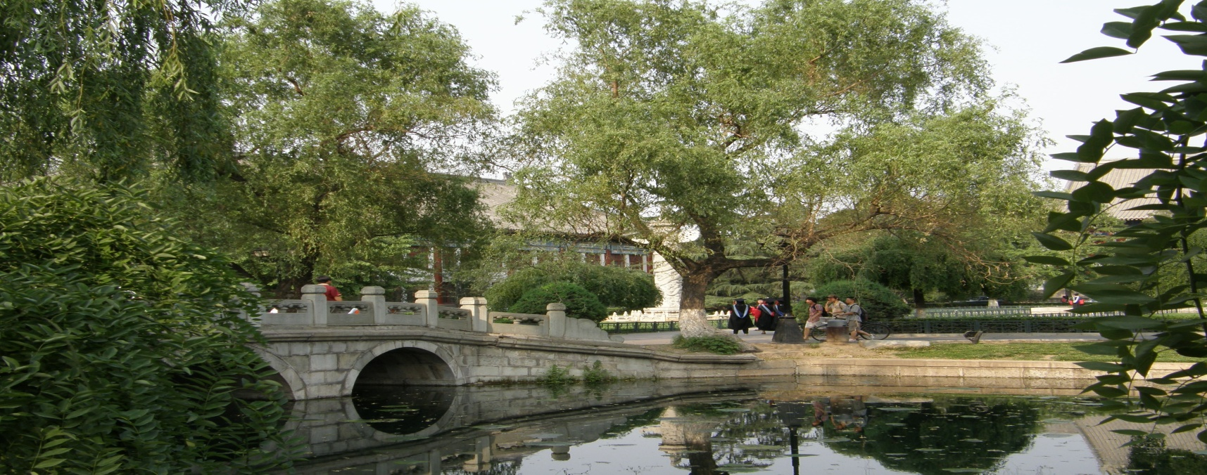
Thanks for your attention and sincerely welcome to visit PKU---Peking University
We look forward to your coming
PKU campus tour as sightseeing will be one of your wise choices when you visit Beijing, More campus pictures could be foud if you aceess the webpaget at:
http://english/ pku.edu.cn/ aboutpku/ virtualTour/

