Slide 1
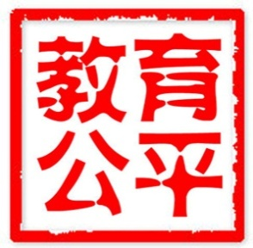
Fair Education in China：
Theory, Reality and Prospect
DR. JIN Baohua
Institute of Higher Education, Beijing University of Technology
March 20, 2013

Slide 2
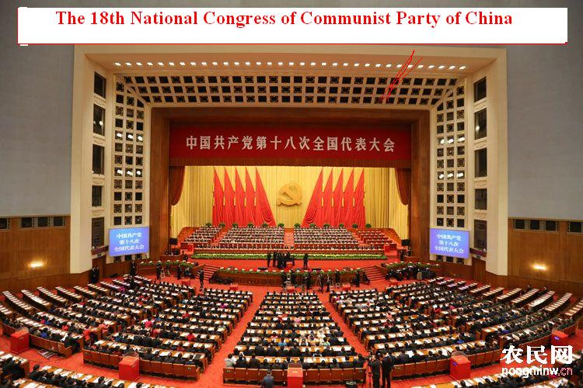
‘We should try hard to promote fair education by reasonably allocating educational resources, giving priority to the rural, remote and poor areas as well as regions of minority, supporting special education, increasing the aid for poor students and giving equal education to farmer-workers’ children so as to make every student beneficial talent.’
--- By HU Jingtao( Pre-President of PRC)
From the Report of the 18th Communist Party of China National Congress
—

Slide 3
Outline of the Report
Relative Theory about Fair Education
Reality of Fair Education in China
Introspection and Prospect of Fair Education in China
1.
2.
3.

Slide 4
1. Relative Theory about Fair Education
Relative Theory about Fair Education
What is Fair Educations?
The Reason for Promoting Fair Education
Nature of Fair Education

Slide 5
1. Relative Theory about Fair Education
(1) What is Fairness?
程序是正义的蒙眼布
Procedure is blindfold of justice
Cihai
Fairness means justice.
Fair and impartial.
Modern Chinese Dictionary
Treat everything reasonably and sensibly without being biased.
English
Grand Chinese Dictionary
Fairness：treating everyone equally just or appropriate in the circumstances.
FAIRNESS, namely just equality, is the evaluation of the interpersonal interests among members of society based on the criterion of equal human rights. It is also the evaluation of whether the allocation of rights and interests among society members is reasonable or not and whether it fits the principle of equal human rights. The nature of fairness lies in its reasonability. Reasonable equality is not only the core value but the evaluation of fairness.

Slide 6
1. What Is Fair Education
B. Differentiation and analysis of fairness and equality and justice
Equality
Justice
Equality is a descriptive concept which concerns more about the sameness between things and more about fact.
Justice is at both individual and societal level with the individual one concerning more about personal morality and being in no comparison.
Both fairness and equality occur in constant interpersonal comparison.
Fairness is a prescriptive concept which concerns more about being reasonable and impartial and more about value instead of being no different.
In all, fairness enjoys a close relationship with equality and justice. However, they are not the same with each other. Basically, fairness means " to be reasonable and sensible" and to be "impartial", which stands for a choice of value and the cognition and evaluation of interest allocation.

Slide 7
1. What Is Fair Education
C. Basic concept of Fair Education
In the sense of moral relationship and moral requirement, Fair Education is the manifestation of fairness in the filed of education. And it is also a kind of evaluation on the fairness of education reception and interest allocation as well as its respect for human rights for equality among all members of society.
Principle of equality
Everyone is equal in educational rights and public resources of education.
Education should be specific and suitable to every individual.
More public resources of education should be allocated to the disadvantaged.
Principle of compensation
Principle of individuality

Slide 8
2. Nature of Fair Education
The meaning of fairness has always been specific and developing rather than abstract or unchangeable.
The invention of the concept of fairness symbolizes the awakening of human sense and men’s departing from the barbarian animal nature to civilization.
Fair Education makes sense only when judged by certain criterion for educational evaluation .Otherwise, it is meaningless.
In some sense, Fair Education refers to the psychological feeling that occurs when making judgment on issues of Fair Education
In addition to being a kind of ethical standard , Fair Education is inseparable from the objectivity of educational fact based on the contents it wants to express.
Developing
Relative
Subjective
Objective
Idealism

Slide 9
3. The Reason for Promoting Fair Education
(1) Internal value
(2) External value
(3) Universal value
Fair Education

Slide 10
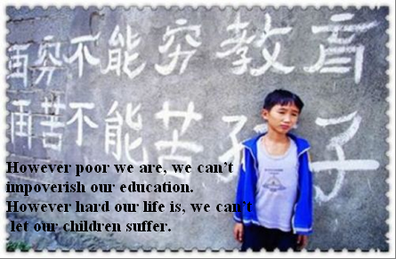
3. The Reason for Promoting Fair Education
A. Internal Value: Fair Education is the Internal Value of Education
Fair Education is essentially a kind of liberation of human nature and the core value pursuance of being a man. In today, Fair Education is the most important mechanism to protect everybody's, especially the weaker's basic right, defend the human nature and promote everyone's overall development.

Slide 11
3. The Reason for Promoting Fair Education
B. External Value: Fair Education is the External Value of Education

Slide 12
3. The Reason for Promoting Fair Education
B. External Value: Fair Education is the External Value of Education
a. Fair Education is One of the Most Important Parts of Harmonious Society.
Fairness included Educational Fairness is the internal and essential content of harmonious society. The construction of socialism H.S inevitably require "prior development of education, promote educational Fairness ".
b. Fair Education is Important Foundation of Harmonious Society.
To cultivate high quality worker and specialized talents that suit to harmonious society and develop our country's great intelligent resource advantage is the important foundation and essential endurance of constructing harmonious society.
c. Fair Education is Also a Way of Realizing Harmonious Society.
Only by insisting on educational Fairness , endowing each learner the same chance of receiving education, can the social members' proficiency, enthusiasm and creativity be developed and realized.

Slide 13
3. The Reason for Promoting Fair Education
C. Universal Value: To Realize Fair Education is the Theme of Today's World
Universal Value
Fair
Justice
Freedom
Equality
Human rights
Fair Education is not only a socialist China education pursuit of the core goal, but also is the universal values in the world today, and is recognized by almost all real democracy of the world.

Slide 14
C. Universal Value: To Realize Fair Education is the Theme of Today's World
For the recent years, as the main approach of human resource's development, education has been valued by every country, they paid more attention to the fair education no matter the developed country or the developing ones.
USA<No Child Left Behind>: it is an education reformation law by Government Bush in 2002 that fair education got more attention. Many states of America also carried out all kinds of education reformation at a certain extent that aimed to eliminate the unfair education.
Japan<Education Promotion Law of Remote Region >: revised in 1985, it is ruled all kinds of measures that the nation and the local governments must take in order to promote the education of Remote Region. Wenbu Province of Japan issued <An Announcement about the Flexible Application of Educated Area System>, and allowed the different states to take measures according to their different conditions.
The Korea carried out "Fairly" education: the former President Lu Wuxuan: “Enriching the welfare policy, eliminating the all unreasonable differences, developing a country that everyone has the same rights to get education”.
Brazil “Students Subsidies Plan": The government provides amounts of cash as subsidies to the mother schools of the poor children, and the condition is that the children should not be dropped out. This not only encourages the parents to send their children to school but also it is a kind of subsidy to the families.

Slide 15
2. The reality of Chinese Fair Education
The Achievements that Chinese Fair Education have made
（1）
The Problems that Existed in Chinese Fair Education
（2）
The Criticism that is Focused on the Higher Education areas
（3）

Slide 16
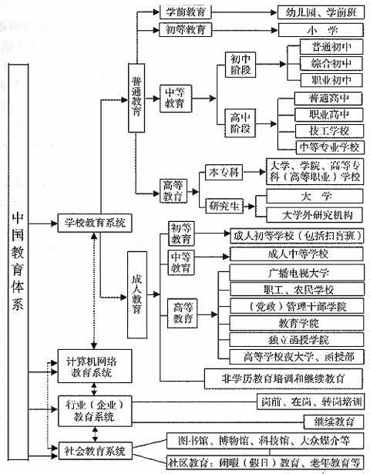
(1) The Achievements that Chinese Fair Education have made
A. Built a whole education system
China have built a whole education system from preschool education to higher education, and carried out the simple course system at the beginning, abolished the double-track system, and made a foundation for the realization of fair education .

Slide 17
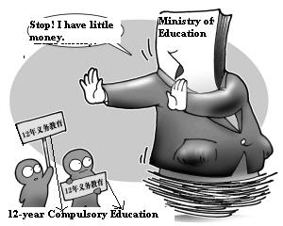
(1) The Achievements that Chinese Fair Education have made
B. Completely achieve the nine -year compulsory education
The presentation of the goal for nine-year compulsory education and its establishment as a nation law are of great importance in the process of realizing fair education.
We have achieved the nine-year compulsory education nationwide in year 2008, and all the children have got this privilege. Ii is really not easy, especially in China, a developing country with the largest population

Slide 18
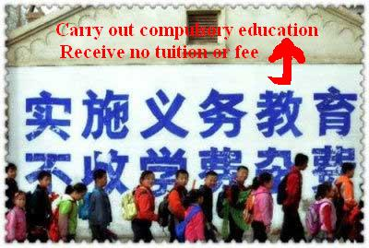
(1) The Achievements that Chinese Fair Education have made
C.Attach great importance to the rural education
Establish the safeguard mechanism for rural compulsory education funds, carry out the policy in rural areas that exempt the education fees firstly; build boarding schools in rural and remote areas, give subsidies on students' living expenses for those who come from poor families; adjust the layout of schools reasonably, improve the education conditions of rural areas deeply.

Slide 19
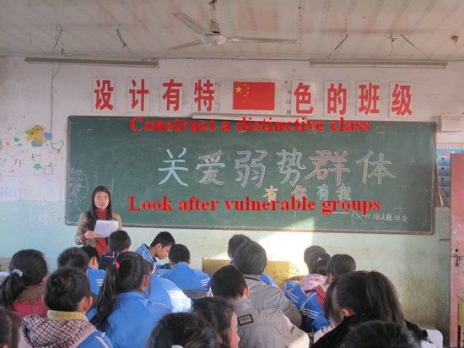
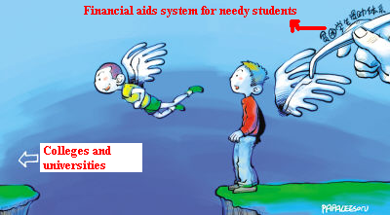
(1) The Achievements that Chinese Fair Education have made
D. The rights and chances that the vulnerable groups got education are improved
Ensure the boys and girls have the same rights to get education.
Establish and perfect the system to help the students who come from poor families, ensure that they are not be dropped off because of the economic difficulties.
In the processing of urbanization，compulsory education also benefit to the children whose parents (peasant)were come to cities to make money.
Carry out the inclusive education，establish a special education system from kindergarten to senior high school.

Slide 20
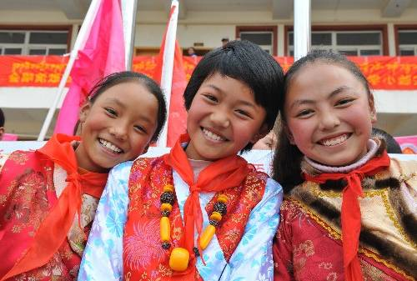
(1) The Achievements that Chinese Fair Education have made
E. The education of nationality areas is developed rapidly
From the aspects of funds, teachers and admissions, our country carried out a series of policy to support the education of nationality areas.
At the end of 2007, the rate of children’s' going to school is 98% in the following nationality minority areas: Mongolia, Ningxia, Xinjiang, Guangxi, Guizhou, Yunnan and so on, and all those areas inhabit a large of minorities, this rate is almost the same as the all nation's average level.

Slide 21
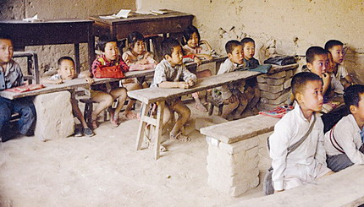
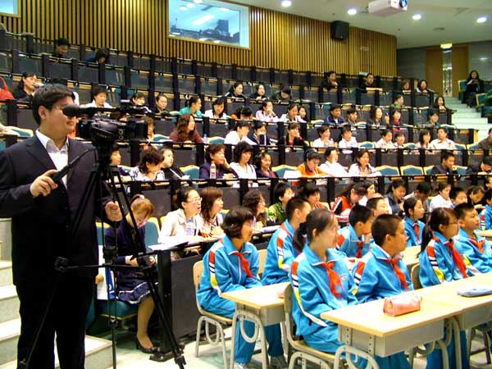
（2）The Problems that Existed in Chinese Fair Education
A. District differences: There are big differences between Eastern's and Western's education development.
The economy of Eastern, Western and Middle is unbalanced because of the history and the real conditions of them, and this is the basic background of Chinese fair education.
The education level of some areas and big cities in eastern is almost the same as the developed country's, however, the nine-year compulsory education is still not popularized in many poor areas of western.
The education of Middle and Western is relatively fall behind from the aspects of teachers, education resources and technology.

Slide 22
（2）The Problems that Existed in Chinese Fair Education
B. Urban and rural differences: the differences of education quality between urban and
rural is still big
“Think highly of urban and make light of rural” is a mainly reflection of education resources unbalanced between urban and rural. For a long time, our education resources allocation is always tend to urban, no matter from the aspects of educational investment, teaching facilities construction and teaching resources allocation.
Most urban schools have sufficient funds, advanced and excellent teaching resources, computers, multi-media and other modern facilities are arranged; while the education funds of most rural schools is in the cart and cannot make ends meet. The qualified teachers are few and in the shortage for a long time, the basic teaching facilities are hard to get guaranteed, let alone to achieve the modern education.

Slide 23
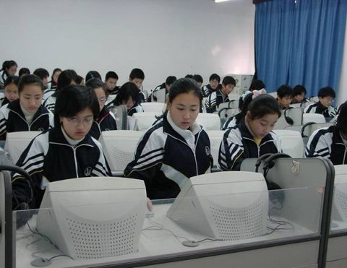
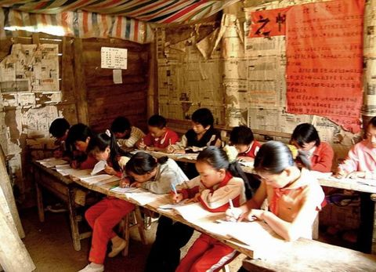
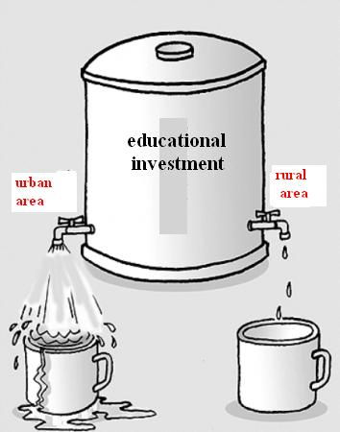
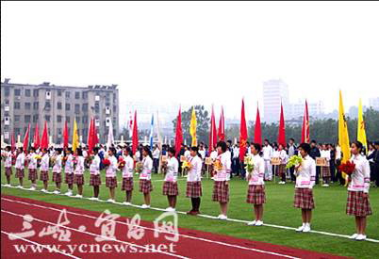
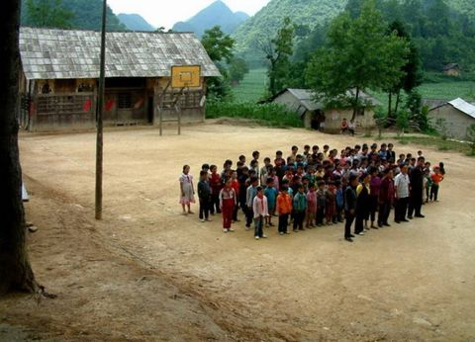
（2）The Problems that Existed in Chinese Fair Education

Slide 24
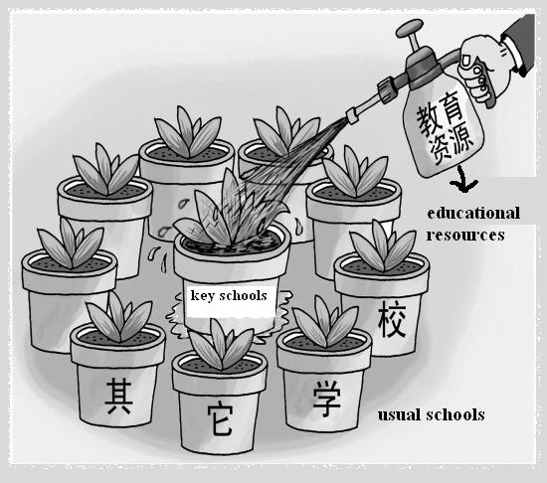
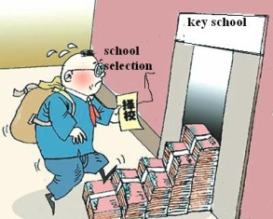
（2）The Problems that Existed in Chinese Fair Education
C. Inter-school Differences: the Prominent Problems of Compulsory Education is
Choosing Schools
Inter-school difference is the most direct and strongest feelings that people can feel, especially the existing of the weak schools is a mainly obstacle to improve the development of the balanced compulsory education, and is also a mainly reason to choose schools in the stage of compulsory education.

Slide 25
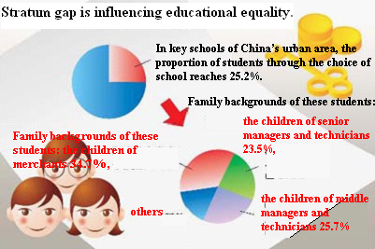
（2）The Problems that Existed in Chinese Fair Education
E. Class differences: vulnerable groups and poverty-stricken students
Since 1980s, our stratum is becoming divided gradually, the gap between the poor and the rich is widening, the education right of the vulnerable groups is influenced, the poor-stricken students have been paid more attention by the whole society.
The disadvantaged group can be divided into the vulnerable groups in urban and the absolute poverty in rural. Because the universities and other non-compulsory education are chargeable, this makes the poverty-stricken students are expanded.

Slide 26
（2）The Problems that Existed in Chinese Fair Education
F. Gender difference： The Problem of female education is serious
The level of female’s receiving education is generally low. Universal inequality of female’s education opportunity is an important aspect of Chinese educational unfairness problem.
Problem of female education is serious in poverty-stricken areas, in particular with insufficient education of girls.
In city and in higher education, gender difference is mainly reflected in the discrimination and unfair treatment of female college students when they hunt jobs. Harder employment for female than boys in the labor market forces . So the female’s education development trajectory towards two extremes: give up the opportunity of receiving higher education and avoid the employment pressure for higher education.

Slide 27
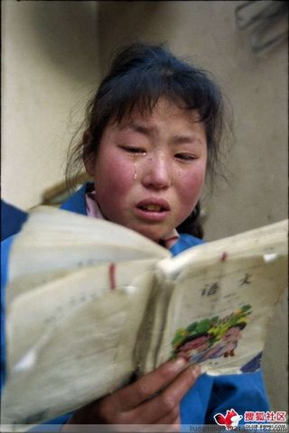
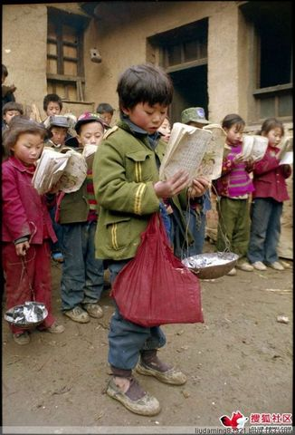
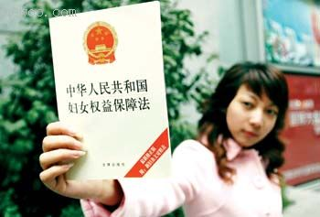
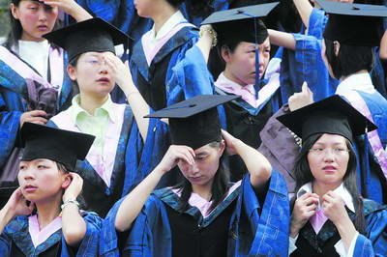
（2）The Problems that Existed in Chinese Fair Education

Slide 28
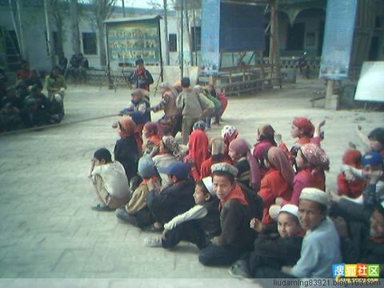
（2）The Problems that Existed in Chinese Fair Education
G. National differences
The 55 national minorities account for 8% of the total population. By comparison, the ratio of minority students enrolled in schools is not low but the development is extremely unbalanced. Primary education is not yet universal in the western poverty-stricken National minority county.

Slide 29
(3) The Criticism that is Focused on the Higher Education Areas
Three points of criticism and blame for Chinese higher education:
A. Criticism for the unbalanced allocation of
higher education resources
B. Criticism of the higher education cost-sharing
C. Criticism of unfair higher education opportunity

Slide 30
(3)The Criticism that is Focused on the Higher Education Areas
A. Criticism for the unbalanced allocation of higher education resources
The allocation of educational resources in different regions is unbalanced. Quality education resources mostly concentrated in the eastern developed regions and some central city. Western regions and small city are in absolutely inferior position.
The allocation of educational resources in different universities is unbalanced. Under the influence of national education policy, most education resources flow to key university and it’s institutions.
Allocation of educational resources between private universities and public universities is unbalanced. Public universities are in the leading position , occupying most of the educational resources. Private colleges can not compete fairly with public ones.
The distribution of educational resources inside the colleges is unbalanced.
………………

Slide 31
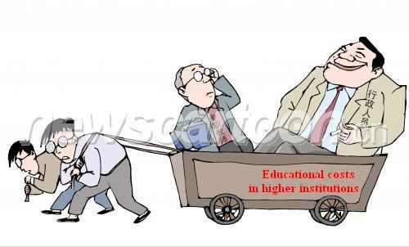
(3)The Criticism that is Focused on the Higher Education Areas
B. Criticism of the higher education cost-sharing
Education opportunity unfairness caused by the higher education charge is concerned. It is generally considered that both the college tuition amount and the way of charging have serious problem.
Because of high tuition fees, the phenomenon of some candidates in poverty-stricken areas rejected by university also occurs. The existing tuition standard makes the gap of higher education chance between the urban and rural further wide.

Slide 32
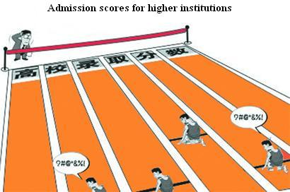
(3) The Criticism that is Focused on the Higher Education Areas
C. Here are some criticisms of the college entrance examination.
A variety of special enrollment means cause injustice, such as the “orientation” ,the general children can’t enjoy.
The excessive whitewash of some colleges in the enrollment of students leads to unfairness.
To struggle for high quality students, some entrance exam camp formed, which caused unfair competition.
Higher education resources in the geographical distribution are unbalanced. Candidates from different provinces can not enjoy fair enrollment chance.

Slide 33
3. Introspection and Prospect of Fair Education in China
Attribution Reflection of the Current Problems of Fair Education in China
A. Institutional Reasons
D. Education Corruption Increased Education Injustice
C. The Impact of Negative of Factors in the Culture
B. Inadequate Investment in Education

Slide 34
(1) Attribution Reflection of the Current Problems of Fair Education in China
A. Institutional Reasons
a. Education Resource Allocation Injustice
According to the proper allocation principle , fair allocation of education resources should no longer continue to enlarge the gap, and as soon as possible to tilt under-developed areas in order to shorten the gap.
‘heavy emphasis on the east light emphasis on the west’
‘heavy emphasis on central light emphasis on local’
‘heavy emphasis on city light emphasis on rural areas’
‘heavy emphasis on higher education and light emphasis on foundation education’
‘heavy emphasis on key school and light emphasis on the weak school’

Slide 35
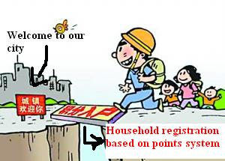
(1) Attribution Reflection of the Current Problems of Fair Education in China
b. Unfair education policy and regulations
The institutional reasons lead to unfair education, another key factor is ignoring the difference between city and rural areas, in urban society and residents as the starting point of the ‘city center’ value orientation.
With the gradual establishment of the market economy system and the process of urbanization, this idea obviously is outdated, but as the mindset it is still a large inertia, still prevalent in the social decision-making.

Slide 36
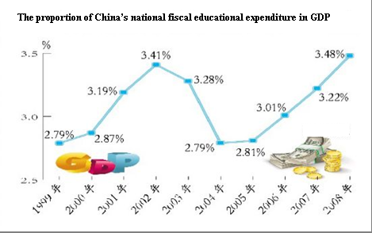
(1) Attribution Reflection of the Current Problems of Fair Education in China
B. Inadequate Investment in Education
In early 1993, the state has made it clear that: National financial education expenditure should reach 4% of national GDP by the end of the 20th century. But until 20th, December last year, Finance Minister pointed out :just to achieve this goal.
For a long time, inadequate investment in education, greatly restricts the development of education, thereby impeding the process of Fair Education

Slide 37
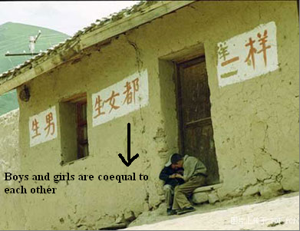
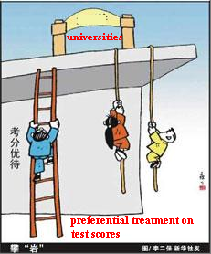
(1) Attribution Reflection of the Current Problems of Fair Education in China
C. The Impact of Negative Factors in the Culture
First, the thoughts of ‘ prefer sons to daughters’ is still very serious.
Second, Early marriage and childbearing outdated customs and bad habits lead girls to premature loss of learning opportunities
Third, Some Religious factors also contributed to girls cannot normally complete their studies .

Slide 38
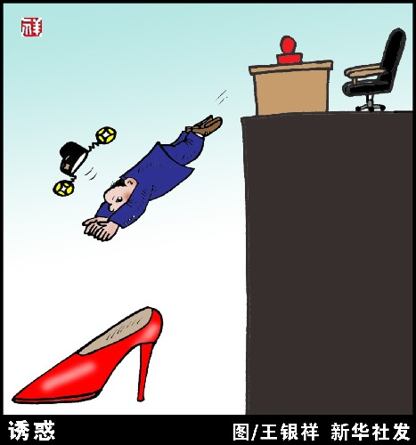
(1) Attribution Reflection of the Current Problems of Fair Education in China
D. educational corruption intensified education injustice
In China, Because there is still a shortage of education resources, far from being able to meet the actual needs of the community, so education was also by the instruction of social corruption behavior.
At the same time, in the process of the field of the education introduce the market economy mechanism, expand school autonomy, because of lack the relevant mechanism and standard, also lead to the distortion of education departments, by all means pursuing the economic interests.

Slide 39
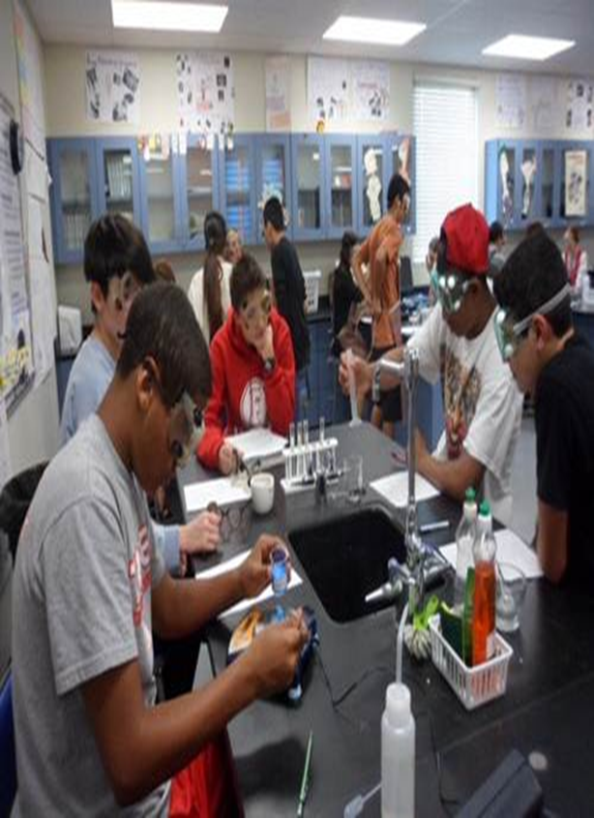
(2) Prospect of the fair education in China
A. The Way Reference of Developed Countries
As the representative of the US, South Korea—— Through powerful state intervention and compensatory policies promote fair
a) The US—Positive Compensatory Policies Promote fair
on the base of Coleman report, from the 1960, the US mainly to eliminate the racial discrimination, through powerful state intervention and compensatory policies promote educational fairness, contributed to the black and white school joint movement, provide students with school bus movement，and provide high school the proportion to recruit the ethnic minority, and so on.
In fact there is huge social unfair American reality, It is not enough to give vulnerable groups the same treatment ,it must take the compensatory principle to the vulnerable groups, only in this way, it can effectively reduce the unfair . This is the Rolls’ compensatory principle.

Slide 40
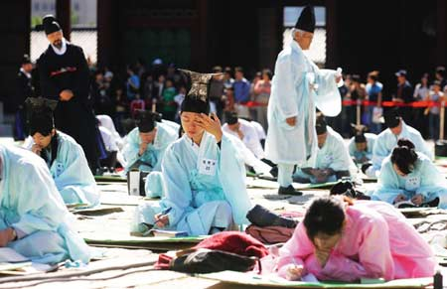
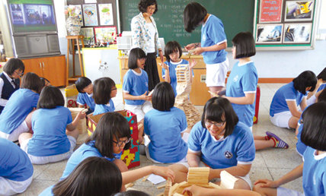
A. The Way Reference of Developed Countries
b) South Korea—According to the Degree of Economic Development of Reverse Compensatory promote Fair
South Korea and many other countries popularize the free compulsory education process, first it is in the most remote, poor island, fish village is free gradually expand to the ordinary rural , at last benefit city, it is a popular strategy based on the degree of economic development ‘reverse’ Let the poorest area and people benefit，in fact it is a kind of compensatory principle too.

Slide 41
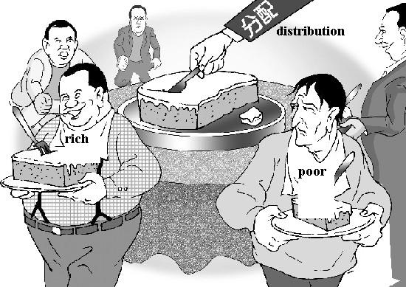
A. The Way Reference of Developed Countries
b. The Representative of Japan——Through the Development Policy Promote fair
Different from the US, as the single culture, single nation, Japan mainly through the development policy promote the fair education.
That is saying, promote fair education goals implication in the overall improvement of education, that is the thoughts that we are familiar with: the enlargement of the total amount(the whole cake), so as to improve each individual education opportunity(one share of the cake).

Slide 42
B. Reflect：What Should China Learn From
A. The Way Reference of Developed Countries
The special nation conditions in China：though China has not huge race，religion and cultural differences like American, but as a vast country，various regions have great gaps in resources，environment, history and culture ,exceed the differences between European countries，this is different from the United States。
Chinese choice of development way: The history of Chinese propagate education has indicated that , in significantly different in reality，this great development gap in population, must use the ‘development 'and ‘compensatory 'at the same time, only this can effectively promote the popularization of education, improve the fair education.

Slide 43
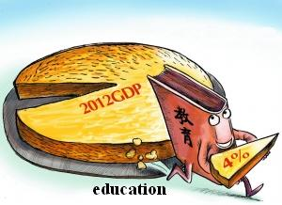
(2) Prospect of the fair education in China
A. The Solution to Chinese Fair Education
a. priority to adhere education development: through development promote fair
Fair Education issues in the development process，so promote fair education must rely on development to resolve, development is the premise to promote fair.
We will continue to strengthen education priority development strategy，with greater determination, more financial to support education career, through development to promote fair .

Slide 44
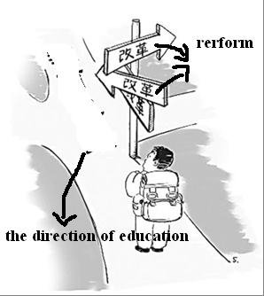
(2) Prospect of the fair education in China
b. Rational Allocation of Education Resource——Through Reform Promote fair
To promote education equity，fundamental measure is to reform the current educational resources unreasonable conditions，rational allocation of educational resources。
To promote education equity, must strengthen the government’s responsibility ，improve and perfect the current education resource allocation imbalance，promote education resource tilt to key areas，key links, difficult areas and weak schools, gradually narrow education development gap between urban and rural areas, regional gaps and inter-school gap.

Slide 45
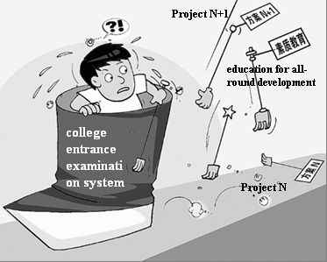
(2) Prospect of the fair education in China
C. Adhere to the Education System Equity——Through Standard Promote Fair
This is a fundamental requirement to Promote Fair.
In the future，educational administrative departments in the implementation before the major educational policy and reform initiative, should stick to ask the advice to the people, seek the social opinion, improve supervision system ,implement the entrance examination ‘sunshine project’(justice fair public)，construct the modern school system，society organizations should plays an active role in the public governance.

Slide 46
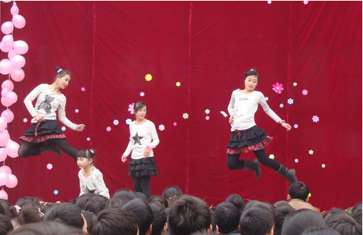
(2) Prospect of the fair education in China
d. Promote the Development of Education Features: Through the Features Promote the Fair
Fair Education is not make a uniform, not deny personality and school characteristics. Fair education unify the equal opportunities and individualized provide the fair platform for variety of talent healthy growth.
Focus on achieve education opportunities equity, promote the basic education public service equally, give special attention to economic difficulties, learning difficulties students, while acknowledge and respect the differences, create conditions for the development of different students personality and top creative talents.
Besides, we should also develop different kind of education, provide more choice to enter an educational institution.

Slide 47
(2) Prospect of the fair education in China
“Our people love life and yearn for better education, stable jobs, more satisfactory income, greater social security, improved medical and health care, more comfortable living conditions and more beautiful environment. We want our children to grow up well, have better jobs and more fulfilling lives. The people’s desire for a better life is what we shall fight for.”
—By Xi Jinping( New President of PRC)

Slide 48
Thanks for your listening!

