Slide 1
Journalists in Smaller Cities of Russia: Are They Different?
Svetlana Pasti & Mikhail Chernysh
University of Tampere & Institute of Sociology, RAS
ICCEES VIII Congress, Stockholm 28.7.2010

Slide 2
Questions
What makes them different in
Social profile?
Job conditions?
Professional values?
How do these differences in professional structure and job conditions are related to professional values?
What do these differences between journalism developments in large cities and smaller cities say to us about the present divided Russia?

Slide 3
Hypothesis
Uneven development of Russian regions provides uneven conditions for journalism
Smaller cities journalists are more depressed than large cities journalists because of economic and political conditions of their job
3

Slide 4
Method
Survey of Journalists in September-November 2008
Two stages:
(1) Congress of Journalists in Sochi
(2) Regions
Questionnaire based on international research by Weaver 1996, 1998; Ramaprasad & Kelly 2003 and Pasti & Pietiläinen 2008

Slide 5
Regions
5
Thirty six cities from all six economic zones of the RF including:
Large city: Moscow, St Petersburg, other cities with one million of population and more
Middle sized city: 200.00-1 million
Smaller city: under 200.000

Slide 6
Respondents
800 respondents
Full-time working journalists in press, radio and television, the internet media providing local news, political and economic issues, culture, leisure, youth topics

Slide 7
Age

Slide 8
Age by locality factor
Age % | Large city | Mid-size city | Smaller city
Under 30 | 44 | 51 | 4
30-39 | 44 | 43 | 13
40-49 | 35 | 46 | 19
50-59 | 33 | 41 | 26
8

Slide 9
Journalist’s father: social position
 | Place of resident
 | Large city (1 million and more) | Middle size city (from 200 to 999 thousand) | Small city (less than 200 thousand)
 | % | % | %
Top manager | 8.4 | 7.2 | 4.3
Mid manager | 25.3 | 18.2 | 17.2
Supervisor | 3.4 | 6.1 | 4.3
Journalist or editor | 4.4 | 4.3 | 0.9
Other professional | 27.3 | 28.8 | 11.2
Clerk | 8.8 | 8.6 | 9.5
Urban worker | 12.1 | 17.9 | 27.6
Rural worker | 4.0 | 5.2 | 20.7
Other | 6.4 | 3.7 | 4.3
 | 100,0 | 100,0 | 100,0
9

Slide 10
Gender
Gender (%) | Large city | Mid-sized city | Smaller city
Male | 44 | 45 | 11
Female | 36 | 46 | 18

Slide 11
Education
Education(%) | Large city | Mid-sized city | Smaller city
Journalistic education | 48 | 40 | 12
Other | 34 | 49 | 17

Slide 12
Type of media
Type of media (per cent) | Large City | Mid-sized city | Smaller city
Newspaper (daily, weekly) | 54 | 60 | 71
TV & Radio | 18 | 22 | 13
Magazines (weekly, monthly | 20 | 11 | 4
Internet media | 6 | 5 | 2
12

Slide 13
Having a second job (%)
13

Slide 14
Salary in 2008
63% of journalists earn 10-30.000 rubles monthly – net income (300-900 euro). They are:
In Large city – 61%
In Middle city -65%
In Smaller city -65%
Average salary in Russia 18.000rub
In Moscow – average salary – 40.000 rub.
14

Slide 15
Motivation
Larg Mid Small
Creative work 43 45 33
Like to write to media 24 24 19
It happened occasionally 14 17 22
Want to help people 10 11 20

Slide 16
Job satisfaction
Reasons for satisfaction (fully and mostly, per cent) | Large | Mid city | Small
1. to independently decide how and what to write, to tell | 64 | 64 | 68
2. Political line | 64 | 58 | 55
3. to help people | 60 | 67 | 67
4. Job security, social security | 53 | 52 | 45
5. Opportunities for better qualification | 52 | 47 | 59
6. to influence society | 48 | 51 | 46
7. Opportunities for second job | 47 | 53 | 38
8. Political independence of the profession | 42 | 35 | 29
9. Opportunities to grow in the post | 39 | 43 | 47
10. Salary | 37 | 41 | 33
11. for a career via journalism in politics, state service, business | 37 | 41 | 32
12. Extra privileges | 34 | 40 | 34
16

Slide 17
Constraints that the Russian journalists face (in per cent )
 | Large | Mid | Small
Local authorities | 20 | 31 | 51
Editors | 23 | 20 | 34
Audience | 18 | 20 | 21
Ethics of the profession | 13 | 14 | 18
Medium political line | 15 | 14 | 10
Medium specialization | 21 | 13 | 14
Influence of federal authorities | 7 | 7 | 7
Advertisers | 14 | 18 | 4
Owner | 10 | 12 | 5
Opinion of colleagues | 4 | 3 | 4
Nothing constrains me | 6 | 6 | 4
Other | 5 | 4 | 2
17

Slide 18
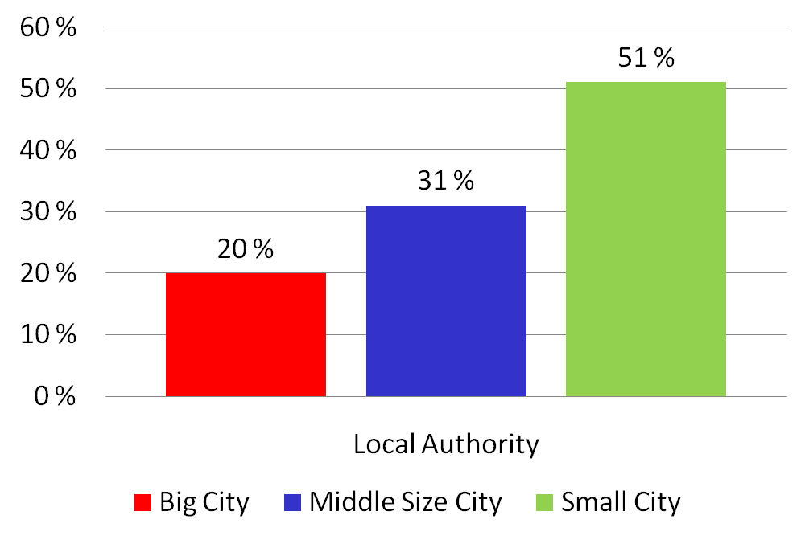
Constraints that Russian journalists face: Local Authorities
18
Notes:
18

Slide 19
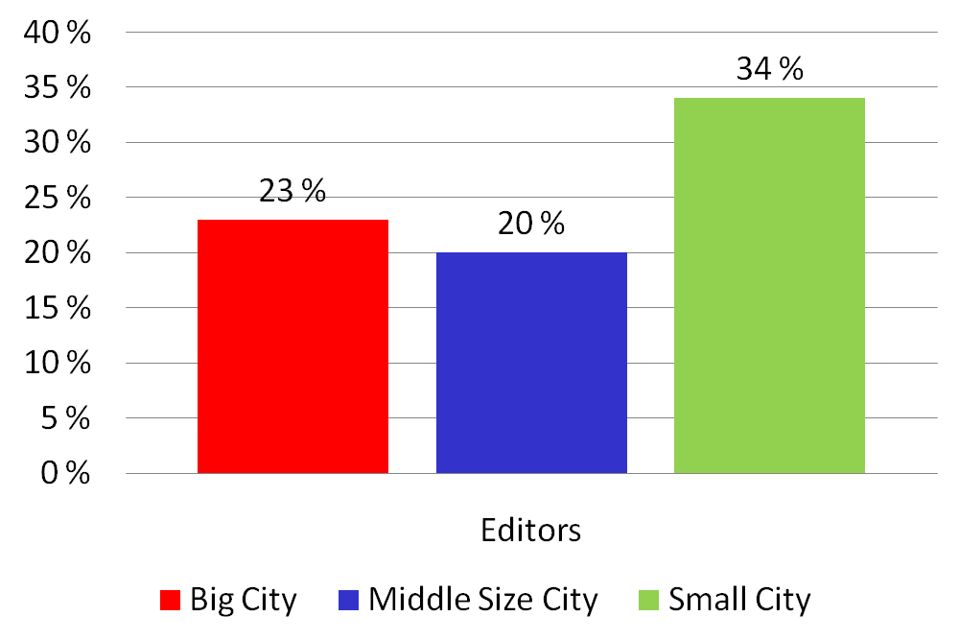
Constraints that Russian journalists face: Editors
Notes:
19

Slide 20
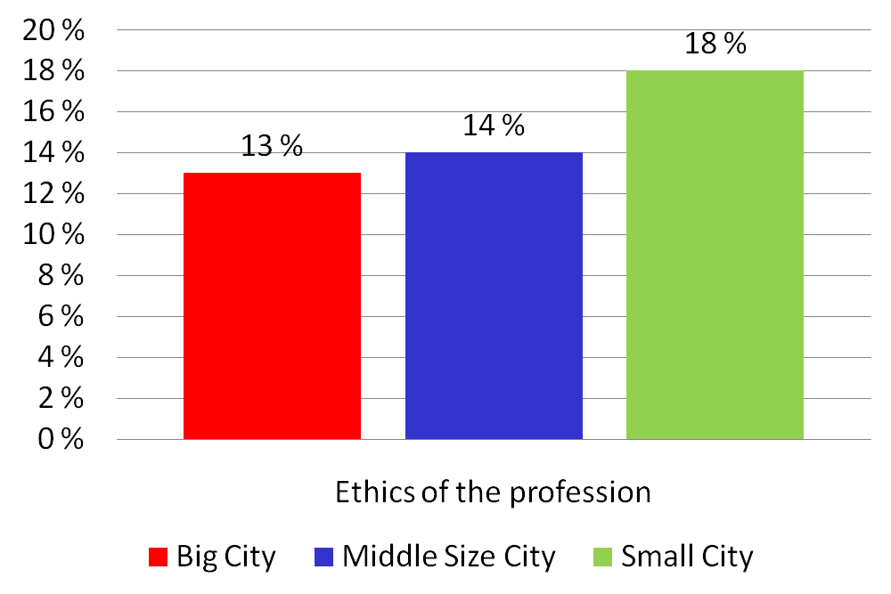
Constraints that Russian journalists face: Ethics
20
Notes:
20

Slide 21
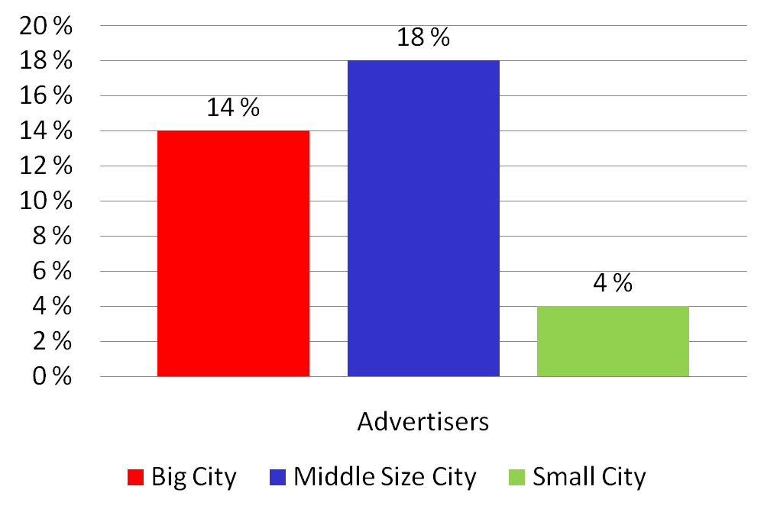
Constraints that Russian journalists face: Advertisers
21
Notes:
21

Slide 22
Support of professional functions
Professional functions (must/chiefly must) | Large | Mid | Small
1. Provide accurate information in timely manner | 91.8 | 94.6 | 95.6
2. Provide analysis and commentary of complex problems | 90.2 | 93.4 | 93.0
3. Keep population informed about how reg. government works | 83.0 | 93.7 | 94.8
4. Give ordinary people a chance to express views on public affairs | 79.8 | 92.0 | 92.3
5. Develop intellectual and cultural interests of the public | 84.2 | 88.8 | 88.5
6. Discuss reg. policy when it is still being developed | 83.0 | 89.1 | 86.0
7. Inform population about viewpoints of local politicians | 78.1 | 83.4 | 89.5
8. Work with letters’ to the editorial office | 75.0 | 80.7 | 96.5
9. Investigate claims and statements made by local government | 79.0 | 78.7 | 72.2
10. Promote the strength and unity of communities | 67.3 | 68.9 | 79.6
11. Provide entertainment and relaxation | 44.4 | 53.0 | 54.4
12. Support reg. government development programs | 34.6 | 37.2 | 63.1
13. Portray a positive image of the region | 24.2 | 30.7 | 50.4
14. Contribute to success of regional government policy | 23.2 | 28.4 | 49.2
15. Portray a positive image of community | 19.6 | 21.4 | 32.7
16. Portray regional leadership in positive manner | 13.8 | 13.8 | 21.2
22

Slide 23
 | Large | Mid | Small
number of respondents | 39.6 | 45.4 | 15.0
Migration/ previous job not in media | 16.0 | 11.4 | 52.2
Media profile/local news | 27.6 | 40.1 | 75.0
Type of media/ newspaper weekly or daily | 53.5 | 59.7 | 71.3
females | 36.3 | 46.1 | 17.6
Status/journalist | 55.4 | 57.0 | 24.3
Age (under 30) | 44.4 | 51.4 | 4.1
Motivation/ search for creative work | 42.5 | 44.6 | 33.0
salary level, from 10.000-30.000 Rub: 300-900 euro | 61.0 | 64.6 | 64.9
union membership | 35.1 | 38.9 | 69.8
Journalistic education (full or part) | 47.5 | 40.1 | 12.4
second job | 50.8 | 46.7 | 29.9
producing corrupt (ordered) materials during the past 12 months | 48.4 | 60.1 | 42.2
disapprove writing paid corrupt materials | 17.4 | 13.3 | 13.8
Disapprove plagiarism as a breaking of professional ethics | 62.0 | 70.0 | 71.6
Not, no forms of control of entertainment | 10.5 | 10.3 | 0.9
Generations, post-2000 | 40.9 | 48.8 | 10.3
Not, no forms of control of the content of political materials in media | 20.3 | 19.7 | 6.0
Differences between Russian journalists by locality factor
(per cent)
23
Notes:
23

Slide 24
Smaller city journalists: Social profile
Mostly offspring of the working class and clerk (58%), distinct of journalists of large cities (middle and upper class)
With a lack of young under 30 (4%)
Womanized
Working in the newspapers (71%)
Came into journalism from other jobs (52%)
Each fifth by chance (22%)
Least of all journalism educated (12% vs 18% not educated)
With membership in the Union of Journalists (70%)
Having a second job (30%)
With average income 300-900 euro as in large cities (65%)

Slide 25
Reverse trends to national trends
No rejuvenation
Less professionally educated
Jumping from working class
Member of journalist union – their legitimization in the profession

Slide 26
Smaller city journalists: Job conditions
Mostly satisfied with professional matters:
Perspectives for the further qualification
Growing in the post
Helping people
Independently to decide how and what to write
But their work under strong political control of outside (local authorities) and inside (editorial)

Slide 27
Smaller city journalists: Professional values
Support of functions of development journalism: in line with local authorities
Social organizers and integrators of local communities
Least of all support of developed journalism – watchdog function
Strong support of censure: political issues and entertainment, distinct from large cities j.

Slide 28
Ethics
They differ little from the journalists of large cities regarding corrupt materials by producing them and not condemning these practices
Although ethical considerations are more strong as constrains in job than in large cities

Slide 29
Divided Contexts: Large city
Ample opportunities in the labor market: numerous media, PR services, publishing industry, advertising agencies ↔
High level of personal independence and decision making in choice of jobs, combining jobs, career developments and networks, further education, free lancing
High social mobility
Via media to state or business structures

Slide 30
Divided Contexts: Smaller city
Restricted media market, undeveloped advertising, low purchasing capacity of population, media attached to local authorities ↔
No many chances to choose jobs and contacts
High level personal dependence -‘everybody knows each other’. For a journalist they are sources of information (mostly, officials) ↔
Support of functions of development journalism
Silence or semi-truth in coverage
Low social mobility
Via other jobs to media and joining local political class

Slide 31
Divided Contexts
Large city – an innovative space:
Market-driven journalism
Part of popular culture
Plural media landscape
Paradise for young
Smaller city – an enclave of traditional paternalist relations of the state and journalism
Newspaper is main local media
Comfort for old journalists

Slide 32
Depressed or not?
Small city journalists enjoy their privileged social position in their communities
Elitization of journalism profession has omnipresent character (large city-small city)
They work in little changed environment attached by economically, politically and professionally to the state
32

Slide 33
Spasibo
for your attention
До новых встреч!

