Slide 1
Who makes new media in Russia? Findings from three case studies http://uta.fi/cmt/tutkimus/BRICS.html
Svetlana Pasti,
University of Tampere
The 6th International Media Readings in Moscow
Mass Media and Communication-2014, October 17-18

Slide 2
New media: Research focus of the BRICS study
In mainstream comparative research, online media have received little attention
Number of online media continue to increase
The definition of new media is unclear
BRICS project defines new online news media as separately established and independent internet media organizations They are not just digital newsrooms or online versions of newspapers, magazines or radio-television stations

Slide 3
Top ten Internet users, in millions

Slide 4
Digital world of BRICS
Countries | Registered domains/websites | Accounts in social media
Brazil | 3.05 million: 16 websites per thousand people | 58.7 million: 69% of online population
Russia | 4.6 million: 31.9 websites per thousand people | 65.8 million” 46% of population
India | 700.956: 0.579 per thousand people | 60.5 million Facebook users: 74,75% of online population
China | 7.9 million: 5.7 websites per thousand people | 250 million blog accounts: 48,7% of population
South Africa | 869.910: 17.05 websites per thousand people | 23.76 million: 279,52% of online population

Slide 5
Survey of the BRICS journalists, 2012-2014
In-depth interview of journalists face-to-face, using a recorder, in the native language of the interviewee
Two metro cities (capital and 2nd largest): 48 journalists from 24 media
Two provincial cities: 24 journalists from 12 media
144 journalists per country, total 720
Sample includes old and online media

Slide 6
Work in progress
Interviews started in 2012
To be finished in 2014
Coding and analysis in 2014
Country reports in 2014
Comparison and final report in 2015

Slide 7
BRICS study sample: Cities
Brazil: Brasilia, Rio de Janeiro, Vitoria, Juiz de Fora
Russia: Moscow, St Petersburg, Yekaterinburg, Petrozavodsk
India: Delhi, Hyderabad, Kolkata, Pune
China: Beijing, Shanghai, Guangzhou, Wuhan
South Africa: Johannesburg, Cape Town, Durban, Port Elizabeth

Slide 8
Three case studies
St. Petersburg study, December 2012- March 2013
Sample: 49 journalists: 24 from 12 new online media and 25 journalists from 12 traditional media (2 journalists per media)
Yekaterinburg study, October 2013- January 2014
Sample: 24 journalists: 12 journalists from 6 new online media and 12 journalists from 6 traditional media
Petrozavodsk study, December 2013 - March 2014
Sample: 23 journalists: 11 from 6 new online media and 12 journalists from 6 traditional media

Slide 9
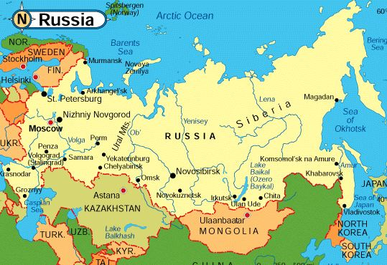
StPetersburg, Yekaterinburg, Petrozavodsk

Slide 10
Hypothesis
Online media are less professional than the conventional mainstream media
To verify we will scrutinize the social profile journalists and their income by comparing the staff of the new media and the old media and their perceptions of each other

Slide 11
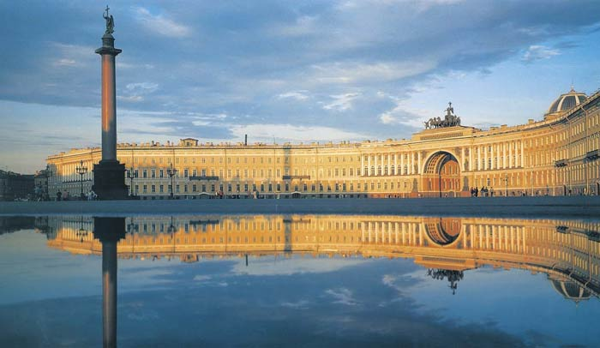
St Petersburg - most Western city of Russia

Slide 12
St Petersburg
The City was founded by Tsar Peter the Great on May 27 1703. Between 1713–1728 and 1732–1918, Saint Petersburg was the imperial capital of Russia. In 1918, the central government bodies moved from Saint Petersburg (then named Petrograd) to Moscow.
It is Russia's 2nd largest city after Moscow with 5 million inhabitants and the fourth most populated federal subject.
It is a major European cultural center, and also an important Russian port on the Baltic Sea

Slide 13
Sample: 12 online media
New media | characteristics | Founders/Own | Size of organization
rbc.ru | News portal/24h | RBC hold (Prokh.) | Until 5
Fontanka.ru | News & analysis | Azhur holding | 21-50 people
Firstnews.ru | News portal | ZAO Firstnews | 21-50
Lenizdat.ru | News portal | Media SPb holding | 6-20
Dozhdj tv/Rain-tv | Internet TV | Media holding | 101-500
Karpovka.ru | Quality gazeta | Journalists | 6-20
Bumaga.ru | Quality gazeta | Journalists | 6-20
Peterburgski dairy | Internet daily | City government | 21-50
Zaks.ru | Political site | MediaSPb holding | Until 5
Ok-inform | Quality magazine | Journalists | 6-20
Politgramota.ru | Political site | Journalists | 6-20
V kurse | Show Magazine | Journalists | N/A

Slide 14
Sample: 13 conventional media
Traditional media | characteristics | Founders/Own | Size of organization
Nevskoe vremya | local quality paper | Baltijskaya media group (Rudnov) | 101-500 people
RBK, RosBusiness Consulting | national paper branch | RBK holding (Prokhorov) | Until 5
Komsomolskaya Pravda | popular national paper | Publishing house KP | 51-100
Gorod 812 (City) | local quality magazine | Azhur holding (Konstantinov) | 21-50
Ekspert Severo-Zapad | national magazine branch | Expert media holding (Deribaska) | 6-20
Darja | national glossy magazine | OOO private | 6-20
The 5th TV Channel | 5th National TV Channel | Media holding (Kovalchuk) | Above 500
LOT | Regional TV Channel | Regional government | 21-50
St Petersburg TV | the city TV Channel | Regional government | 101-500
Radio Rossia, GTRK | the national Radio branch | State | 101-500
Radio Baltika | the city radio | Baltijskaya media group (Rudnov) | 51-100
Radio Zenit | the city radio | Private (Vorozheva Elena director) | 51-100
Radio Svoboda (Liberty) | National radio branch | Foreign (USA) | Until 5

Slide 15
Findings: Online media: 3 types
Independent initiatives of journalists (journalistic start-ups) (6): Bumaga, Karpovka, Politgramota, OK-inform, V kurse, TV Dozhdj (Rain)
Part of independent media holdings (5): (Azhur, MediaSPb, RBC): Fontanka, Lenizdat, Zaks.ru, RBC.ru, First News.ru
City government (1): Peterburgsky dairy

Slide 16
New media vs. Old media
Founders of new media: Capital, State and Journalists
The old media run by the regional government and parliament, the local and Moscow Capital (Gazprom, Oleg Deribaska).
It is rare to meet foreigners in the new media market (internet) radio Liberty
Size of medium: New media – mostly small (5-50) and the old media big (20-500), especially the state-run media

Slide 17
Profile of journalists (49)
 | Online media (23 journalists) | Traditional media (26 journalists)
Age | 17 (>29); 2 (>39); 1 (>49); 2 (>59) | 10 (>29); 3 (> 39); 8 (>49); 5(>59);2(<60)
Gender | 10 female, 13 male | 9 female, 17 male
Education | All - university diploma, 8 – jour-m | All - university diploma, 9 – jour-m
Social class | 22 (middle class), 1 (workers), 1 (jour) | 18 (middle class), 4 (workers), 0 (jour)
Generation in profession | 2 (>1990); 3 (1991-2000), 18 (<2000) | 7 (>1990); 13 (1991-2000), 6(<2000)
Employment/earlier job places | 15 on staff; 1 by contract, 1 freelancer, 6 founders (j.start-ups)/ 20 had 2-4, <5 job places before, 3 – this first place | 17 on staff; 6 by contract, 1 freelancer/22 had 2-4, <5 job places, 2- this first place
Income (+ second job) | 20,000- 130,000 R; (26,000 Rub, the city average ) Euro 500-3200 | 20,000-80,000 Rub. Or Euro 500-2000
Second job | 13 – yes, 8 – no | 11 –yes, 9– no
Membership Union of J. | 4 – yes, 19 – no | 8 – yes, 18 – no
Party/NGO membership | Nobody in party and NGO (4) | Nobody in party and NGO (5)

Slide 18
Self-portrait of online journalists
Q: What is difference between you, journalists online, and those in old media?
“We are younger” (20 under 31)
“We are faster” (Speed of perception, reaction, work)
“Internet media like news agency”
“Long working hours, we are available 24/7”
“No border between work and private life”

Slide 19
Self-portrait of online journalists
Multi-platform:
New media often combines TV, newspaper and news agency. It works against a journalist: lost depth, quality, no idea, often bloopers
Multi-functionality:
Managing editor of online daily + working with social networks: their content and communication with subscribers + anchorperson + news editor of online radio. “No matter how many tasks you do, it is important, how do you do it” (from interview)

Slide 20
New media: Young, healthy, multi-
All young: Established during the 2000s
Healthy media economy
Small-scale organizations in comparison with the conventional media (on average 6-7 journalists)
Most successful with multi-platform strategy:
Fontanka, first internet daily in the city established: Fontanka.Fi, Voditel Peterburga, Doktor Piter, Kvadrat.Ru, radio Fontanka FM
Specialization and expertize, target audiences
Interactivity with audience and interactive advertising

Slide 21
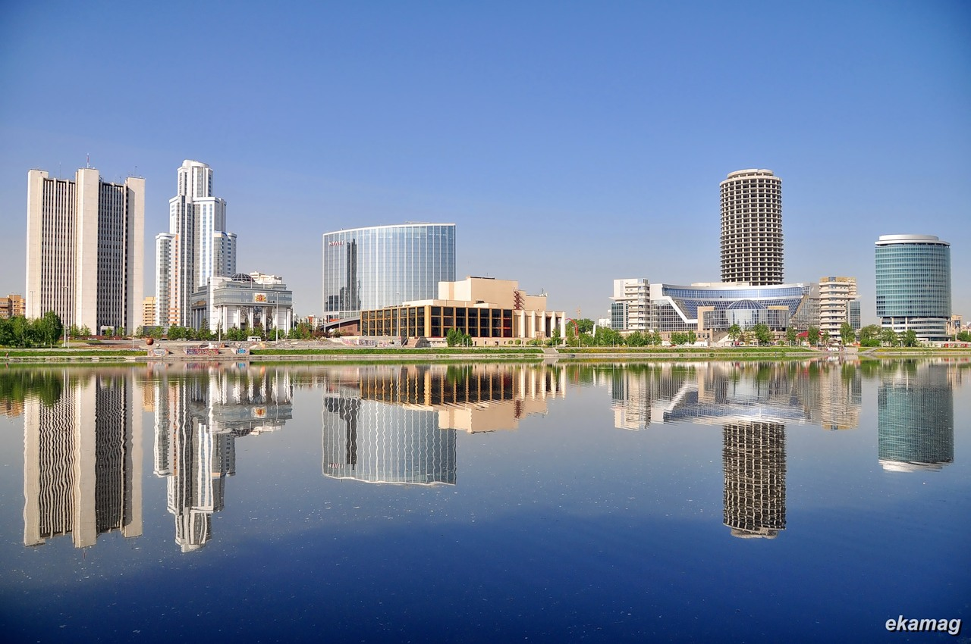
Yekaterinburg –the capital of Urals

Slide 22
Yekaterinburg: 4th largest city in Russia
Founded in 1723 by the order of Peter the Great as the metallurgical factory
By the 20th century it had become one of Russia's largest and most important financial, industrial and cultural centers.
Between 1924 and 1991, the town was known as Sverdlovsk. The city is often said to be situated on the border of Europe and Asia (on the Asian side)
Population is about 1.5million of people: Russians, Tatars, Bashkirs, Ukrainians

Slide 23
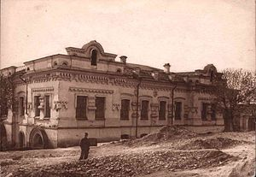
House Ipatjeva, where the Tzar family was shot at night on 16-17 July 1918

Slide 24
Media sample: 6 new + 6 old
Media | type | ownership/founders | Size of medium
1. Znak.com | Online/news agency | Journalistic start-up | 24 journalists
2. EAN (Euarasian) | Online/news agency | Private/ A. Eroshevsky | 5 journalists
3. New region | Online/news agency | Private/A.Shchetinin | 12 journalists
4. Just media | Online/news agency | Private/ Y. Elfimova | 5 journalists
5. Ura.ru | Online/news agency | Journalistic start-up | 50 jour-ts (15 in the city)
6. Internet TV Malina | Online/private | State-Private/region. g | 9 journalists
7.Oblastnaya gazeta | Daily, from 1990 | Regional government and parliament | 100 workers (50 j.)
8. Radio Eho Moskvy Ural | Regional radio | Gazprom media holding | 6 journalists
9.TV 4 | TV | Regional government | 150 workers (100 j.)
10. TV 41 Domashnyi | TV | Private/V.A. Zlokazov | 100 workers (30 j.)
11.Ekspert Ural | magazine weekly | Media holding Expert | 15 journalists
12.Bizness I zhiznj | Business magazine | Abak-press media holding | 4 journalists

Slide 25
Findings: Online media: 3 types
Independent initiatives by journalists: Znak.com, Ura.ru,
Private capital (EAN (Eurasian news agency), New region, Just media
Regional government together with private capital: Internet TV Malina

Slide 26
New media vs. Old media
Ownership: New media – part of media holdings and journalistic start-ups. Founders: Local business and local journalists, but also the regional government together with the business. The old media run by the regional government and parliament, the local and Moscow capital (Gazprom, Oleg Deribaska). No foreigners in this media market
Size of medium: New media – mostly small (5-50) and the old media big (100-150), especially the state-run media

Slide 27
Profile of journalists (24)
 | Online media (11 journalists) | Traditional media (12 journalists)
Age | 9 (>29); 3 (>39) | 6 (>29); 3 (> 39); 2 (>49); 1(>59)
Gender | 6 female, 6 male | 6 female, 6 male
Education | All - university diploma, 8 – jour-m | All - university diploma, 9 – jour-m
Social class | from specialists, from jour-sts 18% | from specialists, from jour-sts 25%
Generation in profession | 0 (>1990); 5 (1991-2000), 7 (<2000) | 3 (>1990); 3 (1991-2000), 6(<2000)
Employment/earlier job places | 12 on staff; 11 had 2-4, <5 job p. | 11 on staff; 11 had 2-4, <5 job places
Income (including second job) | 700- 4000 e; (540 e region average) | 500-4000 e
Second job | 4 – yes, 1 – no | 7 –yes, 5– no
Membership in Union of J. | 1 – yes, 10 – no | 2 – yes, 8 – no
Party/NGO membership | Nobody in party and NGO | Nobody in party and NGO (1)

Slide 28
Journalists of New media (vs) Old media
Younger under 30 (75%); in old media (50%)
Post-Soviet generations: 2000s and 1990s; in old media +Sov.g.
Gender balanced, every journalist with university diploma, from middle class, on staff, no membership in new and old media
High occupational mobility in new media (2 years in one job place), but also in the old media. But they prefer not to switch from online to offline, or vice versa
Better income in new media, a second job accepted in both

Slide 29
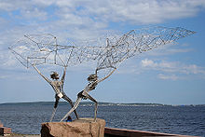
Petrozavodsk: Statue of Fishman on Onego lake

Slide 30
Petrozavodsk: capital of Karelia Republic
A city in the north-western part of Russia, the capital and the largest city of the Republic of Karelia. It is standing on the banks of Petrozavodsk bay, Onega Lake. There are 31 ancient settlements the oldest of which is 8000 years old on the territory of the city.
Petrozavodsk population is 265,000 (2012); land area - 135 sq. km.
Petrozavodsk started with the gun plant, founded near the river Lososinka, the same year as the northern capital, Saint-Petersburg, 1703
In 1956-1991, Petrozavodsk was the capital of Karelian Autonomous Republic of the Russian Federation of the Soviet Union. Since 1991, the city is the capital of Karelia Republic

Slide 31
Media sample: 6 new + 6 old
Media | type | ownership/founders | Size of medium
1. Litsei (Lycée) | Online/ Internet journal | Journalistic start-up | 5
2. Vesti Karelia | Online/newspaper | private | Up to 20
3. Stolitsa na Onego | Online/newspaper | private | Up to 20
4. Vedomosti Karelia | Online/newspaper | Private/Mazurovsky | Up to 20
5. The Republic of Karelia | Online/news agency | Regional government | Up to 20
6.politika-karelia.ru | Online/Center of polit. and social studies of RK | Journalistic start-up | 1
7.TVR Panorama | Regional weekly | State & Private | Up to 20
8. Karelia | Regional newspaper | Regional government | Up to 5
9.My Petrozavodsk | City newspaper | Regional government | Up to 531
10/TV Nika | City TV | Private/Mazurovsky | Up to 20
11.GTRK Karelia:TV&Radio | Republican TV and Radio | State (branch of VGTRK) | Up to 50
12.TV Sampo | City TV | Regional government | Up to 50

Slide 32
Findings: Online media: 3 types
Independent initiatives by journalists:
Litsei (Lycee), politika-karelia.ru
Private capital:
Vesti Karelia, Stolitsa na Onego, Vedomosti Karelia
Regional government:
Respublika Karelia

Slide 33
New media vs. Old media
Ownership: New media – State, Capital and Journalists.
Founders: Local business, the regional government and local journalists. The old media run by the regional government and parliament, and the local capital.
No foreigners in this media market
Size of medium: New media – mostly small (1-20) and the old media bigger (20-50), especially the state-run media

Slide 34
Petrozavodsk: Profile of journalists: 23
 | Online media (11 journalists) | Traditional media (12 journalists)
Age | 3 (>29); 4 (>39); 2 (> 49); 2 (>59) | 5 (>29); 2 (> 39); 3 (>49); 2(>59)
Gender | 6 female, 5 male | 9 female, 3 male
Education | All - university diploma, 2 – jour-m | All - university diploma, 1 – jour-m
Social class | 4 - from workers, 6- from specialists | 4 - from workers, 7- from specialists
Generation in profession | 3 (>1990); 3 (1991-2000), 5 (<2000) | 1 (>1990); 4 (1991-2000), 7(<2000)
Employment/earlier job places | 10 on staff, 10 had 2-4, <5 job p. | 12 on staff, 12 had 2-4, <5 job places
Income (including second job) | 300-1400 e; a half has 800 e (300e region average). | 400 e (state media), 600e -private
Second job | 9 – yes, 1 – no | 5 –yes, 7 – no
Membership in Union of J. | 6 – yes, 5 – no | 8 – yes, 3 – no
Party/NGO membership | Nobody in party and NGO (3) | Nobody in party and NGO (2)

Slide 35
Journalists of New media = Old media
Age – no differences
All three generations presented
Every journalist with university diploma, but a few with journalism diploma, one third from working class, on staff,
Membership in the Union - strong union here
High occupational mobility in new media: 10 online and 12 offline had 2-4 and more than 5 job places before (2 years in one job place).
Better income in new media, a second job accepted in both

Slide 36
Are you different from new/old?
City | Different: number of journalists | Not different: number of journalists
St Petersburg | 3 online and 6 offline | 6 online and 6 offline
Yekaterinburg | 7 online and 9 offline | 2 online and 1 offline
Petrozavodsk | 5 online and 9 offline | 2 online and 3 offline

Slide 37
What common between new and old: Profile
Journalists are highly educated
They come from the middle class
They have a second job
They have a good income
They show a high occupational mobility
Majority does not belong to the Union of Journalists, a party and a NGO

Slide 38
What they see to be different?
Different tasks, approaches: “Our economic magazine has adopted a deeper approach to the topics that we explore. We, as a rule use some analytical data for the publication, sometimes we conduct our own research for publications. For online media, it is important to convey information faster, whereas for us it is more important to analyze the information, to chew it and give the reader”(R.22 Yekaterinburg)
Speed: high degree of immediacy in providing news: here and now, wider agenda for online
Universality (online) versus specialty ( print):“Online journalists must be universal, all-rounder” (R.2 Petrozavodsk)
Quality of journalism
Degree of responsibility and Ethics

Slide 39
How different new from old?
Possibility to establish independent journalistic start-ups online
Possibility not to register online media as a media
Small media organizations online vs. traditional media
Mostly, post-Soviet generations there
In some online media income is much higher than in the traditional media,
Some journalistic start-ups are unprofitable, work for the sake of some idea and mission (education, ecological and social issues)

Slide 40
Concluding remarks
The Hypothesis has not been confirmed
Professionals work in new media
When professionals go to online media this legitimizes a status of online media in the media system
There are two types of online media: the business-oriented (Profit is most important): Fontanka.ru; Ura.ru; Vesti Karelia and society-oriented (Idea is most important): Bumaga.ru; Karpovka.ru; Litsei

Slide 41
Concluding remarks
With rise of Internet –rise of independent online media
To establish online media was available for anybody
Young professionals go to online for politically independent journalism
Online media become influential sources of information and opinion owing to their independence
Politicians, experts, journalists begin a new day with online media, not with the conventional media

Slide 42
Thanks for your attention!
Svetlana.Pasti@uta.fi
http://www.uta.fi/cmt/en/contact/staff/svetlanapasti/index.html

