Slide 1
Struggling for the right to communicate: Experiences from community radio in Brazil
Raquel Paiva
João Paulo Malerba
Universidade Federal do Rio de Janeiro - Brazil

Slide 2
- As with many Latin-american countries Brazil has high concentration of media ownership: for example, one media corporation (Globo) concentrates 70% of the TV market; - Over a decade of left government hasn't addressed the issue; - Unbalanced news coverage on political issues: Brazil faces a disruption within democracy nowadays; - In this scenario, community media struggles to influence public opinion with a alternative journalism .
Brazilian media overview

Slide 3
- Latin-american early examples (1940-60): Sutatenza (Colombia) and Miner’s radio stations (Bolívia); - Principles: access; participation; self-management (Lewis, 1993) runned by ordinary people and/or non-profit organizations; its programming emphasize interests of local communities (geographic, ethnic, cultural and common interests); - Power of mobilisation: “what allows us to define a medium as ‘community’ is not its capacity to provide a service but its intention, its clear aim to mobilise as connected to exercising citizenship” (Paiva, 1998, p. 160). .
Community media overview

Slide 4
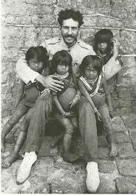
- Community radio principles on the very first stablished radio in Brazil: “Rádio Sociedade do Rio de Janeiro” (1923) “Radio is the school of those who don’t have school, it is the newspaper of those who can’t read, it’s the teacher of those who cannot go to school”. Edgard Roquette-Pinto
Brazilian Community Radio
~ The Historical background ~

Slide 5
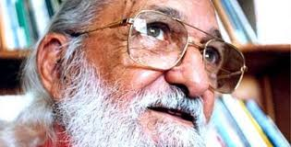
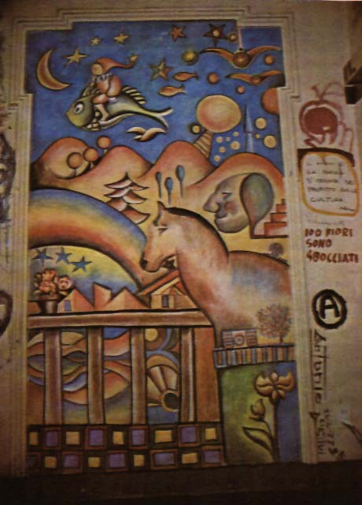
- Historical importance of CR on the struggle for democracy and citizen participation in all Latin America countries, including Brazil. - Three lineages: * from the practice of evangelization and social mobilization of the Catholic Church via radio; * inspired by European free radio stations; * CR model of AMARC.
Brazilian Community Radio
~ The Historical background ~

Slide 6
- 1970-1980: no legal recognition: radio station were closed down and their staff prosecuted; - 1990s: several associations and national, regional and international organizations supporting community radios; - 1996: 8 bills aiming to regulate community broadcasting in Brazil; - Law 9612/1998: Neoliberal government (Executive); 70% of the members of the parliamentary committee were owners or had indirect interests on commercial radio and TV (Legislature); criminalization remains (Judiciary)
Brazilian Community Radio
~ The regulatory framework ~

Slide 7
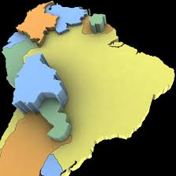
- There are 4.724 licensed CRs covering 3.935 Brazilian cities - Comparative research on community broadcasting regulation from all South-American countries: Brazil has the most restrictive law * legal definition; * overall power restriction; * reservation of frequency; * possibilities for financial sustainability; * license length.
Brazilian Community Radio
~ The regulatory framework ~

Slide 8
Legal definition and power restriction - radio directors must live within one kilometre radius from the station; - designed to meet only communities of a neighbourhood, a village or small town; - excludes ethno-linguistic communities (indigenous, quilombola, migrants etc.), large geographic communities (as slums) and so-called interest communities; - power limited to 25 watts - FM (the typical modulation for local transmissions)
Brazilian Community Radio
~ The regulatory framework ~

Slide 9
- Violation of the principle of universality in the right to communicate: previous restrictions clearly configure an indirect restriction to the freedom of expression; - The Consultative Statement 5/85 from the Human Rights Inter-American Court maintains that “media should be virtually open to all without discrimination, more precisely, there shall not be individuals or groups a priori excluded from the access to such media; this demands the adequate conditions regarding these media, so that in practice, they must be true instruments of freedom of expression and not of its restriction.” (OAS)
Brazilian Community Radio
~ The regulatory framework ~

Slide 10
Beadledom and closures - Highly bureaucratic and slow mechanism of licensing; - Over a period of four years the Ministry of Communication accumulated 11,842 cases pending analysis, only managing to cope with 30% of them; - The waiting time for a license can take up to 10 years or more; - The other side of the beadledown is the closure of unlicensed radio stations: (2002-2015) 13.247 closures (average of almost 3 per day) and 3.765 licenses (average of less than 1 per day)
Brazilian Community Radio
~ The regulatory framework ~

Slide 11
Brazilian Community Radio
~ Waiting time for a license~
56% take longer than
5 years
Malerba, 2016

Slide 12
Brazilian Community Radio
~ CR Closures (2002-2015) (official numbers) ~
Year | Total | ≤ 25
2002 | 1105 | 166
2003 | 1217 | 395
2004 | 971 | 301
2005 | 1543 | 820
2006 | 1602 | 668
2007 | 1342 | 502
2008 | 1252 | 495
2009 | 881 | 385
2010 | 940 | 449
2011 | 692 | 283
2012 | 654 | 260
2013 | 426 | 177
2014 | 353 | 150
2015 | 269 | 98
Total | 13247 | 5149

Slide 13
Beadledom - The Joint Declaration on Diversity of Broadcasting from 2007, signed by the four special rapporteurships on freedom of expression (UN, OAS, OSCE e ACHPR) states that “community radio broadcasting should be recognized in legislation as a differentiated form of media, benefiting from equal and simple licensing” (LIGABO et al, 2007). )
Brazilian Community Radio
~ The regulatory framework ~

Slide 14
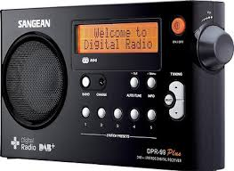
Three transformations affecting CRs * digitalisation of the radio: possibilities (more radio spectrum space) and risks (costs of transition and very low power) * podcasts: radio spot campaigns (health, worker’s right etc.) and interchange of local news via internet (Radiotube) * online radio: possibility of reaching wider audiences and also an alternative for unlicensed CRs
Brazilian Community Radio
~ Online radio and social media ~

Slide 15
Brazilian Community Radio
~ CRs broadcasting online ~
Malerba, 2016

Slide 16
Brazilian Community Radio
~ Online CR audience ~
Don’t no Less than 11 11 to 50 51 to 100 More than 101 Inaccurate
Malerba, 2016

Slide 17
Brazilian Community Radio
~ CRs use of podcast ~
Malerba, 2016

Slide 18
* autonomy from political control : Boas and Hildago (2011) demonstrate that in cases where there was a licensed radio station with ties to a candidate, it raised its share of the votes by 17% and the probability of winning by 28%. * increase participation: citizen participation on community radio rarely involves participation in decision making
Brazilian Community Radio
~ Challenges to CRs ~

Slide 19
Brazilian Community Radio
~ How community get involved? ~
Interviews, debates etc. Requesting songs Decision making meetings They don’t
Malerba, 2016

Slide 20
* funding: Law 9.612 prohibits advertising on community radio programming Nilson José dos Santos - community radio Esperança FM, a quilombo station in the town of Queimada Nova (state of Piauí, North-West Brazil): “Money is a problem, we can’t survive on what the station brings in. For me to do a report in the countryside, for example, it costs time and money on transport” (Santos, 2015).
Brazilian Community Radio
~ Challenges to CRs ~

Slide 21
Brazilian CRs: - remain at the centre of democratization ; - key vehicle for alternative voices, for deliberative talk and dialogue; - space for the rise of civic-journalism ; - contribute for a polyphony of voices and to break down barriers between message producers and consumers; - new ICTs: an opportunity to grow, to strengthen relationships with their audiences, and to build communities in ways that are not bound by geography .
Brazilian Community Radio
~ Conclusions ~

Slide 22
Raquel Paiva – raquelpaiv@gmail.com João Paulo Malerba – joaopaulorj@yahoo.com.br
Thank you

