Slide 1
Media: Overview and current issues in India
Discussion presentation for the 4th International Readings in Moscow: Mass Media and Communications, November 15-16, 2012.
Prof B.P. Sanjay,
vccutn@gmail.com

Slide 2
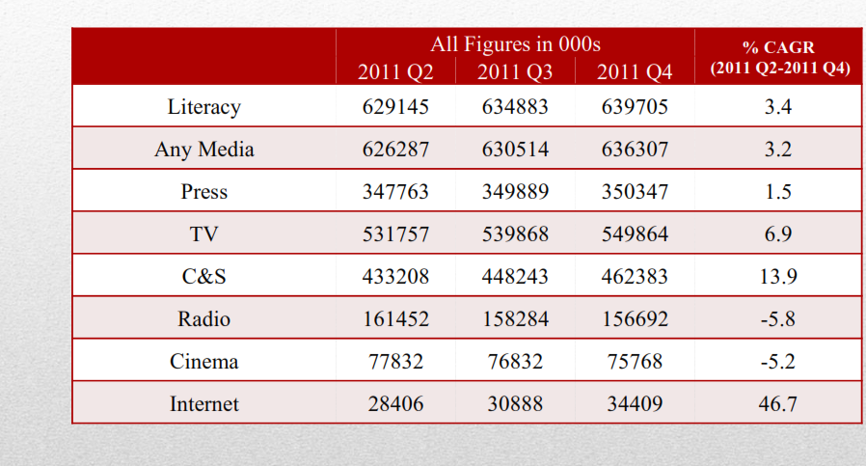

Slide 3
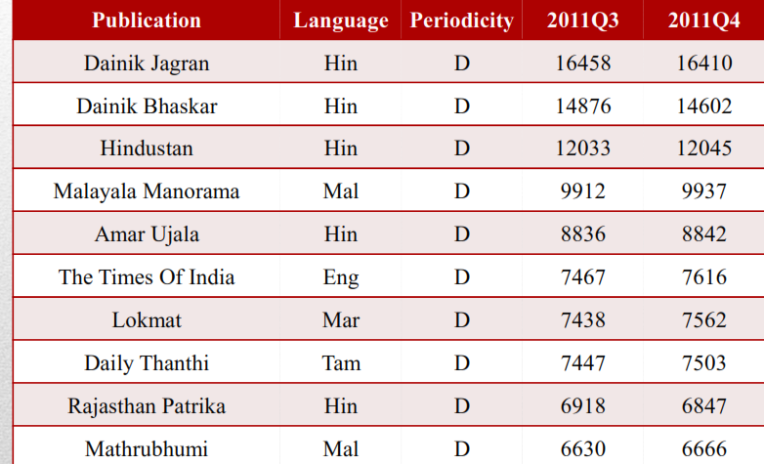
Note Indian Language Dailies have higher readership

Slide 4
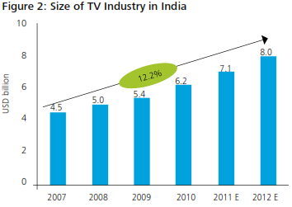
Growing Television…..

Slide 5
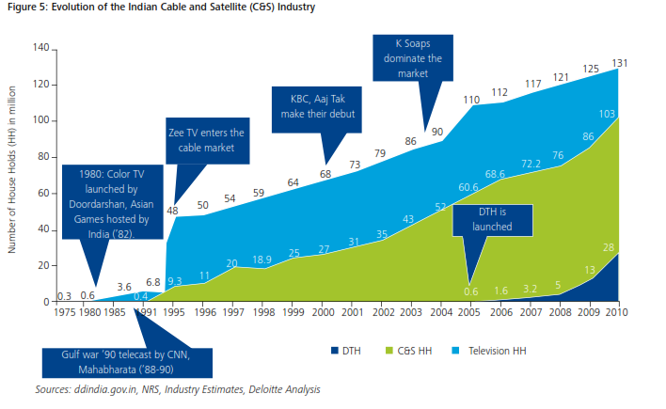
Television growth post privatisation

Slide 6
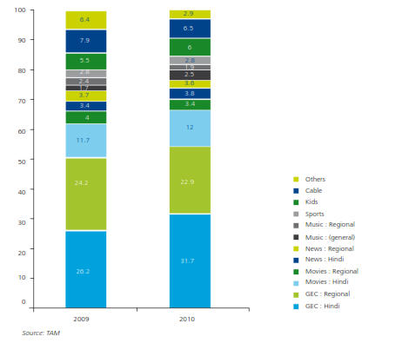

Slide 7
Indicative Figures: Growth rates are significant

Slide 8
Social Media

Slide 9
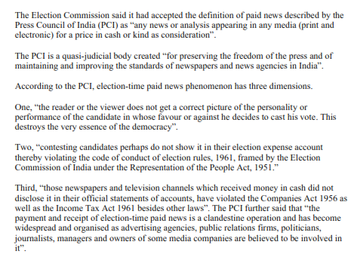
Paid News-….? !

Slide 10
India backs away from Control Issue?
Following outrage from India’s civil society and media, it appears the country’s government has backed away from its proposal to create a UN body to govern the internet. The controversial plan, which was made without consulting civil society, angered local stakeholders, including academics, media, and industry associations.
Civil society expressed fear that a 50-member UN body, many of whom would seek to control the internet for their own political ends, would restrict the very free and dynamic nature of the internet. The proposal envisaged ”50 member States chosen on the basis of equitable geographic representation” that would meet annually in Geneva as the UN Committee for Internet-Related Policies (UN-CIRP).
Rajeev Chandrasekhar, Indian parliamentarian and critic of the proposal, said: “CIRP seems like a solution in search of a problem”. At present, ICANN (Internet Corporation for Assigned Names and Numbers), a non-profit with ties to the US State Department, serves as the platform for internet governance, using an organisational structure that allows input from the wider internet community and not just governments of the world.

Slide 11
Journalism and Media Education
Universities, polytechnics, Media houses, Journalists’ associations. Civil society groups offer a host of regular Under graduate, post graduate, diploma and certificate programmes in India. Media courses are popular in that it offers youth a glamorous and adventurous career. It is both a high paying job as well as very lowly paid profession particularly at the grass roots level making them vulnerable to incentives from the rich and powerful interest groups.
However, there are recurrent issues ranging from necessity to mismatch between expectations of employers to skill sets of graduates….

Slide 12
Difficult to say what is ‘right’ with journalism education
Lot of interest in media from the new generation
Growing interest is a positive development
Glamour gets them into courses – however quickly disillusioned by quality and courses offered
Academics not able to deliver and live up to student expectations
Has not achieved the ‘rigor’ necessary

