Slide 1
Freedom of the press in BRICS countries: International ratings and reality
Jukka Pietiläinen
PhD.
Senior reseacher Docent
Aleksanteri-Institute CMT
Notes:
1

Slide 2
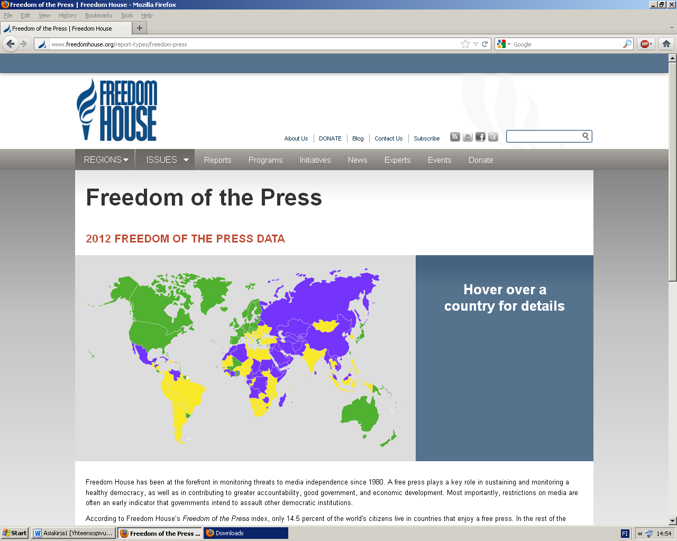
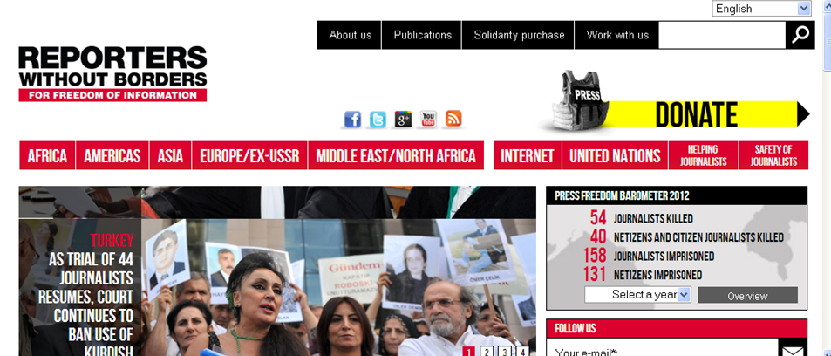

Slide 3
BRICS countries and media
Challenges, problems
Partly free (South Africa, Brazil, India) or non-free media (Russia, China)
Decline in the level of freedom from 1990s Recent improvements only in India (Freedom House)
Reporters without borders: worst scores for all BRICS countries in 2012

Slide 4
Freedom of the press in BRICS according to Freedom House
2002 2003 2004 2005 2006 2007 2008 2009 2010 2011 2012
Notes:
4

Slide 5
Freedom House / Reporters without Borders
South Africa 34 South Africa 12.00
India 35 Brazil 35.33
Brazil 44 India 58.00
Russia 80 Russia 66.00
China 85 China 136.00

Slide 6
Freedom of the press in Russia
1994 1995 1996 1997 1998 1999 2000 2001 2002 2003 2004 2005 2006 2007 2008 2009 2010 2011 2012
Notes:
6

Slide 7
Brazil
Vibrant democracy
journalists also experienced increases in violence, harassment, and censorship
courts becoming instruments of censorship
reporters being censored and attacked by the army and police
Control of mass media in Brazil continues to be highly concentrated among a few extremely large media companies

Slide 8
Russia
Kremlin relying on both crude and sophisticated forms of media management
politicized and corrupt court system to harass the few remaining independent journalists
Journalists continued to find it extremely difficult to cover the news freely
a vast state-owned media empire
Media diversity continued to decline
Government officials continued to harass some news websites and bloggers in 2011,

Slide 9
India
an increase in legal actions and occasional incidents of violence
Physical intimidation of journalists by a variety of actors continued
Members of the press are particularly vulnerable in rural areas and insurgency-racked states
Most print outlets are privately owned, provide diverse coverage, and frequently scrutinize the government.

Slide 10
China
Chinese authorities kept a tight grip on traditional and online media coverage of a range of politically sensitive topics
The CCP maintains direct control over news media coverage through its Central Propaganda Department
propagate positive views of the party and government
Those who cross the party-determined lines can also face arrest.

Slide 11
South Africa
Apartheid-era laws; recent legislation could further restrict the scope of permissible reporting
occasionally threatened with legal actions or charged
Journalists are occasionally harassed and threatened by both government and non-state actors
private newspapers and magazines are sharply critical of the government and political parties

Slide 12
Common elements
Harassment and treats against journalists
Legal actions against media
Separatism/terrorism: China, Russia, India (South Africa, Brazil)
Criticism of government or lower level officials not seen in positive light: ways to control and limit criticism are different

Slide 13
Thank you for your attention
Спасибо за внимание
Kiitos huomiostanne
Dankon pro via atento
Tack Gracias Danke Merci Tänan Тау Рəхмəт
ありがとうございます

