Slide 1
BRAZIL
Professional Characteristics of Journalism in Online and Traditional Media in Brazil

Slide 2
BRAZILIAN TeaM
RAQUEL PAIVA ( PROF. UFRJ)
MUNIZ SODRE (PROF. UFRJ)
MÁRCIO GUERRA (PROF. UFJF)
LEONARDO CUSTÓDIO ( PHD CANDIDATE U. TAMPERE)
CHRISTIANE PASCHOALINO (MD – UFJF)
JÃO PAULO MALERBA ( PHD CANDIDATE UFRJ)
ADRIANA SARAIVA (MD – UFRJ)
VANESSA FERREIRA (GRADUATE STUDENT UFJF)
YURI FERNANDES (GRADUATE STUDENT UFJF)
LAYRHA MOURA (GRADUATE STUDENT UFJF)
GABRIEL DESLANDES (GRADUATE STUDENT UFRJ)
ALEXANDRE LEITÃO (GRADUATE STUDENT UFRJ)
THAIS BARCELOS (GRADUATE STUDENT UFRJ)

Slide 3
Survey PROCESS
STARTED IN MARCH 2013 AND FINISHED IN AUGUST 2014
PROPOSAL ANALYSIS
PLANNING
ANALYSIS QUESTIONAIRE
SELECTION OF THE CITIES
SELECTION OF THE INTERVIEWEES
SCHEDULING OF INTERVIEWS
INTERVIEWS CARRIED OUT
TRANSCRIPTION OF INTERVIEWS
ANALYSIS OF COLLECTED DATA
TABLES DESIGN
TABLE ANALYSIS
WRITING TEXTS
RESULTS PUBLISHED

Slide 4
THE RESEARCH
4 CITIES:
1 CAPITAL
1 IMPORTANT METROPOLITAN CITY
2 MEDIUM SIZE CITIES
THE RESEARCH WAS CONCENTRATED IN THE SOUTH EAST REGION AND THE CITIES CHOSEN WERE :
BRASILIA, RIO DE JANEIRO, JUIZ DE FOR A AND VITORIA
A TOTAL OF 144 JORNALISTS WERE INTERVIEWED : TRADITIONAL AND ONLINE

Slide 5
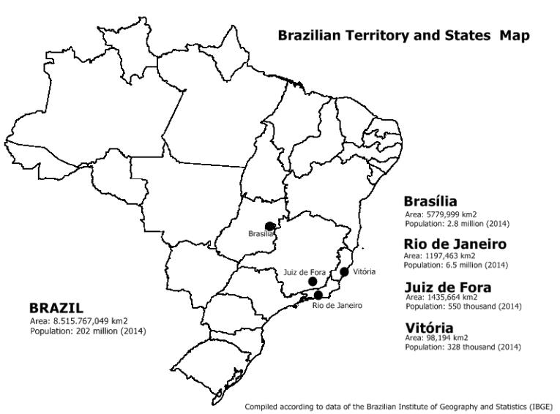
Map

Slide 6
JORNALISM IN BRAZIL (GENERAL)
MIDIA CHARACTERIZED BY FAMILY RELATIONS AND PATRIONIALISM
ECONOMIC CENSORSHIP IS STRONGER THAN POLITICAL
THE NEW GENERATION IS DOMINATING THE PROFESSION
LOW SALARIES AND PREFENCE FOR DIPLOMAS
INTERNET AND NEW MEDIA IS CHARACTERIZING NEWS PRODUCTION

Slide 7
BRASILIA
TOTAL OF 48 INTERVIEWS

Slide 10
RIO DE JANEIRO
TOTAL OF 48 INTERVIEWS

Slide 13
JUIZ DE FORA
TOTAL OF 24 INTERVIEWS

Slide 15
VITÓRIA
TOTAL OF 24 INTERVIEWS

Slide 17
THE WORK OF THE BRAZILIAN JORNALIST

Slide 19
WHAT DID THE RESEARCH SHOW US?
FIRSTLY, WE CAN COMPARE BRAZILIAN JORNALISM WITH THAT OF OTHER COUNTRIES THAT MAKE UP THE POLITICAL AND ECONOMIC BLOCK OF EMERGING COUNTRIES: RUSSIA, INDIA, CHINA AND SOUTH AFRICA. THERE ARE MANY SIMILARITIES AND DIFFERENCES.
THE TECHNOLOGICAL REVOLUTION : BRAZILIAN JORNALISM ADDED NEW TOOLS WHICH RADICALLY CHANGED REPORTING, PRODUCTION AND THE RELATIONSHIP WITH THE READER.

Slide 20
ONLINE JoUrnalism IN braZil
WORK PLACE CHANGES : INTEGRATED NEWSROOM
CHANGES IN BREAKING NEWS (USE OF SOCIAL NETWORKS PARTICULARLY WHATS APP)
CHANGES IN THE RELATIONSHIP BETWEEN READER AND JORNALIST .
CHANGES IN THE FORMAT OF NEWS REPORTS: NEWS BITES, MORE PHOTOS.
CHANGES IN DAILY WORK ROUTINE – WORKING FROM HOME

Slide 21
WHO IS THE COMPLETE JOURNALIST TODAY?
The complete journalist is someone who must bring up to date his skills in the digital devices, news-gathering and editing.
It is essencial to perform aptly on different plataforms (print press, tv, radio, internet) and in different expressing ways (voiced, written, photographic, audiovisual and hipertextual)
It is important to be knowledgeable on management and marketing in order to view cultural goods as business-merchandise and to provide guidelines for audience segmentation.

Slide 22
NEW PROFESSIONAL?
MAIN QUESTION: HOW SIGNIFICANT IS THE CHANGE TO YOUR DAILY WORK AFTER COMPLETE INTEGRATION OF NEW TECHNOLOGIES ?

Slide 23
THANK YOU!

