Slide 1
South African media: local contests and global shifts
Herman Wasserman
Rhodes University, South Africa

Slide 2
SA another BRIC in the wall?
SA joining BRICS heralds new global partnership
Optimistic view: process of emergence from isolated pariah to regional powerhouse
But not as simple narrative as that.
SA’s status as a BRICS country contested – much smaller economy than other partners
Internal inequalities militate against uncritical celebration of economic growth and prosperity

Slide 3
South African media
As far as media is concerned, South Africa can be seen as a regional power:
Vibrant media industry
Free press
Leaders in education and training, professionalisation
Expansion into continent
But not a simple, linear process:
Multiple flows of content, interpenetration of capital
Internal tensions, inequalities
Outward relations controversial – hegemon on continent, China-Africa relationship critiqued
Local contests, global shifts make up a complex dynamic

Slide 4
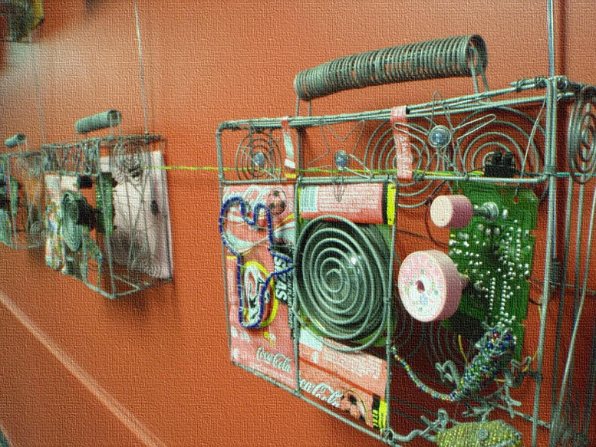
Outline
SA media landscape after apartheid – local contests
SA media within new outward relations – global shifts

Slide 5
SA media in brief
Under apartheid:
Political parallelism (Afrikaans/English/alternative)
Repressive legal environment
Dominated by white ownership and editorial staff
Technologically sophisticated industry

Slide 6
SA media in brief
After apartheid:
Constitutionally guaranteed freedoms
Self-regulated
Less polarised, ‘watchdog’ orientation
Normative frameworks contested
Political economy:
Commercial concentration (demise of alternative media; attempts to transform via ownership and staff but elite continuity/renewal; state intervention via MDDA, but public and community media face challenges)
Unequal access, concentration in a few big conglomerates, content still largely racially segmented

Slide 7
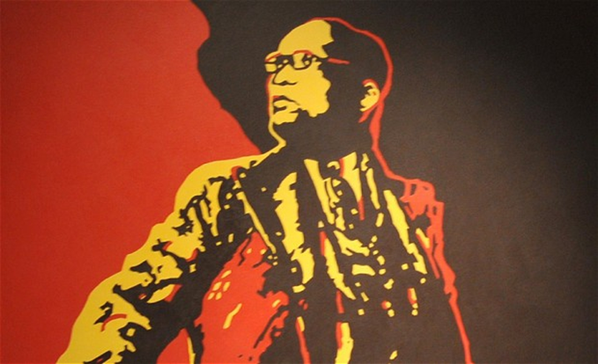
New pressures …
Pressures
Media Appeals Tribunal
Protection of State Information Bill (securitization of state – Marikana?)
Transformation Commission
State interference in SABC (viz Jimi Matthews on Nkandla)
Satire not appreciated (Zapiro sued, ‘The Spear’ outcry, ZA News not on SABC)

Slide 8
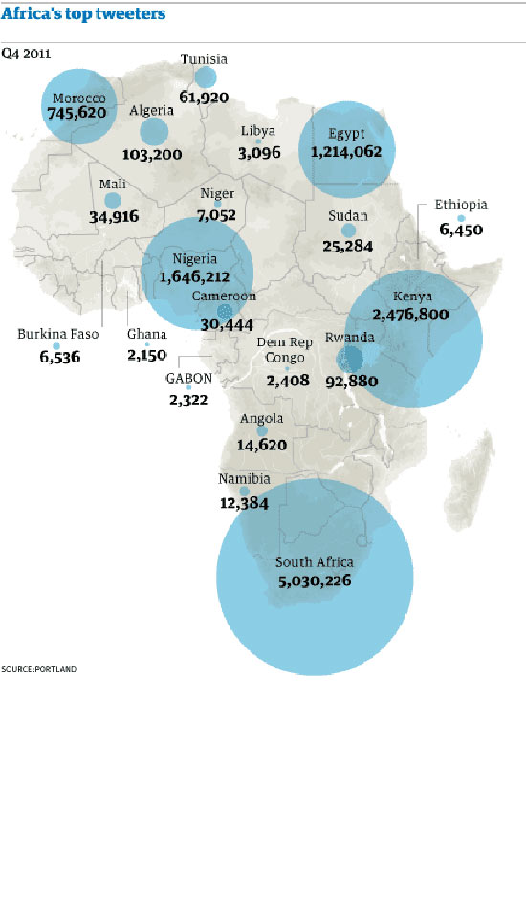
….and opportunities
Opportunities
Technology: huge take-up of mobile phones, more internet access than fixed-line
Social networks : Mxit huge among teenagers, Twitter biggest on continent (twice as many as Kenya in 2nd place)
Strong civil society using social media: Right 2 Know campaign, Equal Education

Slide 9
Global shifts
‘Interpenetration’ of capital
Inward flows:
Capital: Independent Media
Content: global formats
Outward flows:
Hegemonic position on continent
Global interests via pay TV, internet

Slide 10
SA within BRICS
Entry into BRICS alignment brought renewed media focus on international relations
Among these – China most important (continent’s biggest trade partner) and receives most coverage of BRICS group
Most contentious partnership – fears of interference in local politics, loss of jobs etc.
But also fewer strings attached to aid – non-interference in domestic policies
Africa historically ‘a horse – Western brutal rider, beating the horse, Chinese rider gives carrots’
Questions asked in media : new type of imperialism? ‘Scramble for Africa’? ‘Partner or predator’?

Slide 11
Representation of BRICS in SA media

Slide 12
Image of China in SA media
Started with cautious attitude
Analysis of coverage over last 3 years shows balanced view of China emerging, becoming more positive
Cautiously optimistic attitude in media – not pigeonholed as ‘good’ or ‘bad’ story
China firm place on news agenda
Strong economic focus, little social coverage
Economic interest supersedes political issues

Slide 13
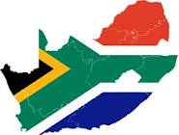
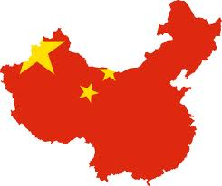
Image of China in SA media
Jan 2011-March 2012

Slide 14
Conclusion
South Africa emerging ‘middle’ power, part of global flows & contraflows of capital & content
Multiple processes of negotiating internal and external relations
As SA finds a place in new geopolitics, inequalities continue internally
Translates into a media system that a) still negotiates its role in relation to state and public and b) views SA’s membership of BRICS with cautious optimism

