Slide 1
Information Disseminator or Opinion Guider?
Ideas of Journalistic Professionalism from China in the Digital Age
Yu Xu
University of Southern California, USA
Ruiming Zhou
Fudan University, Shanghai, China
Xianzhi Li
Capital University of Economics and Business,Beijing, China

Slide 2
New Media Ecology in China
Media Commercialization and Capitalization
Propaganda Model and Market Model
Provide Information
Guide Public Opinions
Digital Communication
New Players in Media Arena
Strategies change of traditional media
News Processing

Slide 3
Revisit Journalistic Professionalism
Two Objectives
Detect the social profiles, functions of journalism, roles of journalists, and ideas of professionalism
Examine the differences between journalist from perspectives of organizational forms and geographic factors
Method
Face-to-face interviews with 146 journalists
4 cities: Beijing, Shanghai, Guangzhou, Wuhan
State-owned news media, news websites or grass-root media
From March 2014 to January 2015

Slide 4
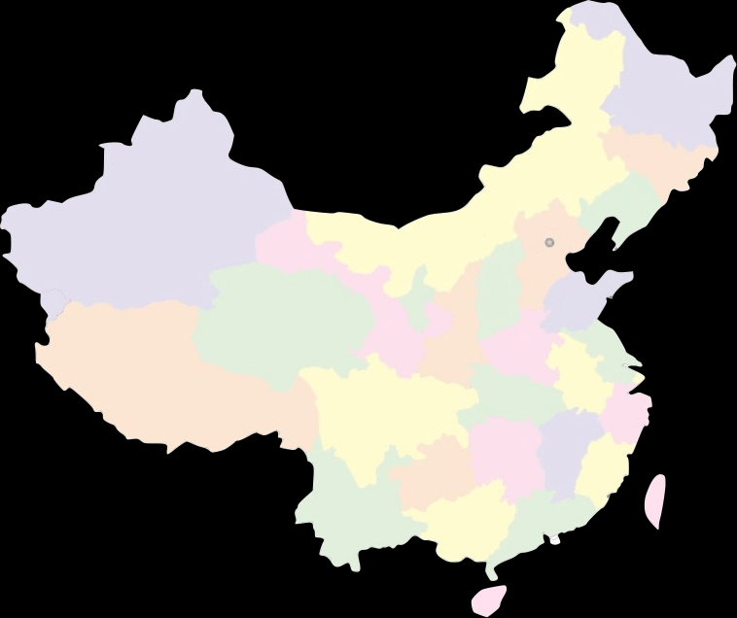
Beijing
Shanghai
Wuhan
Guangzhou

Slide 5
Quick Facts about 146 Journalists

Slide 6
Social functions of Journalism
Cities | Media Type | Function 1 | Function 2 | Function 3
Beijing | Old | Provide information | Guide the opinion | Social supervision
 | New | Provide information | Promote objectivity | Protect people/society
Shanghai | Old | Provide information | Guide the opinion | Provide a picture of the world/day
 | New | Provide information | Interpret issues such as new laws, societal problems, etc. | Help form opinions (public's, various groups)
Guangzhou | Old | Provide information | Educate | Enlighten; Search for solutions (constructive criticism)
 | New | Provide information | Search for solutions (constructive criticism) | Educate
Wuhan | Old | Provide information; Help people/society | Search for solutions (constructive criticism) | Entertain;Interpret issues such as new laws, societal problems, etc.
 | New | Provide information | Provide a picture of the world/day | Guide the opinion

Slide 7
Roles of Journalists
Cities | Media Type | 1st Role | 2nd Role | 3rd Role
Beijing | Old | Information disseminator | Supervisor | Social observer; Rational thinker
 | New | Information disseminator | Objective information recorder | A bridge between the government and the public
Shanghai | Old | Neutral Information disseminator | Public opinion guider | Social progress promoter
 | New | Neutral Information disseminator | Public opinion guider | Social progress promoter
Guangzhou | Old | Information disseminator | Supervisor | A bridge between the government and the public
 | New | Information disseminator | Social progress promoter | Information recorder
Wuhan | Old | Neutral Information disseminator | Supervisor | Social order maintainer
 | New | Neutral Information disseminator | Public opinion guider | Opinion expresser

Slide 8
3 Most Important Predictors By Cities
BEIJING | No.1 | No.2 | No.3
Old Media | Good writer | Engage in ethical conduct in general and in profession | Objective
New Media | Objective | Engages in ethical conduct in general and in profession | Competent, knowledgeable about subject

Slide 9
3 Most Important Predictors By Cities
SHANGHAI | No.1 | No.2 | No.3
Old Media | Curiosity | Good writer | Generally erudite and scholarly; Is objective
New Media | Curiosity | Competent, knowledgeable about subject; Good writer; Unbiased; Engages in ethical conduct in general and in profession; Is objective | Independent

Slide 10
3 Most Important Predictors By Cities
Guangzhou | No.1 | No.2 | No.3
old media | Competent, knowledgeable about subject | Engages in ethical conduct in general and in profession | Independent
new media | Competent, knowledgeable about subject | Is objective | Unbiased; Engages in ethical conduct in general and in profession; Courageous, has grit; Rational

Slide 11
3 Most Important Predictors By Cities
Wuhan | No.1 | No.2 | No.3
old media | The ability to judge news value; Social interaction ability; Interview skills | Engages in ethical conduct in general and in profession | Good writer; Unbiased; Is objective
new media | The ability to judge news value; Social interaction ability; Interview skills | Engages in ethical conduct in general and in profession | Generally erudite and scholarly; Competent, knowledgeable about subject; Good writer

Slide 12
Conclusions
They seldom held a second job, and were primarily satisfied with their earnings.
Online journalists were more likely to have two or more past jobs and less likely to be union and party members than their traditional media counterparts.
Journalists were unable to reach a consensus on important predictors of professionalism, but almost all the journalists mentioned ethical conduct as well as writing skills.
Those factors, such as being independent from interest groups, being objective when reporting stories and lack of bias, are crucial in the West, did not matter a lot in China.

Slide 13
Conclusions
The fundamental function of journalism was to provide information.
The interpret role was emphasized, but it was often defined as “guiding the opinion”, a kind of propaganda discourse in CCP, which means to act as a mouthpiece for the government.
Journalists here believed they should first perform as information provider, and next role was “guide the opinion”.
The most prominent limitation of this study is that we recruited our respondents through non-probability sampling.

Slide 14
Thank You!

