Slide 1
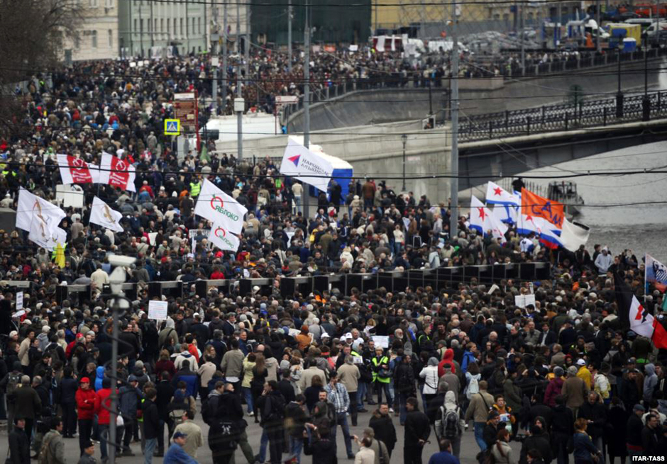
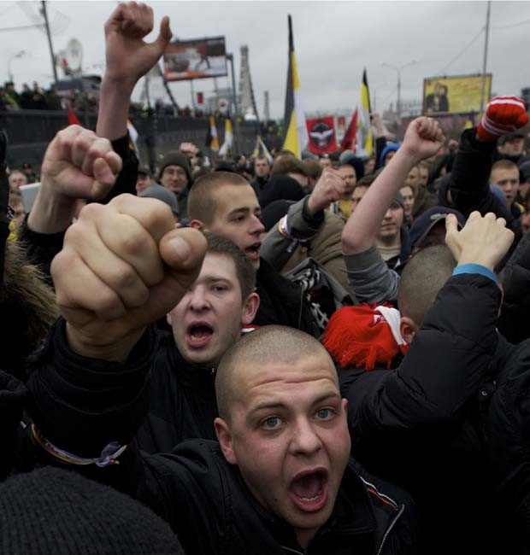
Russian journalists Attitude to protests
Professor Dmitrii Gavra
Professor Dmitrii Strovsky
Rio
September 2015

Slide 2
Basic understanding of political protest in modern political science
Collective action aimed at changing the system of representative and\or executive power, the policy of the state or the relations between citizens and the state in general (Jenkins , Klandermans, 1995)

Slide 3
Some myths about protests in modern Russia
Protests in Putin’s Russia have no tradition.
Protests are week, fragile, underdeveloped, fragmented
Protests are basically from liberal side of political spectrum
Political opposition organizing protests claims democracy, civil rights, press freedom, etc.

Slide 4
Five stages of protest movement in modern Russia (1990 – 2015)
1 stage – 1990 – 1991
Mass democratic demonstrations and social movements against Communist party reign and the strike movement of workers. The most numerous public actions in the history of modern Russia.

Slide 5
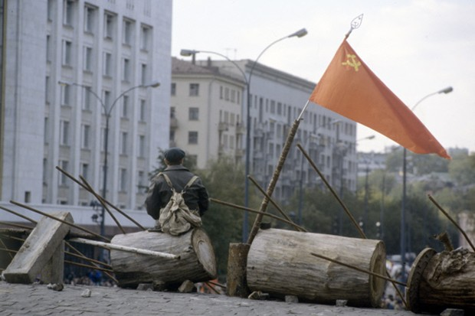
The second stage (1992 – 1993)
political protest of the communist opposition against President Yeltsin with mass political mobilization of October 1993.
The scale of protest less than in the previous period.

Slide 6
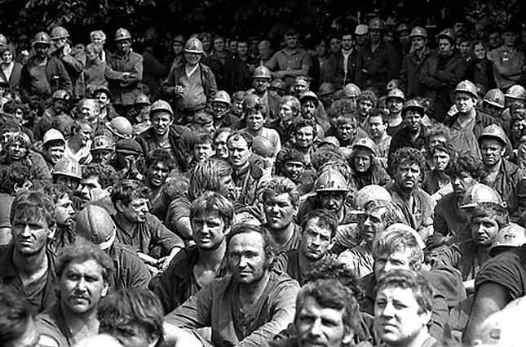
The third stage (1994 -2004)
The growth of the workers strike movement
Low level of political protest.
“Putin’s consensus”

Slide 7
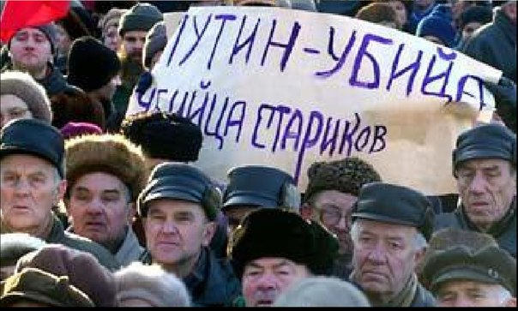
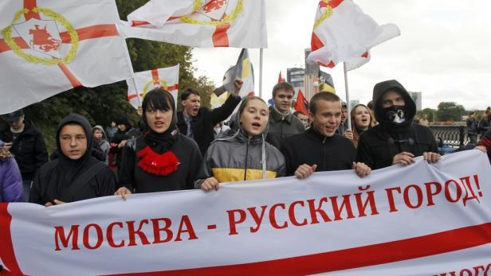
The fourth period (2005 -2010)
Rebirth and growth of political protest
Mass protests of old age pensioners against Putin’s monetization social reforms – 2005
Protest of the car owners 2007-2010
Ecological protests 2007 – 2010
Protest in the Rissian regions against local authorities
Protest of the Russian nationalists

Slide 8
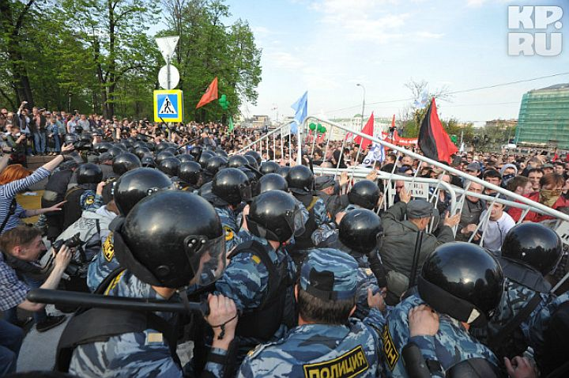
Finally, the fifth period since 2011
Following the December 4, 2011 parliamentary elections, thousands of Muscovites took to the streets to protest reports of electoral fraud.
Within the week, protests calling for “fair elections” had spread to other large Russian cities;
over 30,000 citizens pledged virtual support for the opposition on Facebook; and the street-based protests attracted a diverse range of discontented citizens.

Slide 9
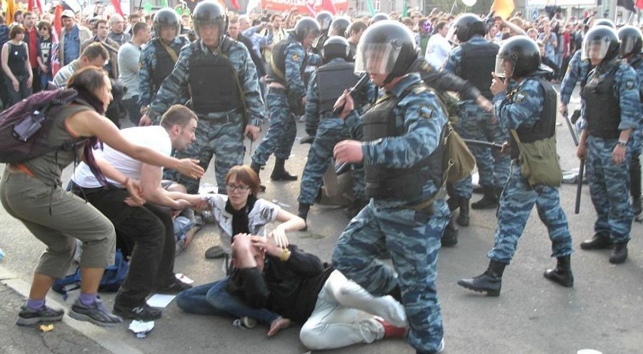
Finally, the fifth period since 2011
Young urban professionals marched alongside pensioners and intellectuals, and the ideological spectrum ranged from liberal and communist to nationalist and monarchist.
Official police estimates suggested 25,000 had joined the demonstrations, while various opposition leaders claimed the crowds reached up to 150,000

Slide 10
Structure of the Russian protest
Protest
Workers strikes
Russian nationalists protest
Ecological protest
Protest of systemic and non-systemic political opposition
Protest of different social groups

Slide 11
Geography of the protest and geography of the survey

Slide 12
Survey data Russian journalists attitude to protest: split, but still negative

Slide 13
Structure of the journalist’s attitude to protest: the factor model
Type of the media. New versus traditional
Type of the region. Metropolitan versus provincial.
Type of the media ownership. State versus independent.
Generation belonging (political socialization period).
Political values. Liberal versus conservative.
Type of the media channel: newspaper, radio, TV

Slide 14
New media journalist are more likely to support protest

Slide 15
Metropolitan and provincial journalists: different in their attitude to protest

Slide 16
Traditional media journalists: more conservative, especially in province

Slide 17
Structural model of the Russian journalists positive attitude motivation to political protest
Protest positive
Oppositional political values shared with protesters
Personal liking of the protest leaders and common protesters
Distrust and negative attitude to acting political regime
Positive attitude to the civil right of legal protest without support to protesters

Slide 18
Why do journalists support protests? Factors
Factor 3. Distrust and negative attitude to acting political regime
Roman, 42 yr., TV-correspondent
The protests help to destroy state oligarchy which is greedy about getting profits only for itself.
The authorities do not worry about social problems, and the protests remind them: you are bastards, you have to know your place!
We as people are being cheated with these Russian powers.

Slide 19
Why do journalists support protests? Factors
Factor 4. Positive attitude to the civil right of legal protest without particular support to protesters
Igor’ , 27 yr., reviewer of Internet Gazette
It is normal to have and transmit comments from all those who are involved in one or another situation. Journalistic reports stimulate our authorities to conceive what goes on around them. It is important to know the opinions of all sides.

Slide 20
Why do journalists support protests? Factors
Factor 2. Personal liking of the protest leaders and common protesters
Anna, 28 yr., radio correspondent
The people from opposition are great because they come out onto the streets. They can say about what other people are silent, and this is important because lately it is not habitual in our country to speak about what is not liked.

Slide 21
Structural model of the Russian journalists negative attitude motivation to political protest
Distrust to the protest leaders
Fear of instability, political turbulence
Trust and positive attitude to the actual political regime

Slide 22
Why do journalists neglect protests?
Protests shake the boat and make the whole state mechanism totally or, at least, partly unmanageable;
Darya, 40 yr.., editor in chief of the glossy magazine:
As an individual of an old formation I think that it is not worth shaking the boat. I have a very ambiguous attitude to the protests in Russia.

Slide 23
2. Mistrust to the leaders of opposition as personally feeble who simultaneously tend to reach their own purposes;
Anton, 32 yr., newspaper correspondent:
The ideas of opposition seem to be good, but their leaders are powerless and do not set concrete programs and purposes. Besides, they discredit each other. Therefore people do not support the opposition
Pavel, 25 yr., Internet journal
Many of those who protest, do this for money. I have many friends working for security bodies and they know that those who participate in protests get the money in the lobbies. I am prone to believe them.
Dmitry, 26 yr.., Internet portal
I support protests but do not feel interesting to take part in them. I cannot influence the powers and some people from the opposition look arrogant and selfish to real people’s needs

Slide 24
3. The leaders of the protest movement think only of themselves
Kirill, 26 yr., Internet newspaper
They are stupid and cannot work consistently and hard. It is correct that these people are bullied. It is always as a historical process continues. If it is going ro be a civic war, it is not awful because later will be better.
Maria, 28 yr., Internet website
Journalists often provoke situations and are eager to draw attention only. All journalists are involved in money work.
Valeriy, 45 yr., radio correspondent
Those who come out onto the streets want satisfy their ego, first of all. They are not real fighters and seem to be untrusted. Many of them dream about destroying the system without bringing something positive to it.

