Slide 1
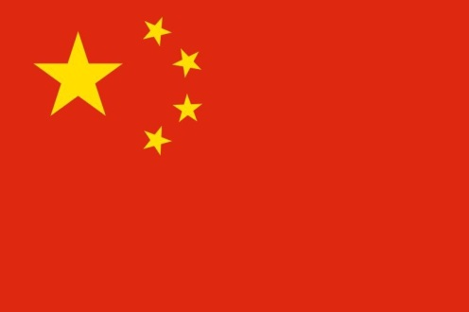
South Africa and China as BRICS partners: media perspectives on geopolitical shifts
Herman Wasserman
Rhodes University, South Africa

Slide 2
Outline
SA in BRICS – closer relationship
Mediation of geopolitical shifts
Interpenetration of media presence
SA coverage of China
China coverage of SA
Conclusion

Slide 3
SA & China in BRICS
SA joining BRICS in 2010 on invitation from China heralds new partnership
Emerging from isolated pariah to regional power
SA’s status as a BRICS country contested – much smaller economy than other partners, inequality
Criticism of BRICS as no more than ‘catchy acronym’ (Bremmer in NYT)
BRICS might compete rather than collaborate
Opposition to status quo rather than coherent team

Slide 4
Geopolitical shifts are mediated
In these geopolitical shifts – media a key player
Media among flow and counterflow of capital
Media represent these countries to each other
Media a proxy for negotiation of key values:
‘Debates about media are debates about
democracy’

Slide 5
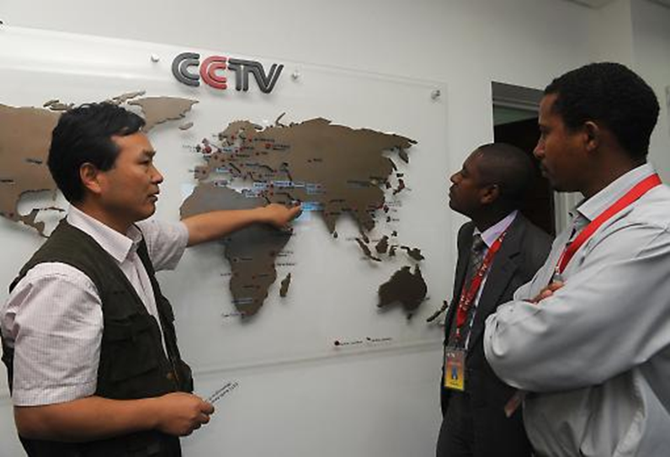
Interpenetration of media
China’s use of media for ‘soft power’ in Africa:
CCTV based in Nairobi
Xinhua used widely by African media, also on mobile
China Daily publishes African edition from Johannesburg
Exchange visits and training for journalists
Infrastructure development for African media
http://martinplaut.wordpress.com/2012/11/23/chinas-soft-power-offensive-in-africa/

Slide 6
Interpenetration of media
‘The rise of ChinAfrica’ – Chinese investment supports economic boom on continent
African media company Naspers ‘rides big Chinese wave’ through Tencent

Slide 7
Image of China in SA media
Started with cautious attitude
Analysis of coverage over last 3 years shows balanced view of China emerging, becoming more positive
Cautiously optimistic attitude in media – not pigeonholed as ‘good’ or ‘bad’ story
China firm place on news agenda
Strong economic focus, little social coverage
Economic interest supersedes political issues

Slide 8
SA coverage of China

Slide 9
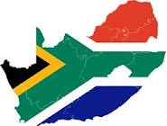
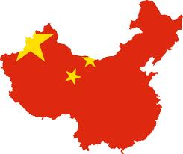
SA coverage of China

Slide 10
Chinese coverage of SA

Slide 11
Conclusion
SA-China - mediated relationship
Media an actor in growing relationship
Image of China in SA media becoming more positive; Concerns about SA in Chinese media
Mostly economic and political coverage
BRICS economic category – will media help make it social and cultural category as well?

Slide 12
Thank you
h.wasserman@ru.ac.za
See CFP for special issue of Ecquid Novi: African Journalism Studies on China in Africa (2013)

