Slide 1
China‘s New Long March to World Class Universities: From “project 211” to “project 2011”
LIU Baocun
Institute of International and Comparative Education
Beijing Normal University

Slide 2
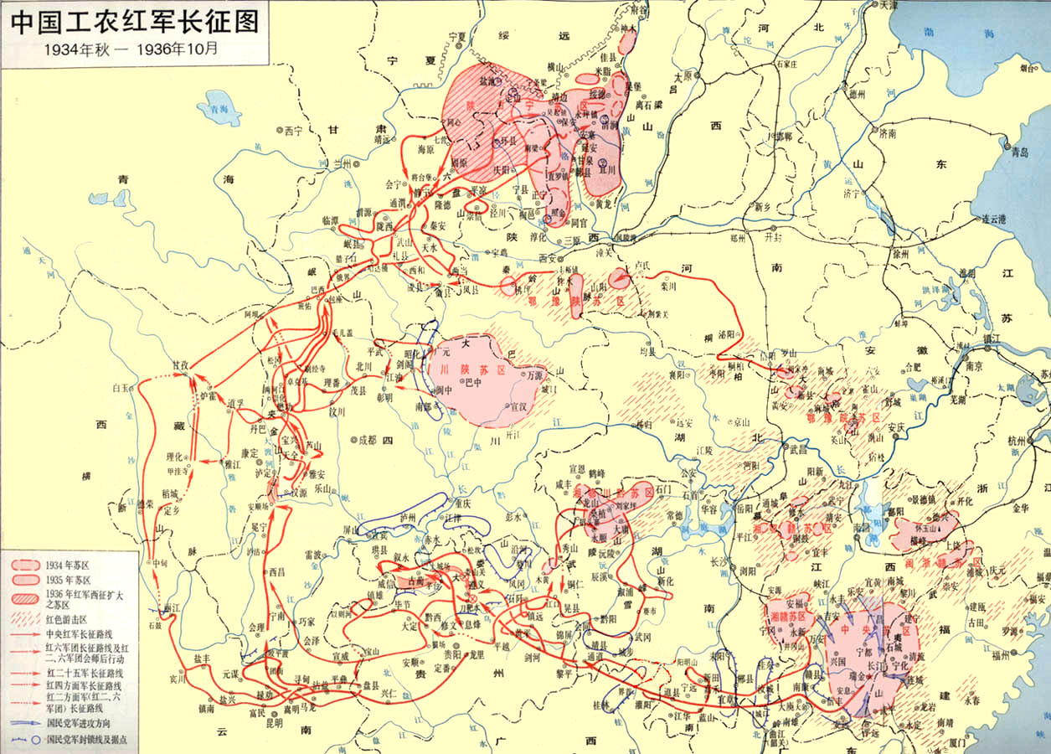
Preface
The Long March of the Red Army during 1934 to 1936, which covers 12500 km and 11 provinces, is a miracle in the world military history.

Slide 3
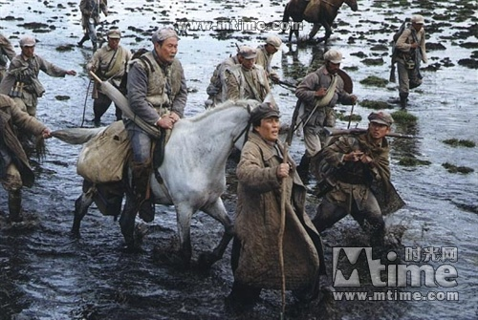

Slide 4
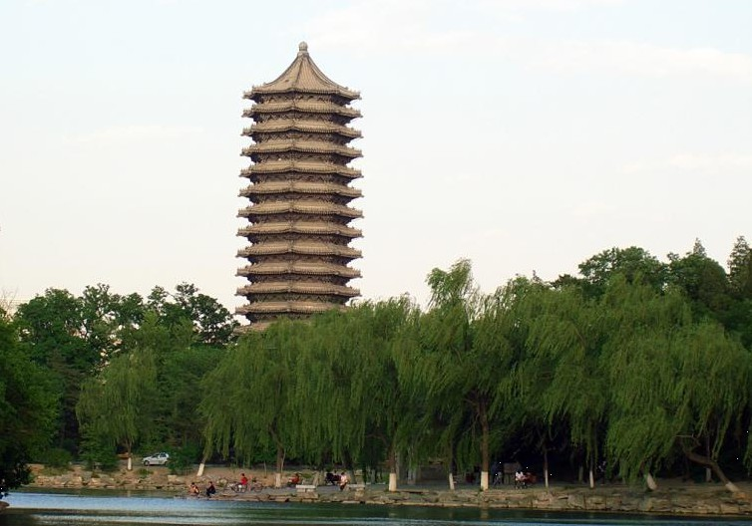
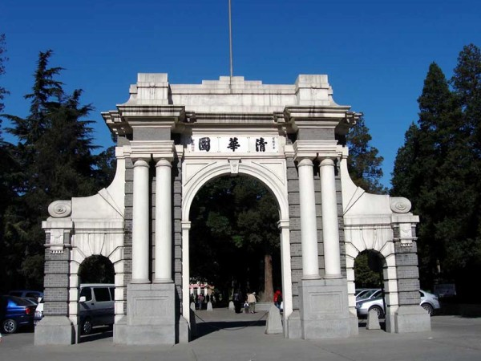
On May 4, 1998, at the 100th anniversary of Peking University, Chinese President Jiang Zemin announced that “China should build several world-class universities in order to realize the modernization of the country”

Slide 5
Outlines
1.The Concept of A World-class University
2. The National Strategies to Build World-class Universities in China
3. The Effects, Problems and Future Policy Trends to Enhance the Leading Universities in China

Slide 6
1. The Concept of A World-class University
Everyone wants a world-class university. No country feels it can do without one. The problem is that no one knows what a world-class university is, and no one has figured out how to get one. Everyone, however, refers to the concept.
----Philip G. Altbach

Slide 7
1.1 Characteristics of the concept of World-class University
World-class university is a collective concept;
World-class university is a comparative concept;
World-class university is a vague concept;
World-class university is a developing concept.

Slide 8
1.2 Some characteristics of a world-class university.
Excellence in research underpins the idea of world class--research that is recognized by peers and that pushes back the frontiers of knowledge.
Academic freedom and an atmosphere of intellectual excitement is central to a world-class university.
World-class universities have a significant measure of internal self-governance and an entrenched tradition.
Adequate facilities for academic work are essential.
Finally, and central to the academic enterprise, adequate funding must be available to support the research and teaching as well as the other functions of the university.

Slide 9
2. The National Strategies to Build World-class Universities
1. The early initiatives to build key universities
In 1949, China had 205 colleges and universities, among them 124 are public while 81 are private .
China wants to train more qualified engineers and relevant talents to support the economic development, especially the development of heavy industry.
During 1951-1953, China reorganized its colleges and universities, following the Soviet Union model.

Slide 10
2.1 Key universities in 1950s
In 1954, the Ministry of Higher Education decided to build the first 6 key universities:
Remin University of China
Peking University
Tsinghua University,
Harbin University of Technology
Beijing University of Agriculture
Beijing Medical University

Slide 11
The Key universities were assigned three missions:
--to train high-quality talents of different professions and research;
--to train faculty for other colleges and universities ;
--to support other colleges and universities with instruction .

Slide 12
Measures to enhance the key universities:
--to provide them with better faculty members;
--employ foreign experts for them;
--to improve their infrastructures and relevant facilities;
--to enhance their education programs.

Slide 13
In 1959, the central government expanded the key universities to 16 institutions. Besides the first 6 key universities, the 10 new members of the club are as follows:
Beijing Normal University
Beihang University
Beijing Institute of Technology
Fudan University
Science and Technology University of China
Tianjin University
East China Normal University
Shanghai No. 1 Medical University
Shanghai Jiaotong University
Xi’an Jiaotong University.

Slide 14
Later in 1959, 4 more universities are admitted to the key university club.
China Medical University
Harbin Institute of Military Engineering
No.4 Military Medical Universities
Institute of Communication Engineering

Slide 15
2.2 Key universities in 1960s
In 1960，The central government decided to add 44 universities to the key university club, and leads to 64 key universities in total.
In 1963, 4 more universities were admitted to the key university club, and the total number increased to 68 universities.

Slide 16
The 68 universities including different kinds higher education institutions:
14 comprehensive universities
33 institutions of engineering
5 medical institutions
4 agriculture and forestry institutions
3 institutions of economy and finance
2 normal universities
2 universities of foreign studies
1 academy of arts
1 institution of physical education
2 military institutions.

Slide 17
2.3 key universities during the cultural revolution
During the cultural revolution from 1966 to 1976，some of the key universities were closed, merged with other institutions, or moved to the rural areas.
Many campuses were occupied for other purposes and apparatuses, books and facilities were destroyed.

Slide 18
2.4 key universities after the cultural revolution
In 1978, the central government decided to resume and build the national key universities and 88 universities were chosen as key universities, which account to about 22% of the total.
By the end of 1979，97 universities were selected as key universities.

Slide 19
2.5 Project 211
In 1993，the State Council decided to build about 100 key universities and some key disciplines so that the quality of education, research and management at these universities, disciplines and programs can reach a higher level compared with their counterparts in the world.
It is also hoped that these universities will set an example to other higher education institutions.

Slide 20
112 universities were selected to join Project 211.
Project 211 focused on three main tasks:
-- to enhance the key disciplines;
--to consummate the public service systems;
--to improve the overall conditions of the universities.

Slide 21
Expenditure from difference sources (billion RMB)
Year | Total expenditure | Central government | Local government | Universities
1995-2000 | 18.63 | 2.755 | 10.32 | 5.56
2001-2005 | 18.75 | 6.0 | 5.97 | 6.78

Slide 22
Expenditure from difference sources (billion RMB)
Year | Total expenditure | Key disciplines | Public service systems | Overall conditions
1995-2000 | 18.63 | 6.47 | 3.61 | 8.55
2001-2005 | 18.75 | 9.79 | 3.71 | 5.26

Slide 23
2.6 Project 985
On May 4, 1998, at the 100th anniversary of Peking University, Chinese President Jiang Zemin announced that “China should build several world-class universities in order to realize the modernization of the country”
On Dec.24,1998, The Action Plan of Education Development for the 21Century decided to build several world-class universities and disciplines in 10-20 years.

Slide 24
Project 985 gives priority to the following main tasks:
Mechanism innovations in personnel management, evaluation , salary, research management and organization, accountability.
Faculty development
Innovation platforms as national labs, national key labs, national engineering research centers, national engineering technology research centers, innovative teams, national centers in humanities and social sciences.
Supporting facilities in public resources, equipments, libraries, electric databases, teaching and research buildings.
International exchange and cooperation.

Slide 25
39 “Project 985”universities
provinces | universities | number | %
Beijng | Peking University, Tsinghua University, Remin University of China ,Beijing Normal University , Beijing Institute of Technology, Agriculture University of China, Minzu University of China, Beihang University | 8 | 20％
Shanghai | Fudan University, Tongji University, Shanghai Jiaotong University, East China Normal University | 4 | 10％
Shanxi | Xi’an Jiaotong University, Northwest Polytechinical University , Northwest A&F University | 3 | 7％
Hunan | Central South University, Hunan University, University of National Defence Science and Technology | 3 | 7％
Hubei | Wuhan University, Central China University of Science and Technology | 2 | 5％
Sichuan | University of Electronic Science and Technology of China, Sichuan University | 2 | 5％

Slide 26
Jiangsu | Nanjing University, Southeast University | 2 | 5％
Liaoning | Northeast University, Dalian University of Technology | 2 | 5％
Shandong | Shandong University, Ocean University of China | 2 | 5％
Tianjin | Tianjin University, Nankai University | 2 | 5％
Guangdong | South China University of Technology, Zhongshan University | 2 | 5％
Anhui | Technology University of China | 1 | 3％
Zhejiang | Zhejiang University | 1 | 3％
Heilongjiang | Harbin University of Technology | 1 | 3％
Chongqing | Chongqing University | 1 | 3％
Gansu | Lanzhou University | 1 | 3％
Fujian | Xiamen University | 1 | 3％
Jilin | Jilin University | 1 | 3％

Slide 27
3. The Effects, Problems and Future Policy Trends to Enhance the Leading Universities in China
3.1 The Effects of the national strategies to build world-class universities in China
3.1.1 The capability of the leading universities is improved and the Chinese Universities are getting better place in the world rankings of universities.

Slide 28
3.1.2 There arose many centers of excellence and strong educational programs.
national labs
national key labs
national engineering research centers
national engineering technology research centers
innovative teams
national centers in humanities and social sciences.

Slide 29
3.1.3 The universities attracted hundreds of outstanding scholars from domestic and international universities and cultivated thousands of innovative talents.
Recruit faculty members from abroad;
Attract leading scholars from other universities;
Cultivate innovative talents at bachelor, master and doctoral level.

Slide 30
3.1.4 The research capability of the leading universities were upgraded with recognized findings.
The R&D outlay of Project 211 universities during 2000-2005 is 8.3 times as much as that during 1990-1995.
During 2000-2005, the Project 211 universities accounts for more than 50% the national awards in science, technology and social sciences while 70% in 2006-2010.

Slide 31
3.1.5 The leading universities are becoming power stations to the rapid developing economy
The leading Universities such as Peking University, Tsinghua University as well as their science parks are becoming a leading force in technical innovation and high-tech industries.
The leading Universities play an important role in social development as think tanks and innovation engines.

Slide 32
3.2. The Problems and Future Challenges of the Leading Universities in China
3.2.1 Lack of leading world-class scholars
Low Salary
Different culture
Different food
Different evaluation

Slide 33
3.2.2 The bureaucratic university governance system
University as a branch of the government;
University as an enterprise

Slide 34
3.2.3 Insufficient fund and low efficiency of fund distribution
Insufficient fund
Unbalanced fund distribution
Low efficiency

Slide 35
3.2.4 Isolation from the outside world
Competition rather than cooperation among universities;
Isolation from the society

Slide 36
3.3. Future Policy Trends in the National Strategy to Build World-class Universities in China
3.3.1 Continuous support to Project 211 and Project 985 in the next decade to accelerate the development of the leading universities.

Slide 37
3.3.2 Priority to build 2-3 leading research universities into world-class universities
Project 211: 112 universities
Project 985: 39 universities
2-3 world-class universities
Several high-level universities
Dozens of universities with recognized features.

Slide 38
3.3.3 Project 2011 to Enhance the Collaboration between Universities and the Society
-- to build collaborative innovation centers in knowledge advancement, high-tech industry, cultural innovation and regional development.
-- to build a mechanism of collaboration among universities, among universities, research institutions, industry enterprise, and local governments.
--involvement of international innovation partners are encouraged.

Slide 39
3.3.4 The modern university system is highly expected.
To explore governing board system, and encourage social involvement in university management.
To promote de-bureaucratization of university management.

Slide 40
3.3.5 Competition Mechanism and Accountability
Center of Excellence VS World-class University
Government-dominated or market-driven
Accountabilty

Slide 41
3.3.6 University culture should be strengthened
To guarantee academic freedom.
To respect and guarantee individual development of the students, faculty members as well as HEIs.
University culture should promote the development of the students and play a leading role in the culture of the society.

Slide 42
Thanks for Your Attention !

