Slide 1

READING CIRCLE AS COLLECTIVE ACTION
TOWARD DECOLONIZING KNOWLEDGE PRODUCTION
Oshie Nishimura-Sahi & Tram Ninh
EDU PH.D COFFEE METING
03/2022

Slide 2
OUTLINE
Opening: Ideas behind this meeting and objectives
Self-introduction
Brief introduction to “Asia as Method” (Chen 2010)
Free discussion

Slide 3
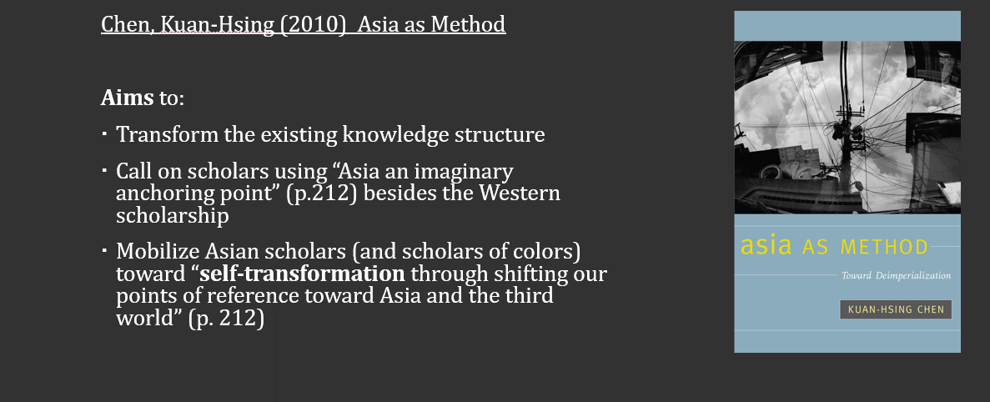
IDEAS BEHIND THE MEETING: BOOK CIRCLE
(Oshie’s reflection)
Notes:
Asia as Method: What is all about?
Chen, Kuan-Hsing (2010) Asia as Method: Toward Deimperialization
In my reading, the main purpose of Asia as method is to transform the existing knowledge structure, and at the same time, to transform scholars with an Asian background by using “Asia an imaginary anchoring point” besides the Western scholarship as the system/centre point of reference (p. 212).
Chen (2010) calls Asian scholars in particular, and scholars of colour in general, for self-transformation through shifting our points of reference (from the Western scholarship) toward Asia and the third world” (p. 212).
In this regard, Asia as method is a collective initiative or an ‘attitude’ calling for a discussion on how Asia can generate knowledge (Nguyen 2016, p.321).

Slide 4
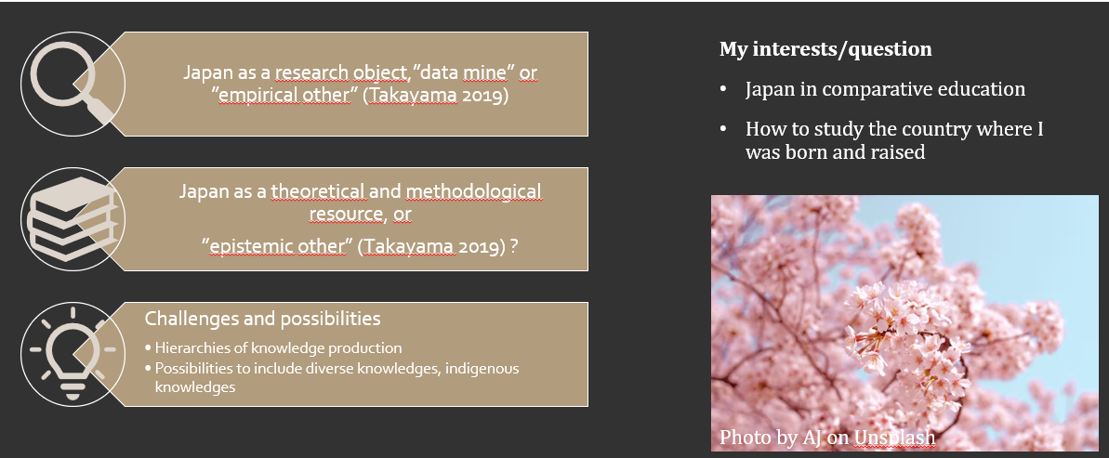
IDEAS BEHIND THE MEETING: BOOK CIRCLE
(Oshie’s reflection)
Notes:
Japan has been extensively studied in terms of prominent reference societies in Asia (see Santos and Centeno 2021), a point of comparison (e.g. Takayama 2012; Takeda and Williams 2008), and a comparative link in global educational governance (e.g. Yonezawa et al. 2018; Willis and Rappleye 2011). In the large body of literature, Japan has been often studied as a research object rather than a theoretical and methodological resource. To put differently, Japanese education has been a data source or an ‘empirical other’ where ‘theories are applied, revised or domesticated’ rather than an ‘epistemic other’ that provides a source of new theoretical insights and develops alternative theories (Takayama 2019: 147, 153). Recently, a group of scholars explore the possibility of using Japan as an epistemic resource in conducting comparative education (e.g. Hayashi 2021; Takayama 2020: Komatu and Rappleye 2017; Rappleye 2020), aiming to multiply the epistemological framework to study and highlight the more proliferated worldview in education.

Slide 5
CHEN’S PROBLEMATIZATION
The hegemonic structures in knowledge production worldwide
One-way flow of knowledge from the West to the East
  The structural desire toward North America and Europe
  In knowledge production, Asian intellectuals focus more on multiple links to North America or Europe rather than connection among ourselves
  'Local knowledge’, in many cases, is not adequately recognized as valid/respectable knowledge to be applied into scientific research.
  Comparative studies: Compare Euro-American theory and the local experiences >>> The West is equipped with universalist theory; the rest mainly play the role of particularist empirical data.
  “The West as dominant method”

Slide 6
CHEN’S PROBLEMATIZATION
Several earlier strategies/arguments in postcolonial studies to dealing with this situation.
EAST
WEST
Refuse the universalism of the West >>> The West has no essence and no unity
The West’s experiences only fit one part of the globe. The West is not the home of modernity
Various elements that appeared to be from the West have actually existed in other civilization for long time.
Popular limitations :
East and West dichotomy >>> The discussion is framed as the East versus the West
Obsessed with critique of the West >>> Eurocentric anti-eurocentrism (Wallerstein, 1997)
The West has become ‘the object of both desire and resentment.’
In the Third world, the West is perceived as ‘An opposing entity, a system of reference, an object from which to learn, a point of measurement, a goal to catch up with, an intimate enemy, and sometimes an alibi for serious discussion and action.’
Notes:
Wallerstein, I. (1997). Eurocentrism and its avatars: The dilemmas of social science. Sociological bulletin, 46(1), 21-39.

Slide 7
THE PROPOSED ‘ASIA AS METHOD’
(1) A geocolonial historical approach to carefully consider the impacts of colonialism/imperialism/Cold War
The Western-centric structures in knowledge production and the challenges in overcome that situation show that historical influences of colonialism/imperialism/Cold War are still there.
Study geographical spaces in the formerly colonized world, carefully consider their socio-historical conditions to understand their transformation in the new context of neoliberal globalization.
(2) Internationalist localism
Respects the tradition and the existing base entities without essentializing it.
Do not mobilize the resources of tradition simply to oppose the West or opposing external influences in the process of changes.
Pay attention to the process of translations, in which external ideas are organically embedded in the local social space.
>>>Local but also transborder, regional, and even international

Slide 8
THE PROPOSED ‘ASIA AS METHOD’
(1) + (2): The discussion of Nationalism and Globalization
Globalization may go with risks
  Capital-driven forces may colonize all spaces on the earth under the name of (unchecked) freedom.
  Unequal power relations can be intensified leading to new form of imperialism
A thorough look into nationalism is inevitable in the discussion of the intersecting processes of De-colonialism, De-imperalism and De-Cold war >>> A total negation of nationalism is nothing but escapism.
  Look at local histories to understand the different effects that nationalism played in different locations.
  Reflect on the position of nationalism as a part of our complexed subjectivity

Slide 9
THE PROPOSED ‘ASIA AS METHOD’
(3) Subjectivity:
Decolonization in knowledge production require us to free our mind from the obsession toward the West >>> look into the inner logic of our own local societies and self-analyze to reflect on our own subjectivity.
Ground ourselves in the cultures of our own: Doing studies in relation to our own living spaces, address the issues arising out of our own environments, try to apply our local logic to understand these issues.
(4) Inter-referencing and Multiplying references frame to go beyond ‘the West as method’
Shifting points of reference to different parts of Asia. Societies in Asia to become one another’s reference points.
By looking at how (Asian) societies deal with problems similar to our own >>> Facilitate a different understanding of the self and of the region >>> Rebuilt subjectivity.
There is no desire to stress the distinctiveness and the East-West binary
>>> Recognizes that many elements of the West have become internal to base-entities in Asia
>>> Consider the West only as a layer in multiple layers of our subjectivity.

Slide 10
THE PROPOSED ‘ASIA AS METHOD’
(5) Ontology and epistemology:
Puts an emphasis on local practices and issues but not intellectual thought. Not begin with an analytical concept or theoretical propositions but concrete social events and practices (but remains dialogue with theoretical arguments.)
No desire to formulate theoretical concepts applicable to all contexts. The goal is to generate historically grounded explanations that give insights for specific interventions.
Not asking which values are more universal than others. What is needed is a comparison of how values have been put into practice and how they are transformed.

Slide 11


REFLECTION
… The East and the West? …
‘Westerners teach their children to be independent but Easterners are not…’
‘People in the West are disciplined and respect order… Easterners often jostle for fear of losing benefits.
… Escaping or returning? ...
Fukujawa Yukichi’ Datsu-A Ron (Escaping Asia)? China vs. Japan? Or the struggling between different layers of subjectivity/identity/histories?
Notes:
20 sự khác biệt rõ nét giữa văn hóa Phương Đông và Phương Tây (nhatbao.mobi)

Slide 12

REFLECTION
… Nationalism and globalization…
“ I’m so proud of Thai I wanna show the world that I’m from Thailand “
(-LISA-)
‘I can relate with Lisa even I'm not thai, coming from ASEAN country inviting racist remarks from others... and Lisa said it like 'no matter what you say i’m proud with my country'.
‘It’s interesting… because we Germans, we don’t know that feeling… If you say in Germany that you are proud of Germany…then you sound like a nazi straight away’
‘It's the same here in Sweden. I think it's important that we retakes the meaning of nationalist from the racists by highlighting why we are proud of our countries and cultures without belittling others.’
… How to apply this book…? Method or methodology?

Slide 13
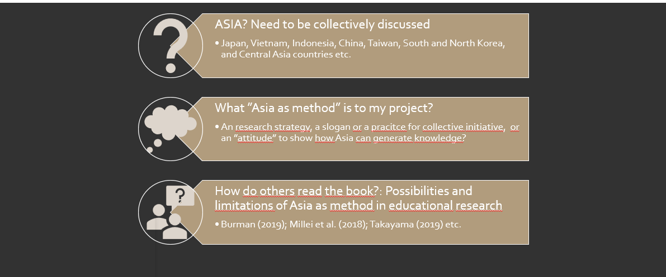
REFLECTION

Slide 14
LET’S SHARE OUR THOUGHTS…
Are you familiar with any themes/topics that Chen discussed? Whether this discussion brought to you any inspiration?
Have you ever experienced the feeling of academic ’Otherness’? Is it a good or a bad feeling? Advantage or disadvantage?
Have you ever realized the complexity or the multiple layers in your subjectivity/identity/culture?
Do you think that this topic/this book is only applicable to the Asian? Third world? The colonized?
What do you think about the idea of a book reading club? Have you ever experience the feeling of academic loneliness? Do you want to create a space for sharing and building up new ideas together?
Have you ever read a similar literature that you want to share?
Do you have any ideas for the reading book club? What can be the most interesting topics? What activities that you want to include in the club?
Do you want to receive updates from us in the future?

Slide 15
LET’S SHARE OUR THOUGHTS…
In the group discussion, participants further clarified:
The unbalanced power relation when the centre of reference is West or Northern-America and Europe in various contexts/examples.
Neoliberalism academic practices, ‘gatekeepers’ that sustain and magnifying the situation
The sustained binaries and the problematics ‘labels’: North – South, East – West, Third world, Developed/Developing countries, etc >>> A need to self-challenge our “habitual practices of thought”
Post-nationalism?
Decoloniality, inner colonialism?
The ideas from Asia as Method:
  Use “Asia as an imaginary anchoring point” (p.212) besides the Western scholarship (rather than alternative);
  Mobilize scholars of colours toward “self-transformation through shifting our points of reference toward Asia and the third world” (p. 212)
How to make the process of knowledge production more transparent and create a space for connecting different indigenous and disvalued knowledges >>> The role of the book club

Slide 16
THE BOOK READING CLUB
Current focus:
Asia as method: Chen
Wider focus: The politics of knowledge production
Aims:
A meaningful activity to enhance interaction in our academic community
Build a network and try to involve members with diverse background
The possibilities to include more diverse indigenous knowledges
Next plan?
1st meeting: PhD coffee | Monday: 14 of March | Briefly present the content of the book Introduce and invite people to join the reading circle Listen to the diverse perspective of other people on this topic
2nd meeting | Second half of April | Critical reflection on Chen Neoliberal academic structures and practices: Its influences on magnifying the unbalanced hierarchy of global knowledge production? How/what can we do in facing this situation?
3rd meeting | Second half of May | Going beyond the book and integrate Chen into a larger network of knowledge

Slide 17
REFERENCES
Burman, E. (2019). ‘Child as Method: Implications for Decolonising Educational Research’. International Studies in Sociology of Education 28 (1): 4–26.
Chen, K-H. (2010). Asia as Method: Toward Deimperialization. Durham: Duke University Press.
Kenway, J. (2015). ‘“Asia as Method”: Chen’s Conceptual Openings’. IN H. Zhang. et al. Asia as Method in Education Studies : A Defiant Research Imagination. Routledg, pp. 13 – 31.
Millei, Z. et al. (2018). ’Towards Decolonizing Childhood and Knowledge Production. In I. Silova, N. Piattoeva, and Z. Millei (eds.), Childhood and Schooling in (Post)socialist Societies: Memories of Everyday Life, New York: Palgrave Macmillan, pp. 231–256.
Takayama, K. (2019). ‘Radical Potentials and Predicaments: Reimagining Japanese Education in Postcolonial/Decolonial Times. IN Kyoto University Global Education Office (ed.) A ´Japanese Model´ of Education Culture in a Global Era? Retrospect and Prospect: Inaugural Symposium of the Global Education Office. Hosted by the Graduate School of Education, Kyoto University, pp. 142 ̶ 158.
Wallerstein, I. (1997). Eurocentrism and its avatars: The dilemmas of social science. Sociological bulletin, 46(1), 21-39.
Zhang, H., Chan P. W. K., Kenway, J. (2015). Asia as Method in Education Studies : A Defiant Research Imagination. Routledge.

Slide 18

Thank you!

