Slide 1
Biological context annotation

Slide 2
WHAT?
Manual creation and homogenization of the biological context annotation for AOPs and key events from the AOP wiki
AND WHY?
To be able to interlink and contextualize different AOPs, and to better understand the possible connections between different pathways

Slide 3
SORTING THE DATA
We compiled all the relevant AOP's for human and some model organisms
This included...
Homo sapiens
Cataarrhini
Macaca fascicularis
​Macaca mulatta
Mammalia
Bos taurus
Canis lupus famialiaris
Felis catus
and more...
Rodentia
Mus musculus
Rattus norvegicus
Mesocricetus auratus
and more…
Vertebrata

Slide 4
OVERVIEW – THE PROCESS
STEP 1:
STEP 2:
STEP 3:
Check the already given information on the key event
If needed, look for more information
( AOP wiki, PubMed…)
Annotate accordingly
The key event name
given justification:
NAME
The already given annotation
given justification:
LOCATION
given justification:
OTHER
And a link to the source!

Slide 5
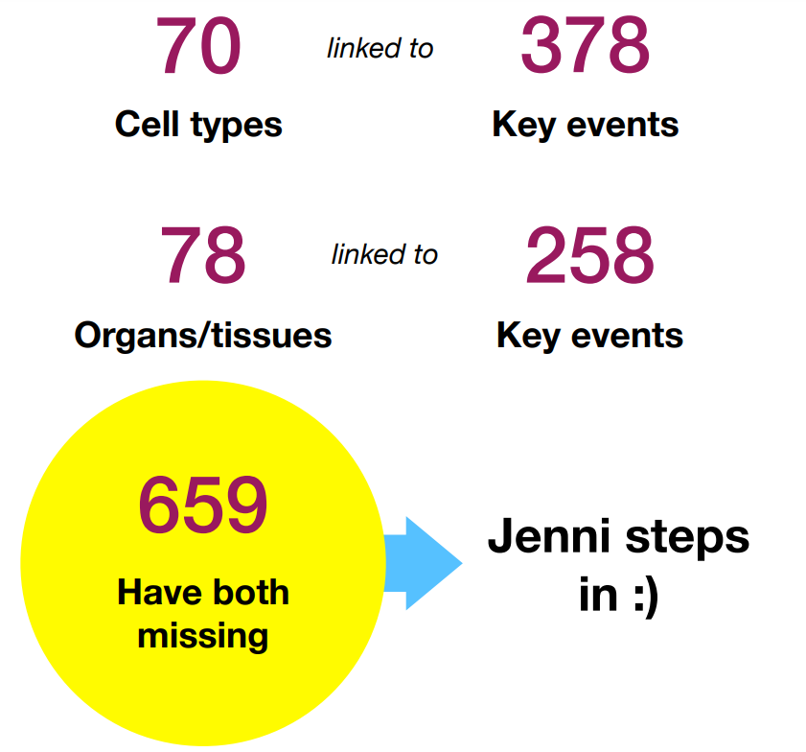
BEFORE NOW
14
System types
521
Key events
linked to
65
Organ/tissue types
425
Key events
linked to
69
Cell types
561
Key events
linked to
8
Cell component types
39
Key events
linked to

Slide 6
Now
809
out of
898
Key events
have been annotated
A total of
185
AOPs
And all of the
AOPs have
an annotated
key event linked to them!

Slide 7
SYSTEM

Slide 8
ORGAN
/TISSUE

Slide 9
CELL

Slide 10
Data-driven annotation

Slide 11
WHAT?
Enrichment analysis of the Enrichr gene sets and the genes linked to the same key events that were also manually annotated
AND WHY?
To be able to annotate the key events by matching gene data. This gives us a different on-look to the subject and supports the manual context annotation

Slide 12
OVERVIEW – THE PROCESS
STEP 1:
STEP 2:
STEP 3:
Modify the already existing code to match the current data
Translate the gene ID's to Ensembl ID's
Run the enrichment process and save the results

Slide 13
COMPARISONS
KEY EVENT INFORMATION
MANUAL ANNOTATION
AN EXAMPLE OF THE DATA-DRIVEN ANNOTATION (HUMAN GENE ATLAS)

