Slide 1
Promoter Sequence Analysis

Slide 2
Process Pipeline FOR SORTING DATA

Slide 3
Getting Familiar with the data, Cutting and sorting
We selected only the CTD gene chemical associations which comprised of increased or descreased expression
Then we chose only species that had more than 10000 associations to them
We made some charts based on the data and we saw that there were a lot of variation in the data, between the gene amounts and across the species a like
We only decided to work with chemicals that had to be more than 50 but less than 1000 genes per chemical associated to them. We also made some charts based on these to compare.
Later we cut Oryctolagus cuniculus due to having only one unique chemical to which these genes were associated to

Slide 4
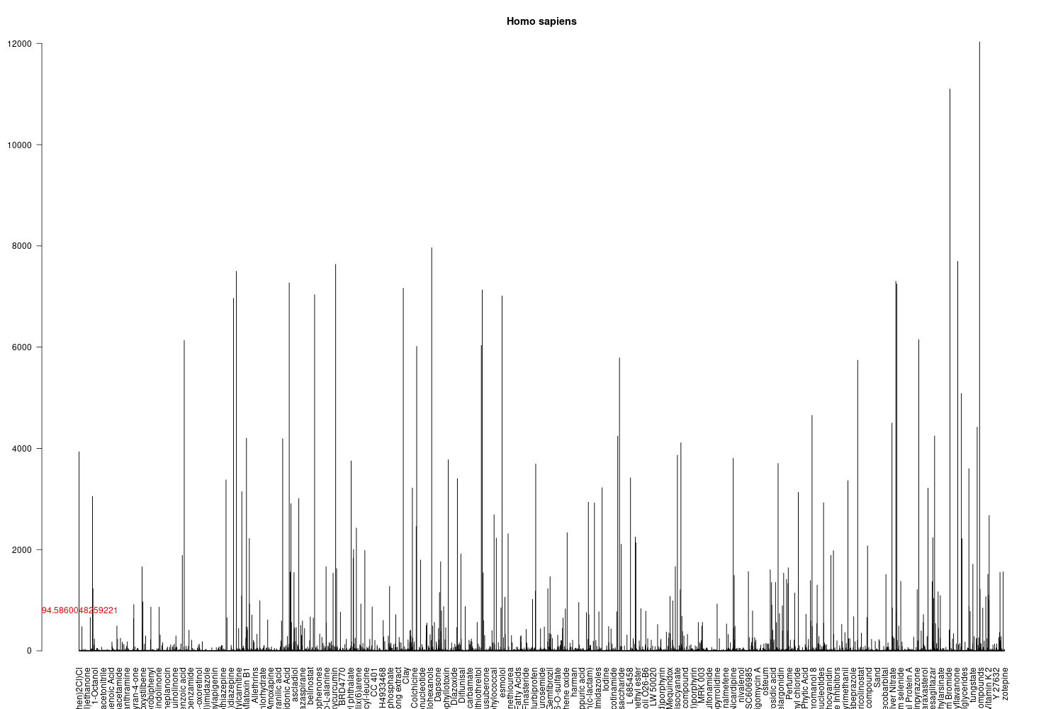

Slide 5
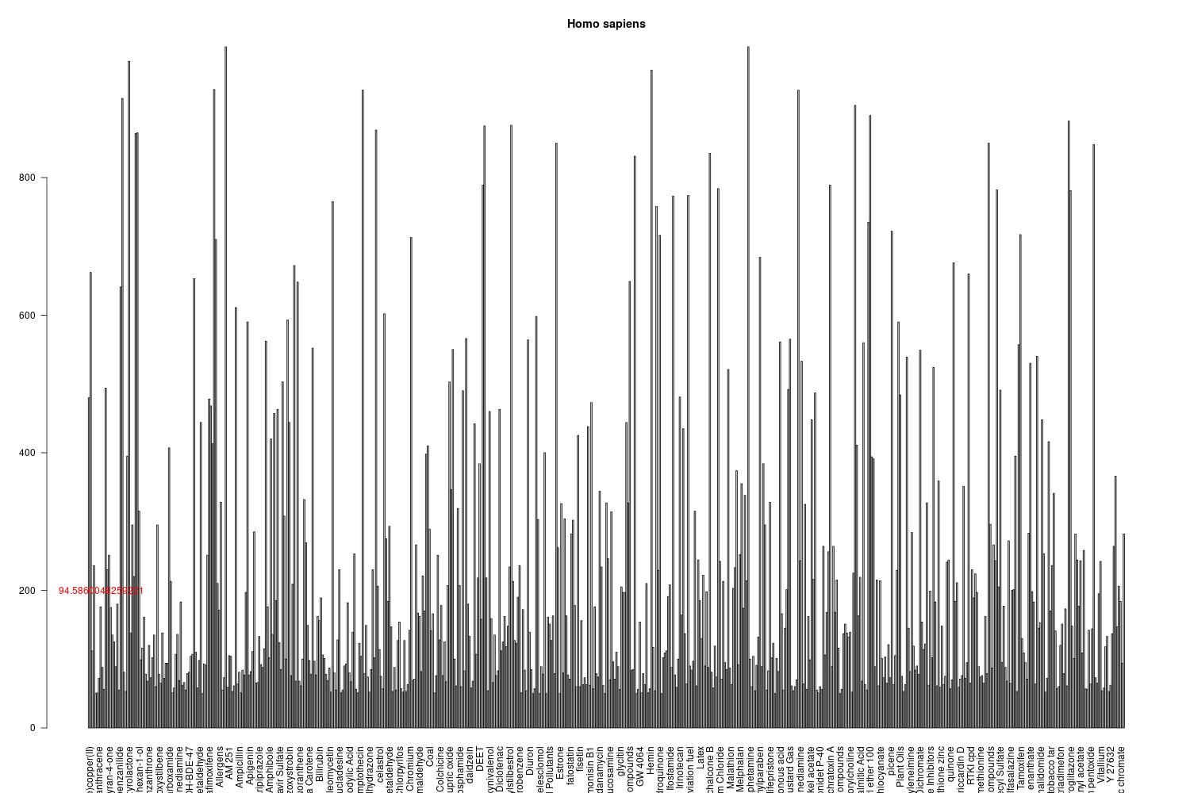

Slide 6
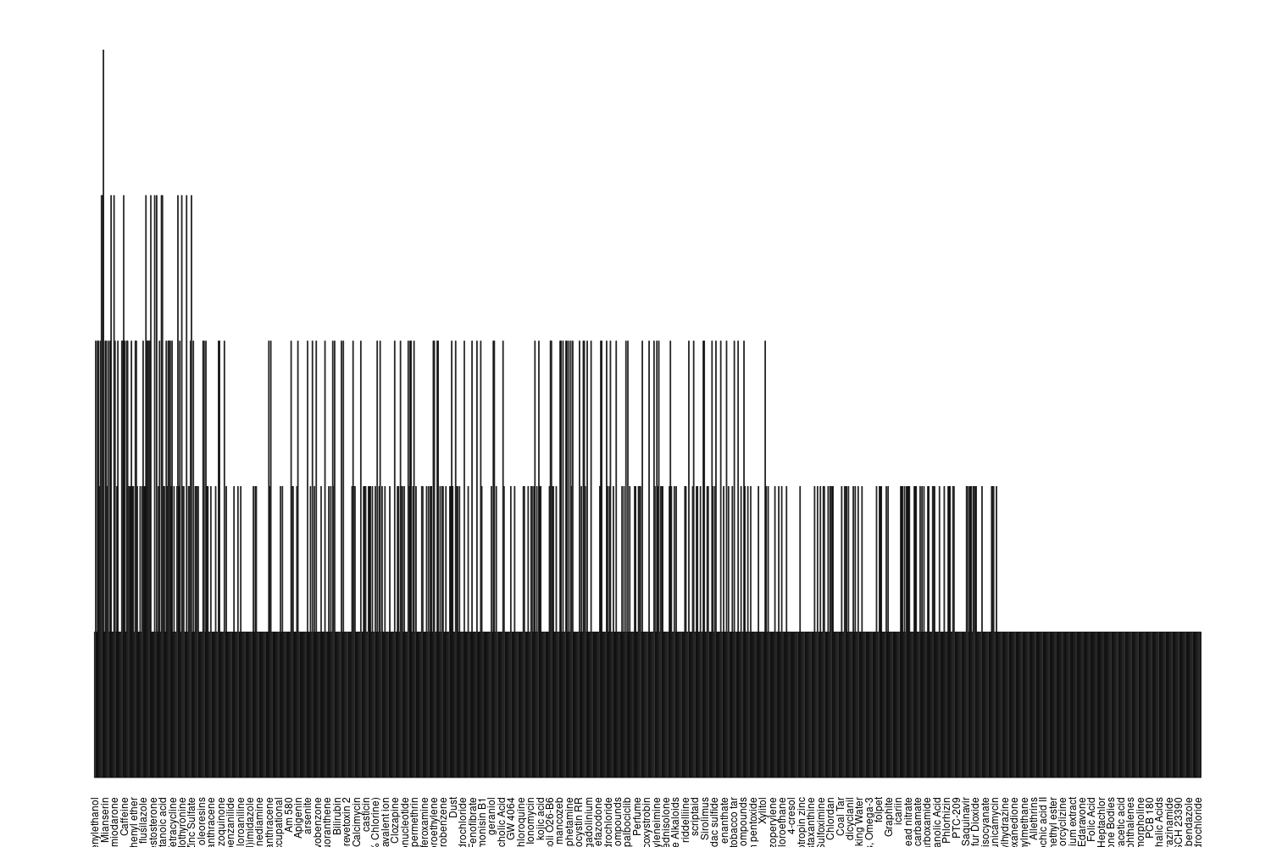
THE NO. OF SPECIES CHEMICAL HAS BEEN TESTED IN

Slide 7
For the chemicals that have been tested in 3 species, the most common combination of species is Homo_sapiens, Mus_musculus and Rattus_norvegicus with 95 combinations out of 115
The chemical that has been tested in 5 is
Chemicals that have been tested in 4 species are …
With other species than mammals

Slide 8
HOW MANY GENE LISTS WE HAVE PER ORGAniSM
SPECIES | STARTED WITH | AFTER STREME/TOMTOM
c. elegans (NEMATODES) | 14 | 14
c. elegans (VERTEBRATES) | 14 | 14
d. rerio | 91 | 91
g. gallus | 22 | 22
h. sapiens | 621 | 618
m. musculus | 436 | 433
r. norvegicus | 464 | 464

Slide 9
AFTER Running the promoter sequence retrieval + MOTIF MATCH

Slide 10
How many transcription factors?
We have 4370 found transcription factors and 401 of them are unique.
DID WE FIND ANY ORPHAN MOTIFS?
Yes, we found orphan motifs in all species
Human : 45 orphan motifs
Gallus gallus: 1 motif

Slide 11
Does the amount of genes per chemical correlate with the number of motifs found?
SPECIES | CORRELATION
c. elegans (NEMATODES) | 0,6260192
c. elegans (VERTEBRATES) | 0,6260192
d. rerio | 0,6369216
g. gallus | 0,8176161
h. sapiens | 0,6521524
m. musculus | 0,4170344
r. norvegicus | 0,595853

Slide 12
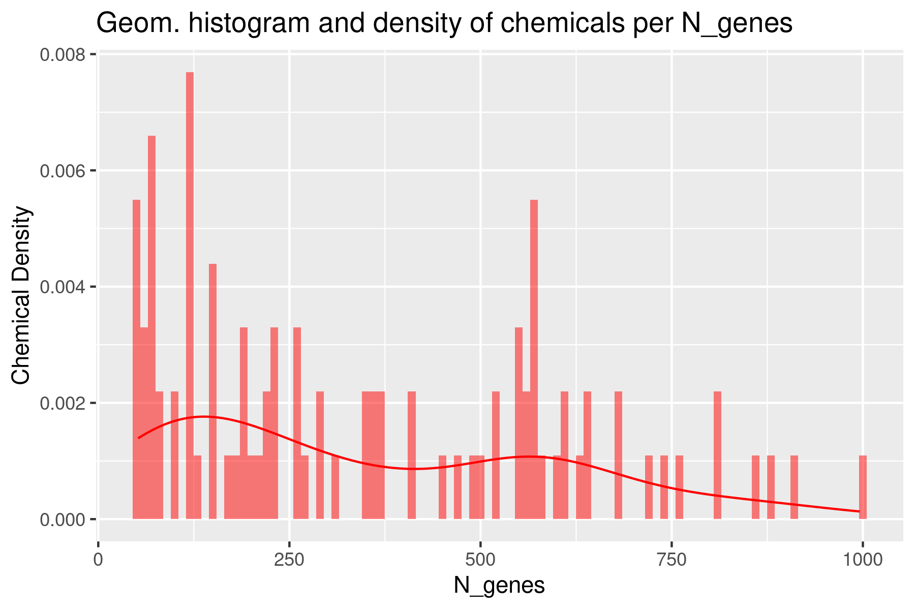
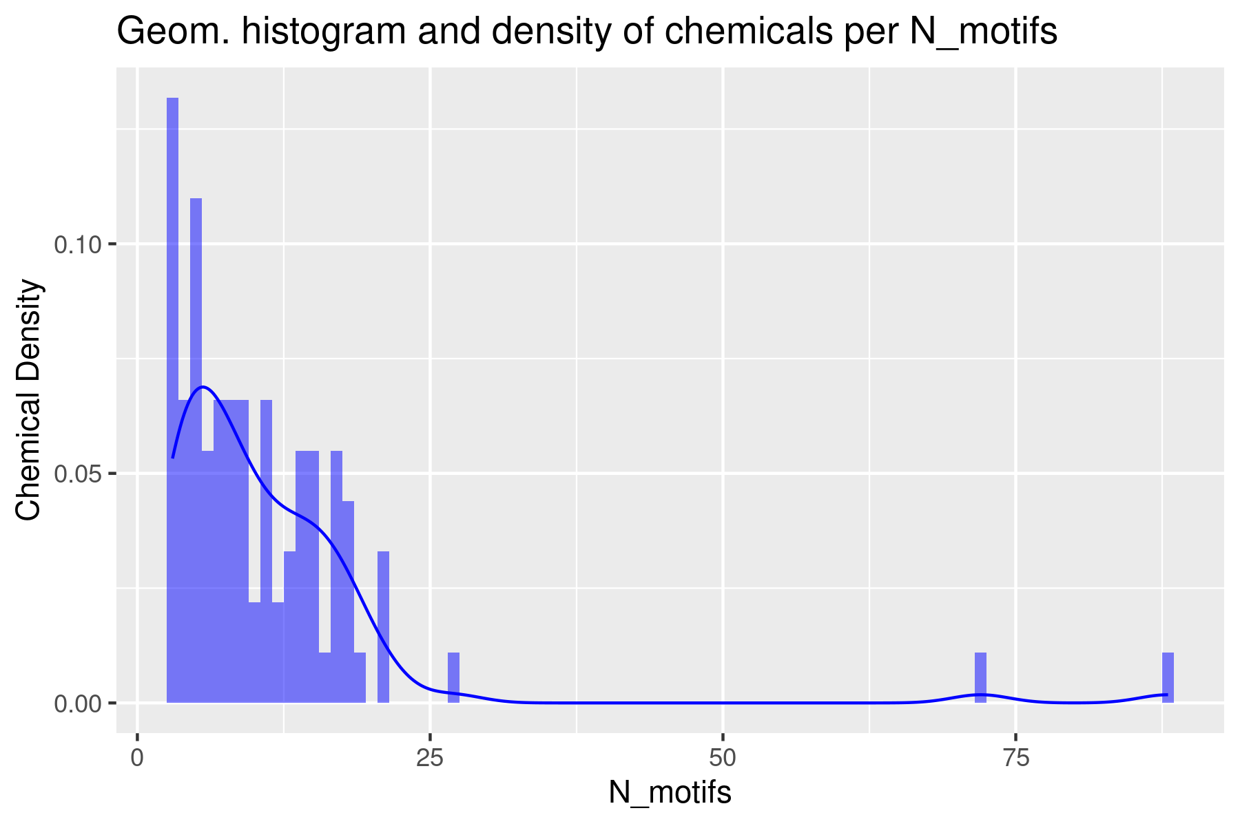
Danio rerio

Slide 13
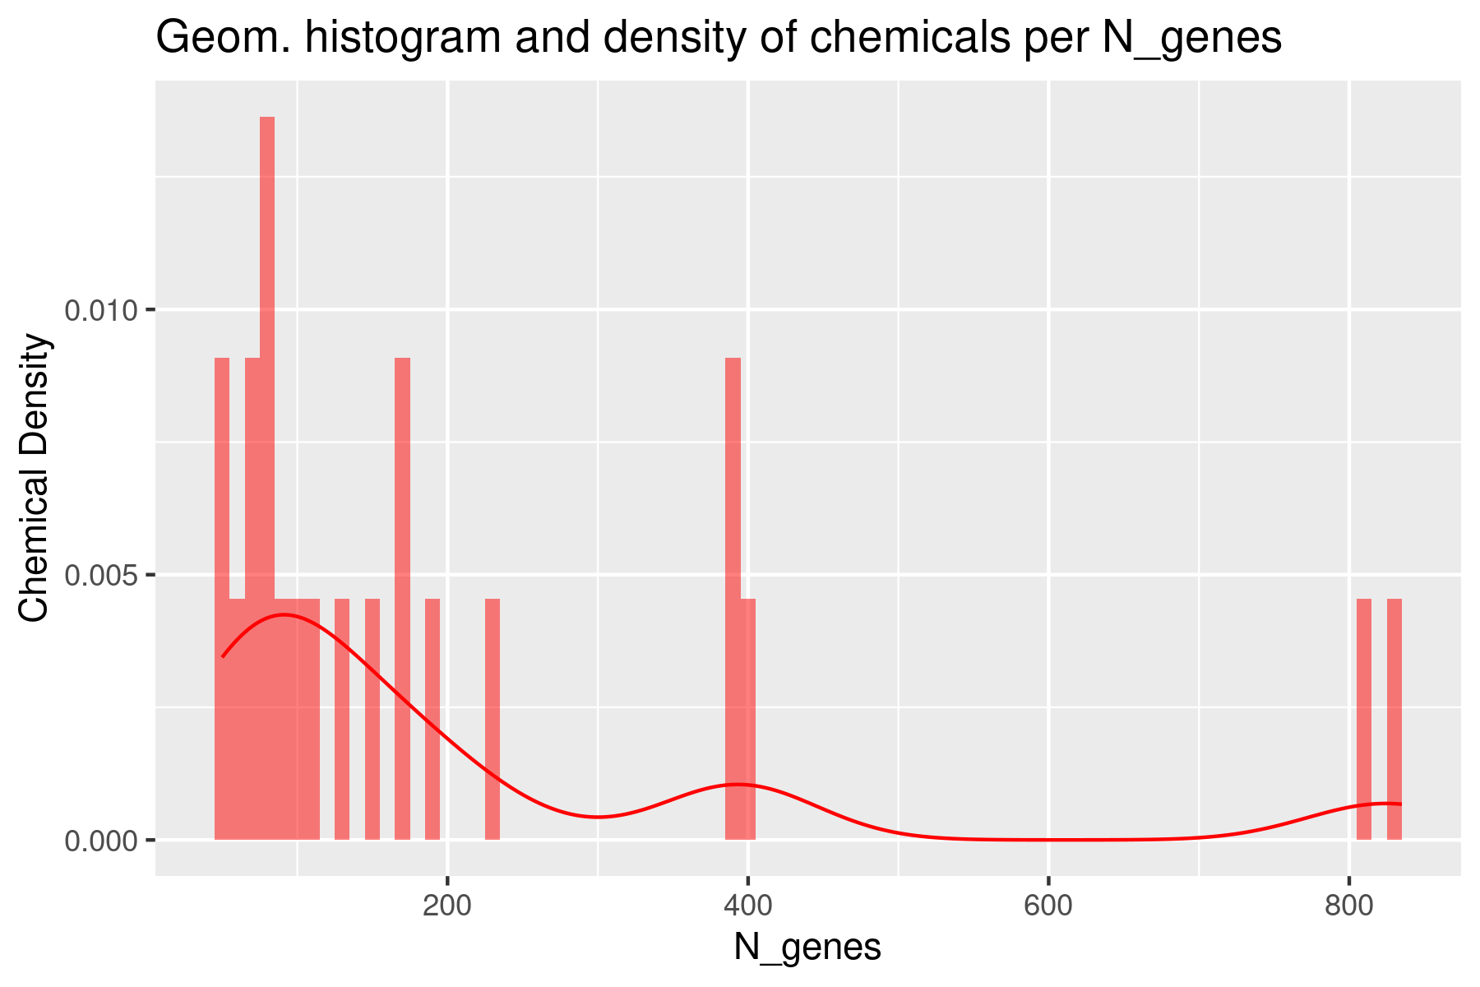
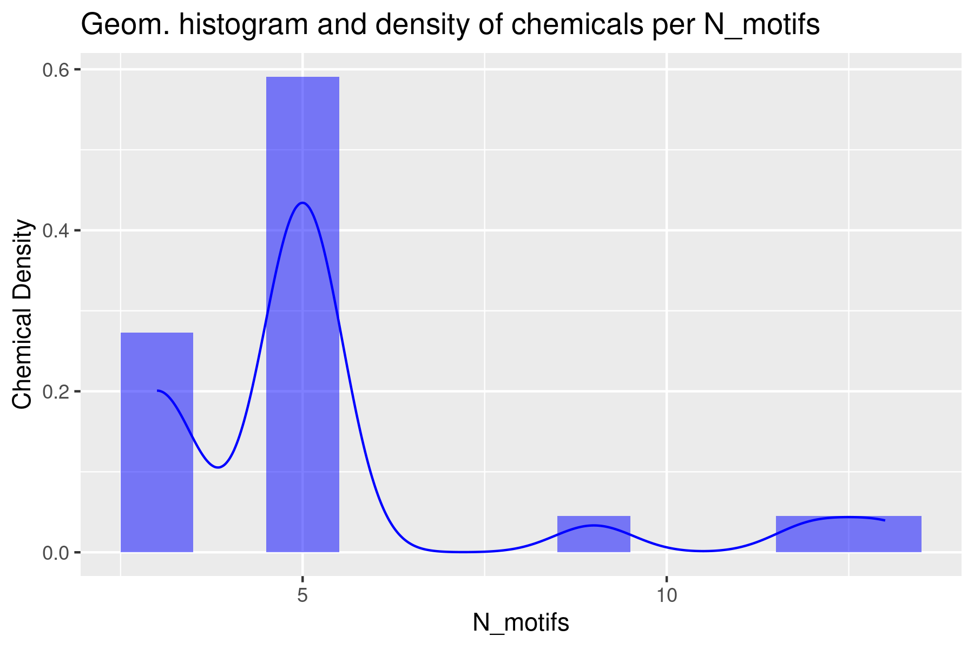
Gallus Gallus

Slide 14
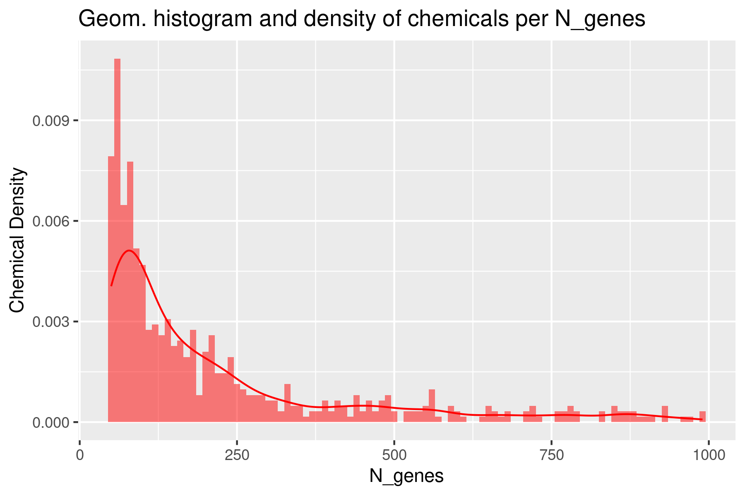
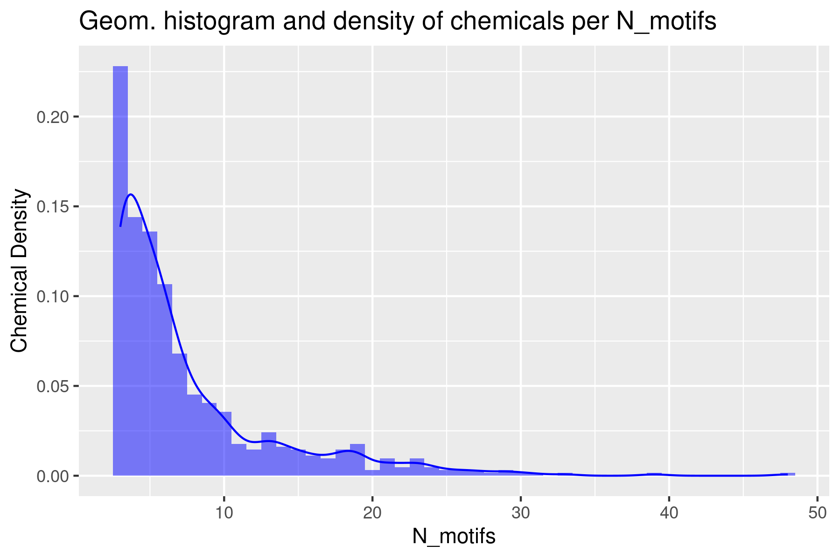
Homo Sapiens

Slide 15
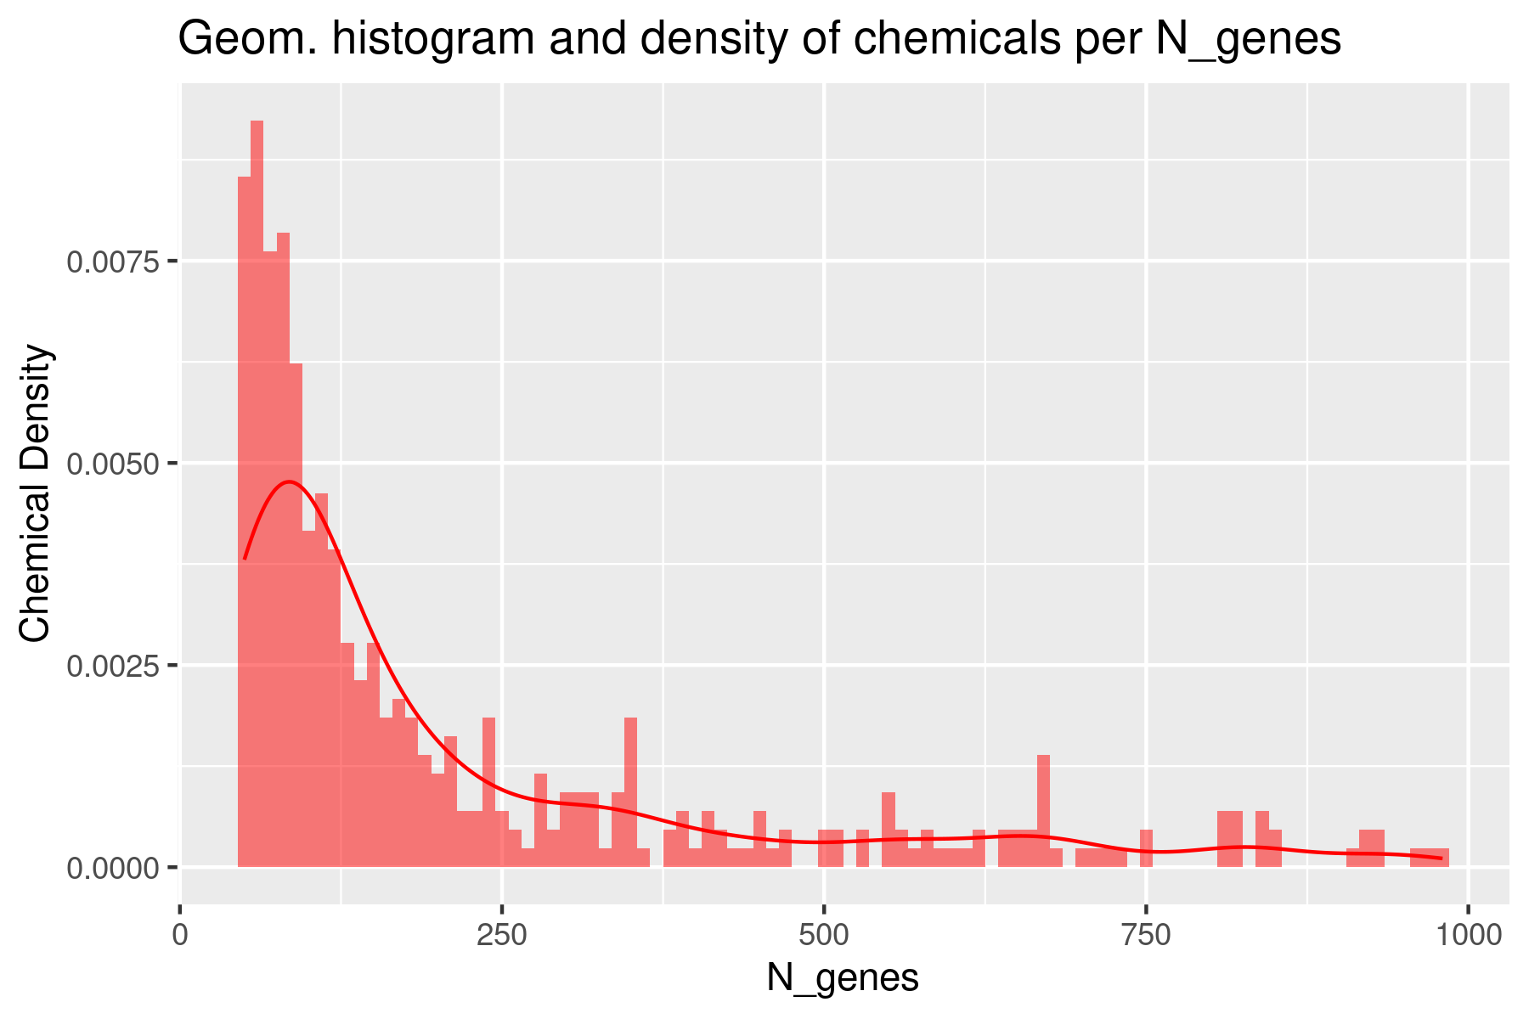
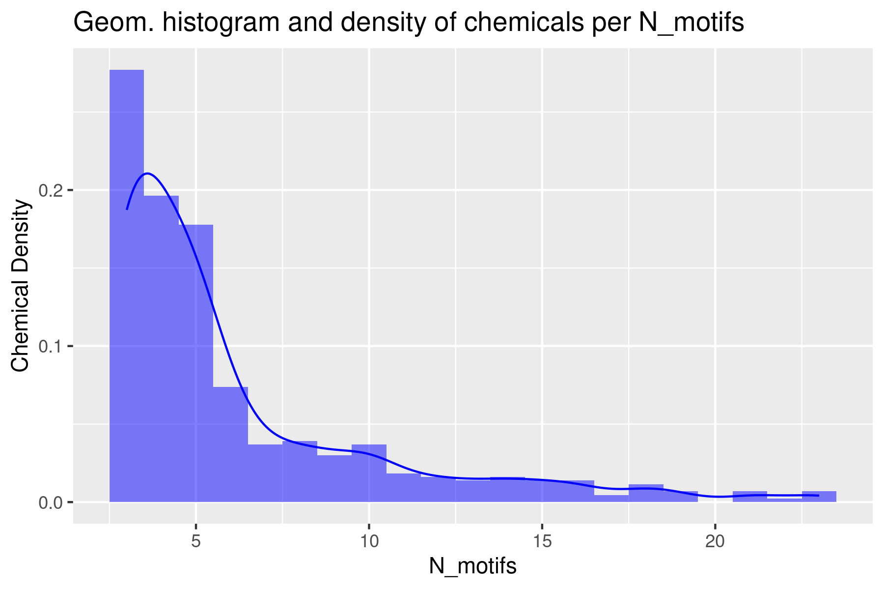
Mus musculus

